Slide 1
Stellar PSF Subtraction
Use data taken at other times and wavelengths to model the star
Diversity of Images in Time
Diversity of Images in Wavelengths
Angular Differential Imaging (ADI)
Spectral Differential Imaging (SDI)
GPI data on Beta Pictoris b
Credit: Christian Marois

Slide 2
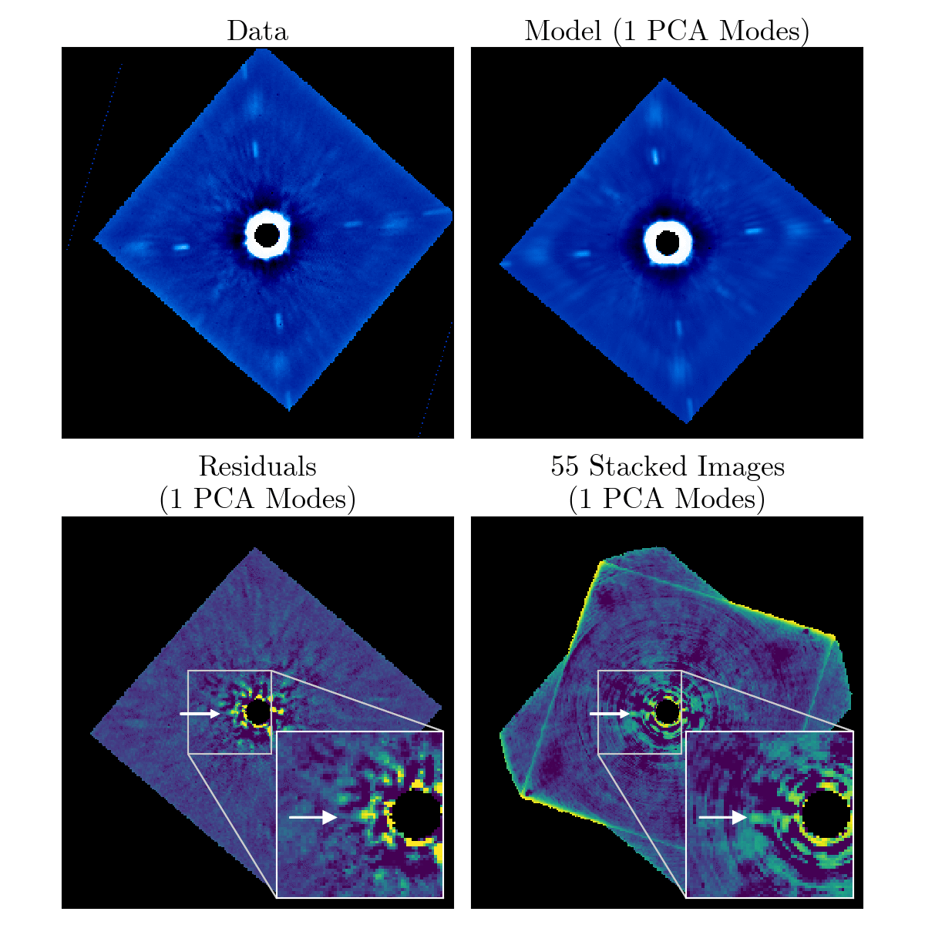

Slide 3
Planet-Disk Interaction
Warp
β Pic b Orbit
Credit: NASA/ESA/Golimowski

Slide 4
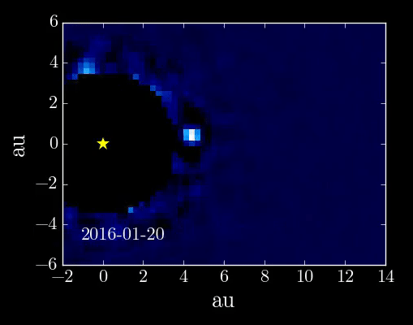
The Orbit of β Pictoris b
Warp
β Pic b Orbit
Credit: NASA/ESA/Golimowski
Millar-Blanchaer+ 2015
Wang+ 2016
β Pictoris b (~10 M_{Jup}) is likely inducing a warp in the debris disk
Orbit gives insight on disk dynamics, dynamical history, and possible unseen planets
Possibly the first directly-imaged exoplanet to also transit

Slide 5
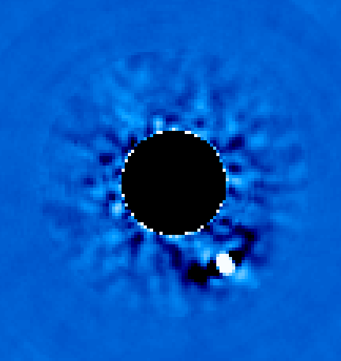
Astrometry of β Pic b
ADI/SDI causes planet to leak into PCA modes and distort itself
Angular Differential Imaging (ADI)
Stellar PSF Subtraction
Self-subtraction
Notes:
Underestimated errors, stuck in local minimas

Slide 6
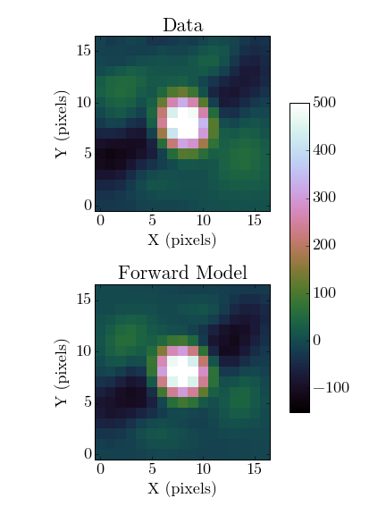
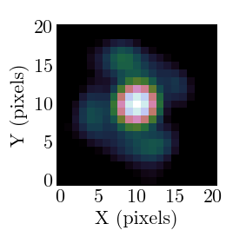
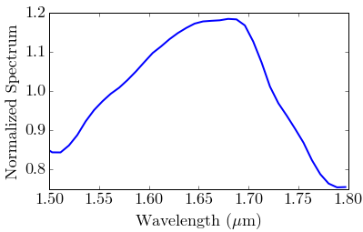
Forward Modelling
Instrument PSF
ADI/SDI Sequence
Perturbed PCA
(Pueyo 2016)
$$Z+ε ΔZ$$
Model Spectrum
Wang et al. 2016

Slide 7
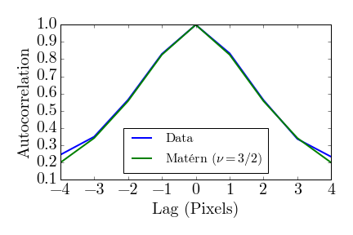
Astrometry of β Pic b
Speckle noise is correlated on λ/D scales
~λ/D
Wang et al. 2016
Notes:
Underestimated errors, stuck in local minimas

Slide 8
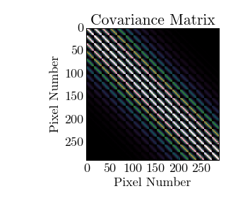
Astrometry of β Pic b
Treat Speckle Noise as a Gaussian Processes
$$R=D −αF(x, y)$$
$$\log{\text{ℒ}\text{ = −}\frac{1}{2}( R^{T}C^{−1}R+ln⁡(\det{C))}}$$
$$C_{ij}=σ_{i}σ_{j}\left(1+\frac{\sqrt{3}r_{ij}}{l}\right)\exp\left(−\frac{\sqrt{3}r_{ij}}{l}\right)$$
Wang et al. 2016
Notes:
sqrt

