Slide 1
Planets in binary systems
Lea Hirsch
Planets Lecture
November 8, 2017

Slide 2
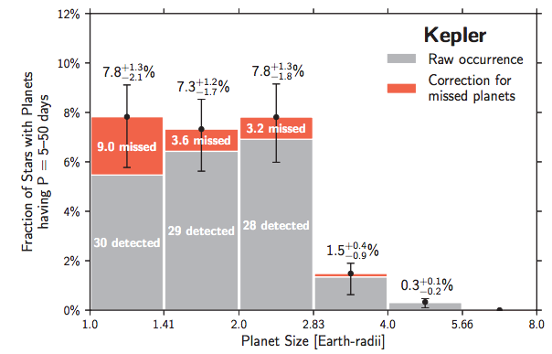
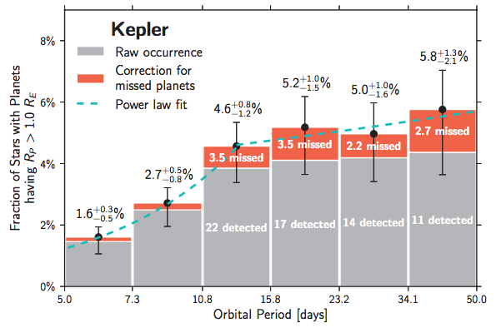
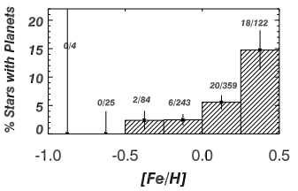
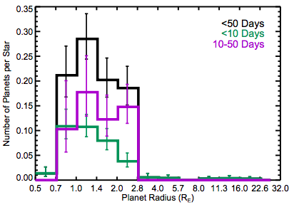
Exoplanet Demographics
Petigura et al. 2013
Dressing & Charbonneau 2013 (Teff)
Fischer & Valenti 2005

Slide 3
Exoplanet Demographics Depend on stellar host properties
1. What can we detect?
2. What kinds of planets actually form?

Slide 4
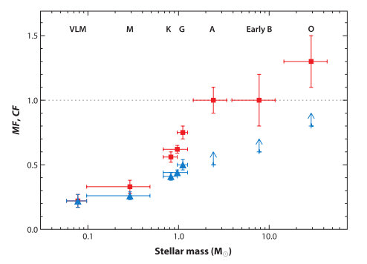
An excursion into stellar multiplicity
Raghavan et al. 2010
Avg. # Companions per Star
Duchene & Kraus 2013
Log P (days)

Slide 5
Impact of stellar multiplicity on planetary systems
1. What can we detect?
2. What kinds of planets actually form?

Slide 6
Impact of stellar multiplicity on Planet detection
Part 1

Slide 7
Planet detection: transit method
Transit assumption:

Slide 8
Planet detection: transit method
But what if the picture is actually more complicated?

Slide 9
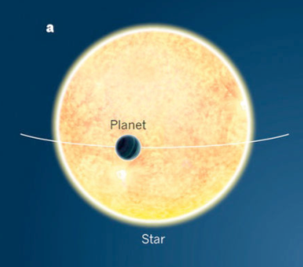
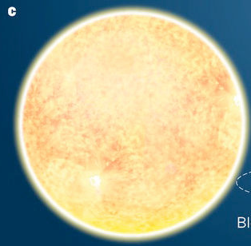
Blended Stars Dilute the Transit Depth
Observed Transit Depth
True Transit Depth

Slide 10
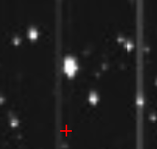
Notes:
How does this play out? Here’s an example of what a star might look like on the Kepler detector (which as a pixel scale of 4”/pixel)

Slide 11
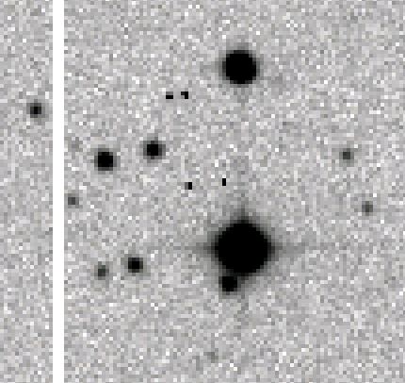
Notes:
If you take a higher-resolution image of this region, you find that this target is really 2 stars. This is just a seeing-limited image; if you go into high resolution, you can find companions at separations of less than 0.1” which really wouldn’t be distinguishable with the Kepler images, even with light centroid studies.

Slide 12
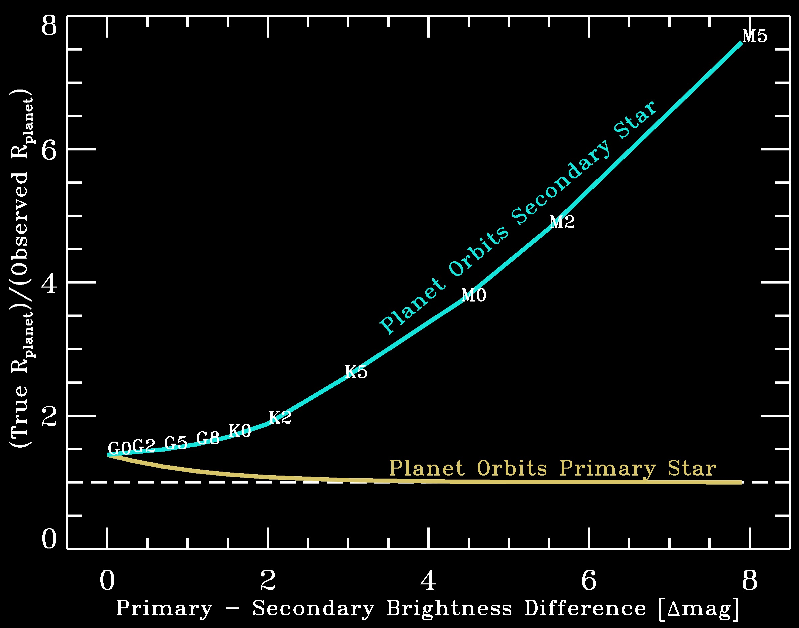
The planet radius needs to be corrected:

Slide 13
Planet detection: radial velocities
MOST RV SURVEYS EXCLUDE KNOWN BINARY SYSTEMS TO AVOID THESE PROBLEMS
Relative Doppler shift is constantly changing
Brightness ratio and spectral features depend on both stellar spectral types

Slide 14
Impact of stellar multiplicity on planet formation and evolution
Part 2

Slide 15
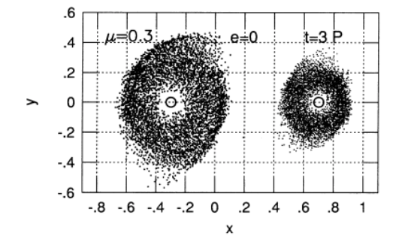
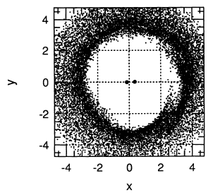
Binary companions truncate protoplanetary disks
Artymowicz & Lubow 1994

Slide 16
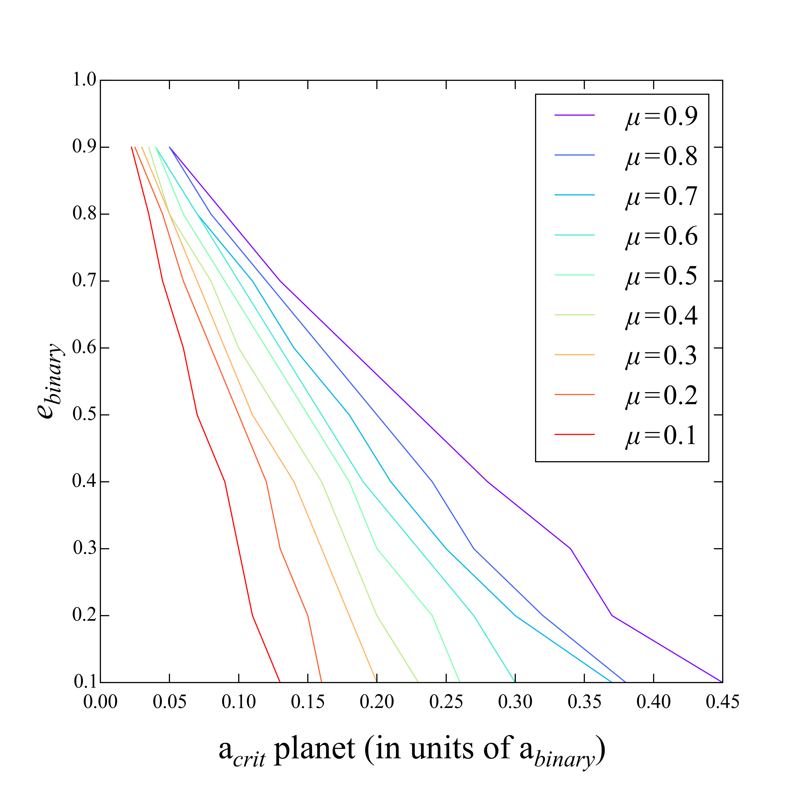
Binary companions can destabilize planet orbits
stable
unstable
e = 0
Very eccentric
M₁ >>M₂
M₁ = M₂
M₁ << M₂
e = 0.5
Binary Eccentricity
Nearly circular
0 5 10 15 20 25 30 35 40 45
Outermost Stable Orbit (in units of % of binary orbit)
Adapted from Holman & Wiegert 1999

Slide 17
Surveys of planets in binary systems
Survey planet hosts for stellar companions, compare stellar multiplicity to multiplicity of non-planet hosts
Survey binary star systems for planets, compare planet occurrence to occurrence in single star systems.

Slide 18
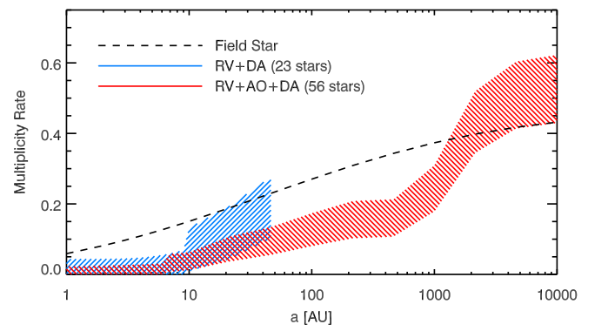
Surveys of planets in binary systems
Survey planet hosts for stellar companions, compare stellar multiplicity to multiplicity of non-planet hosts
Fewer binaries with separations < 1000 AU among planet hosts than “field stars”
Wang et al. 2014

Slide 19
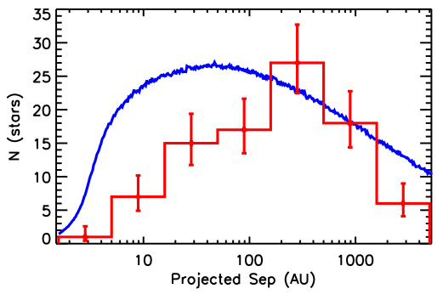
Surveys of planets in binary systems
Survey planet hosts for stellar companions, compare stellar multiplicity to multiplicity of non-planet hosts
Fewer binaries with separations < 100 AU among planet hosts than “field stars”
Kraus et al. 2016

Slide 20
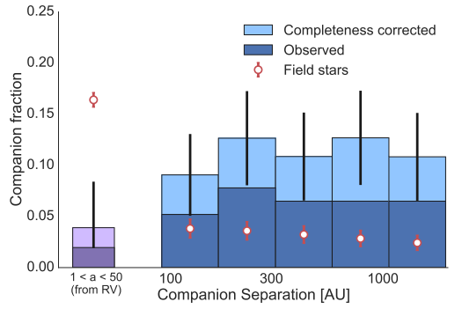
Surveys of planets in binary systems
Survey planet hosts for stellar companions, compare stellar multiplicity to multiplicity of non-planet hosts
More binaries with separations > 100 AU among HOT JUPITER hosts than “field stars”
Ngo et al. 2016

Slide 21
Conclusions
Binary companions make it harder to find planets, and to infer their properties correctly
Stellar multiplicity also probably affects planet formation and/or evolution by:
Truncating the protoplanetary disk?
Disrupting or destabilizing planet orbits?
Surveys seem to bear out that there are fewer planets around binary systems with separations < 100 – 1000 AU

