Slide 1
A Closer Look at Microlensing
C249: Planetary Astrophysics
September 6, 2017

Slide 2
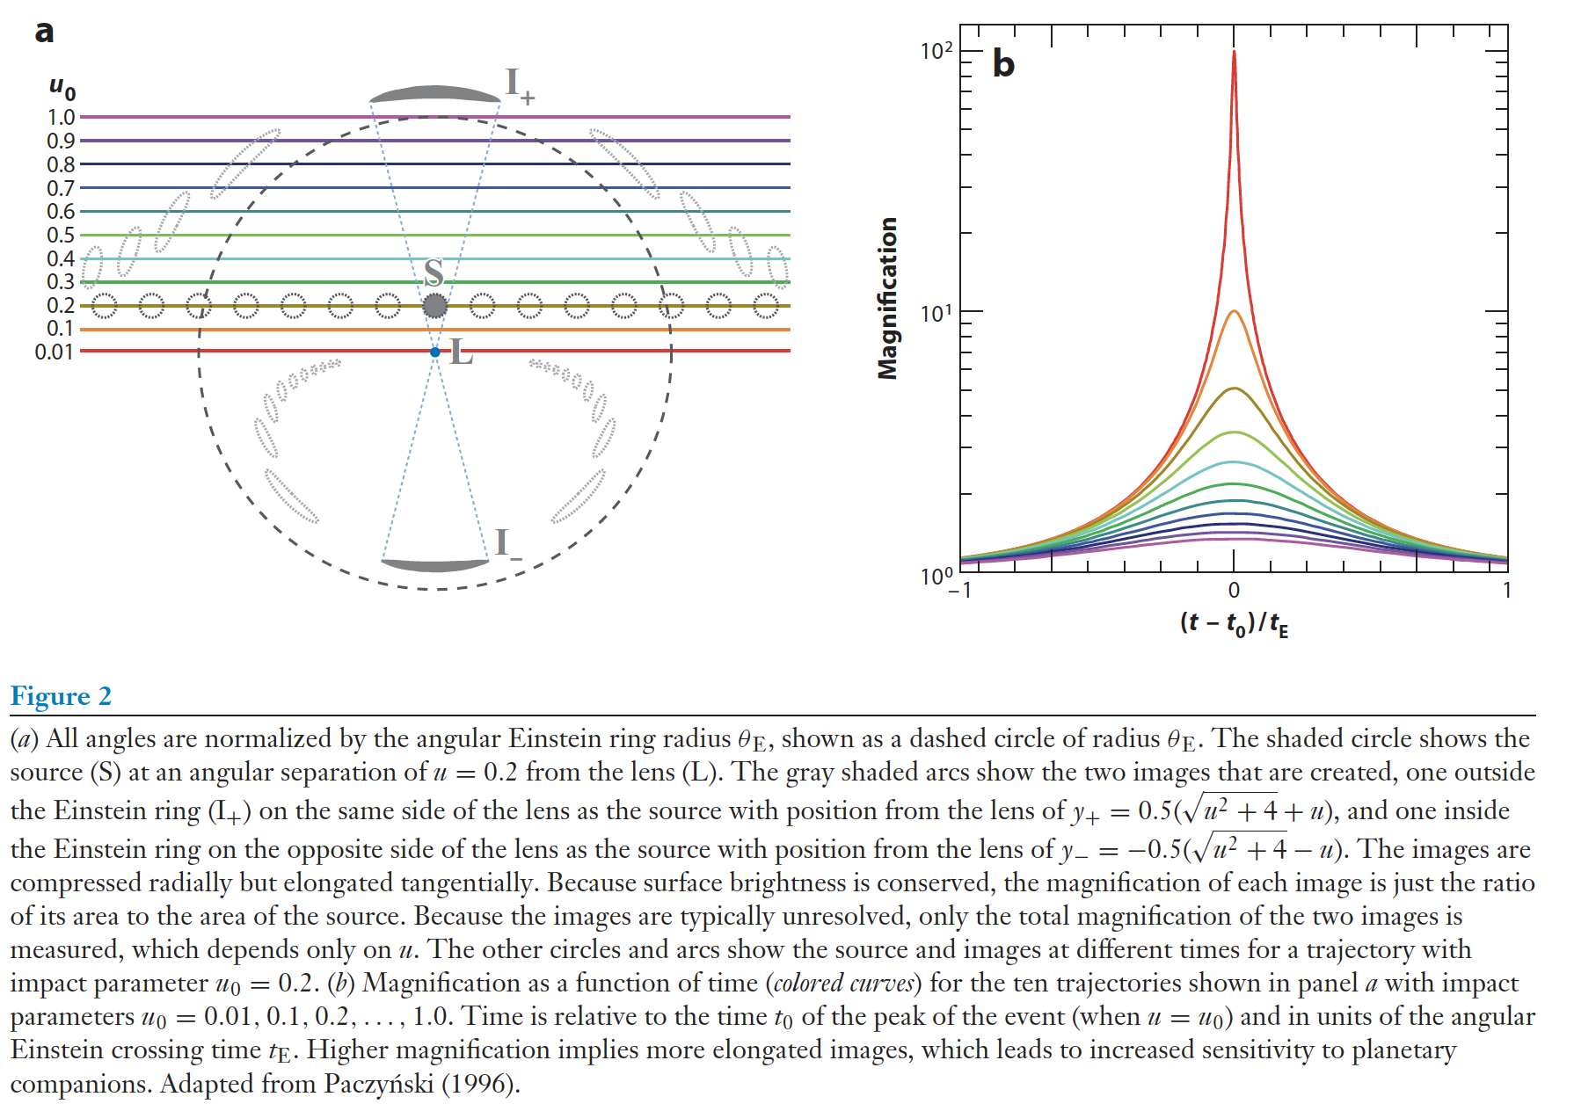
What does a microlensing event look like?
Gaudi 2012

Slide 3
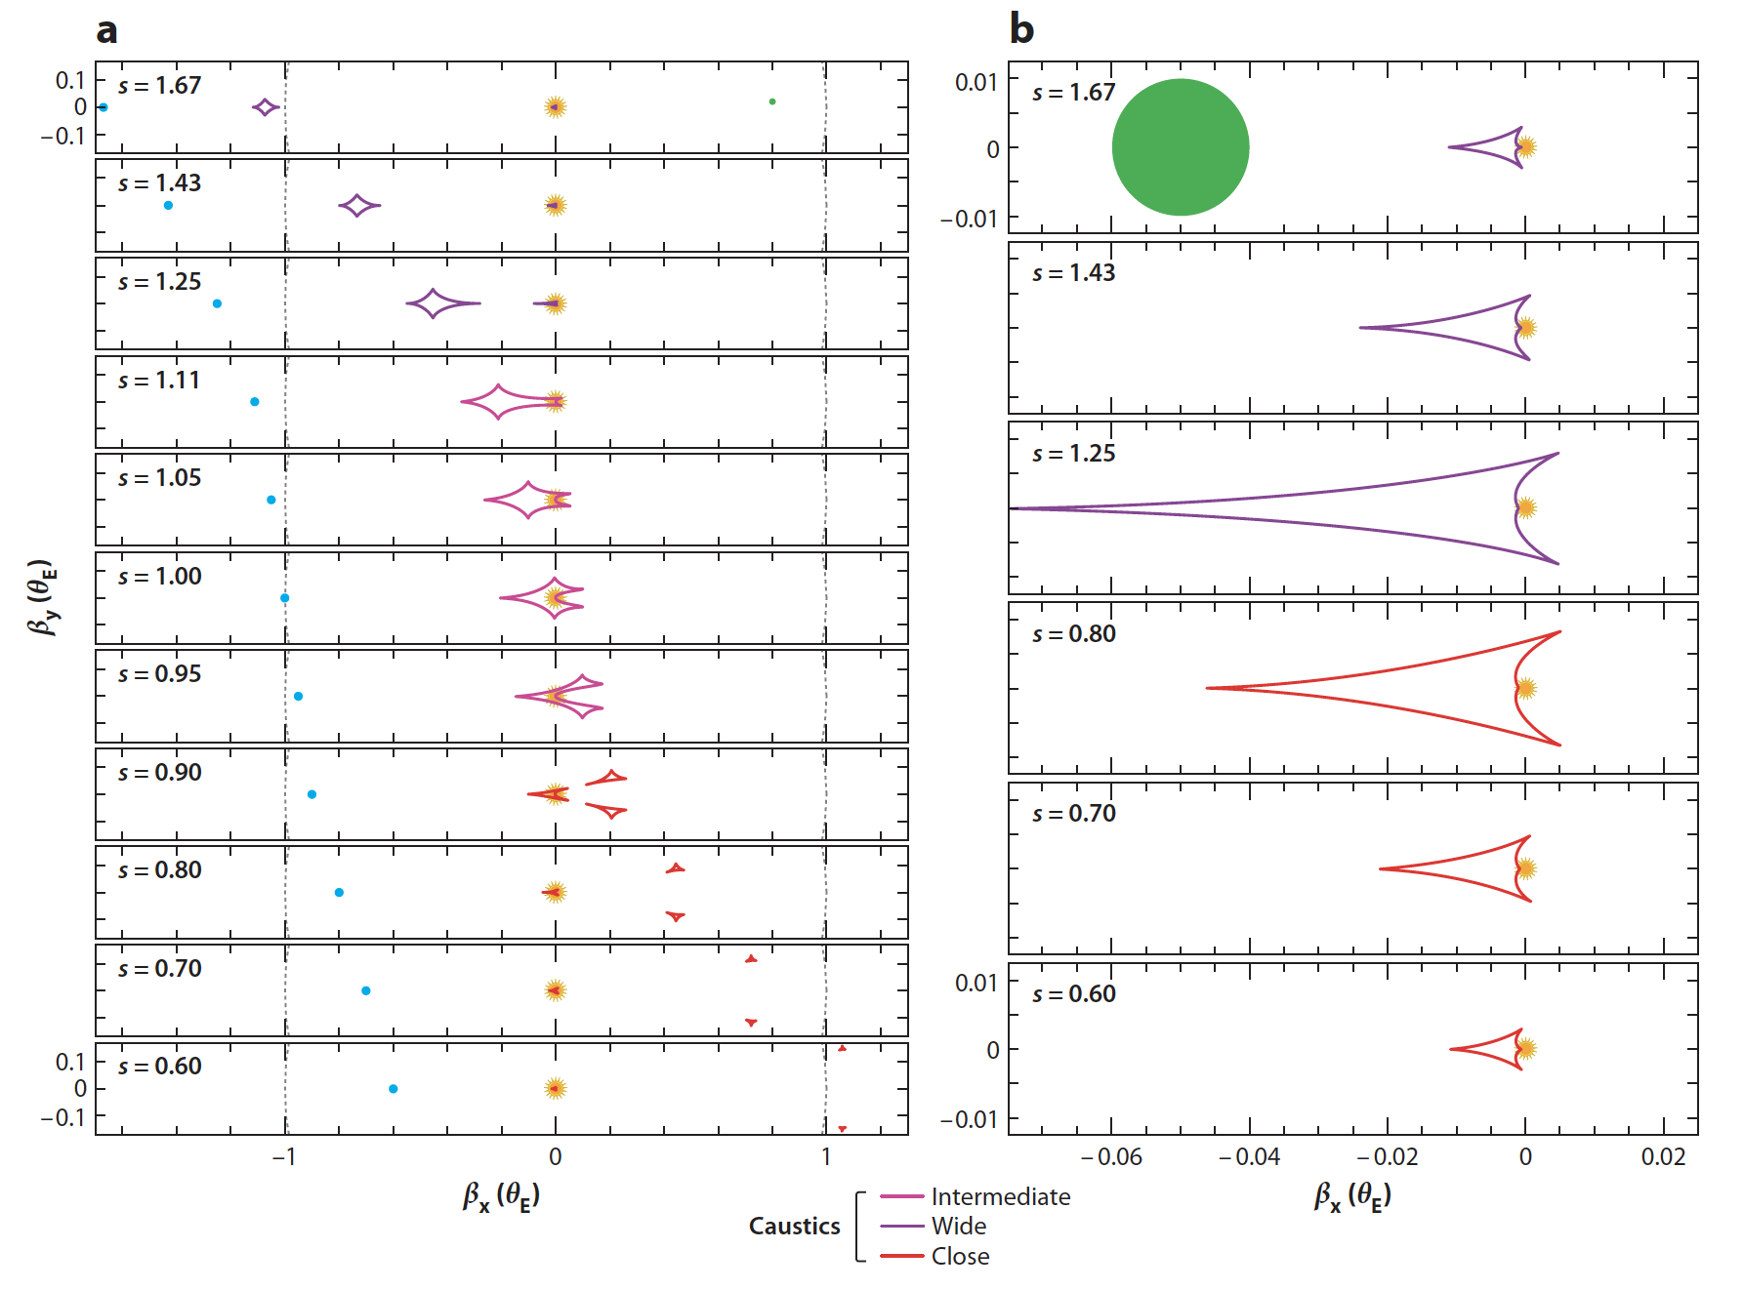
What are caustics?
s = instantaneous projected separation of star & planet (in Einstein radii)
Gaudi 2012

Slide 4
What are caustics?
Representative source size
Planet
Star
s = instantaneous projected separation of star & planet (in Einstein radii)
Gaudi 2012

Slide 5
What are caustics?
Planetary caustic
Representative source size
Central caustic
Planet
Star
s = instantaneous projected separation of star & planet (in Einstein radii)
Gaudi 2012

Slide 6
How would the light curves appear?
Gaudi 2012

Slide 7
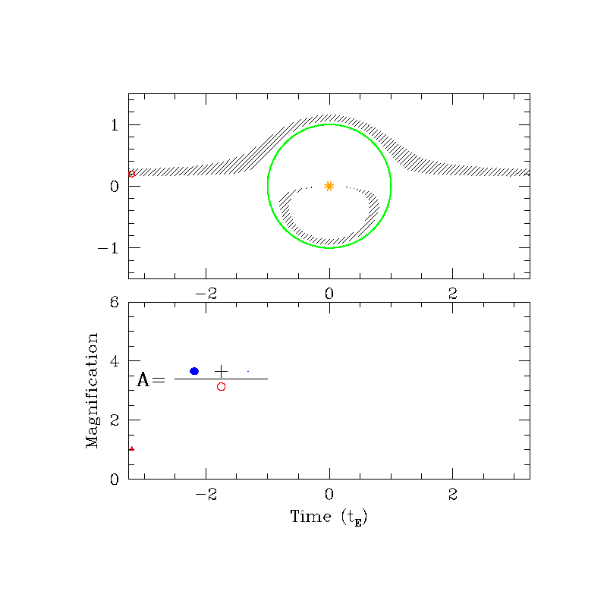
Sample Event: Star without Planet
Animation by Scott Gaudi

Slide 8
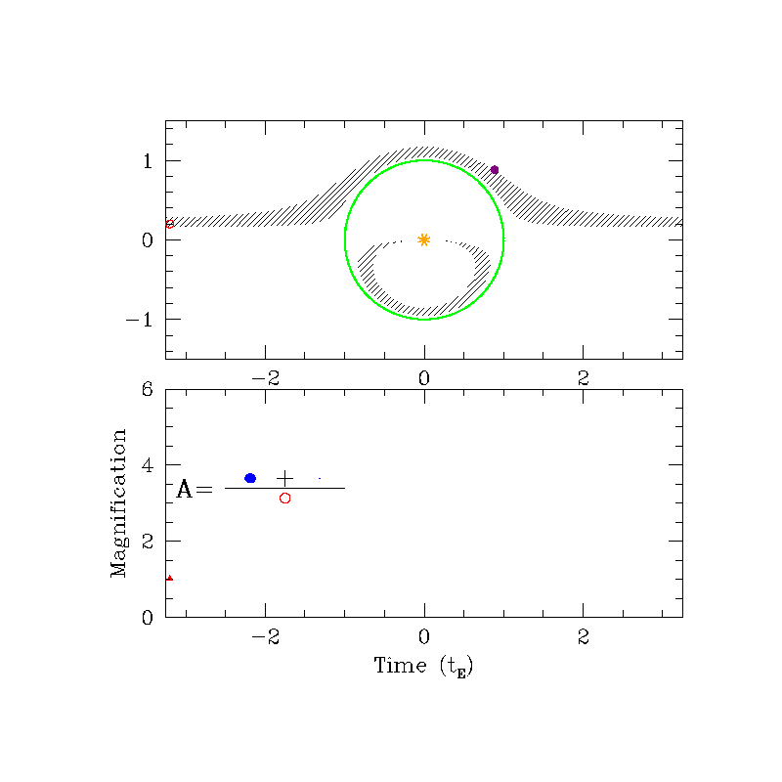
Sample Event: Star with Planet
Perturbation of Major Image
Animation by Scott Gaudi

Slide 9
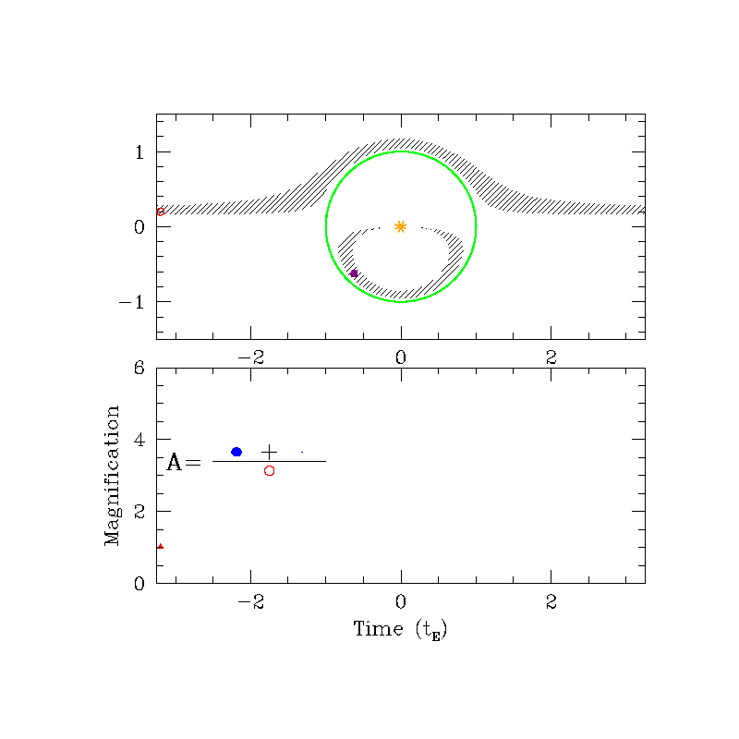
Sample Event: Star with Planet
Perturbation of Minor Image
Animation by Scott Gaudi

Slide 10
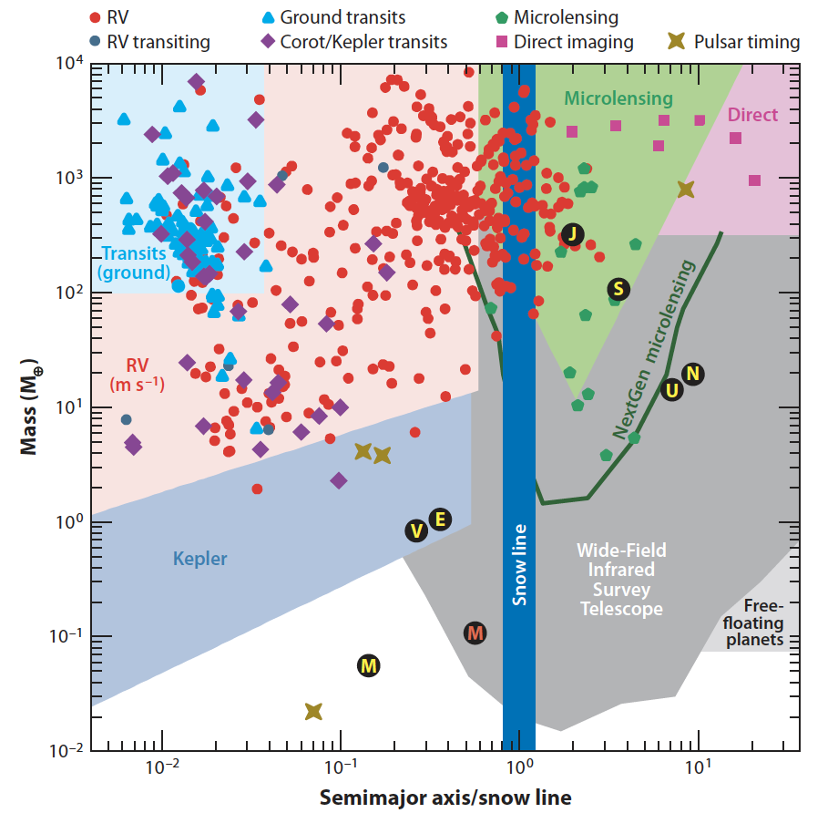
What is the planet discovery space for microlensing?
Gaudi 2012

