Slide 1
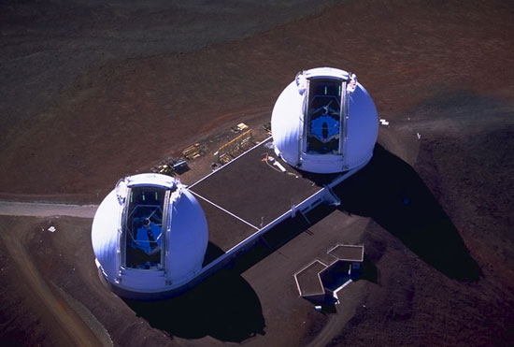
V773 Tau: a compact quintuple Pre-Main Sequence system?
Keck Science Meeting − October 15, 2010
Gaspard Duchêne
(UC Berkeley, Obs. Grenoble)
Andy Boden (Caltech), Guillermo Torres (CfA Harvard),
Andrea Ghez (UCLA), Quinn Konopacky (LLNL)

Slide 2
High-order multiple systems
Rare, but present in the field (up to N=7)
Mizar, Castor, ADS 9731, ν Sco
Formation in multiple phase
Two levels of fragmentation
Dynamical interactions (tides, scattering, exchange)
No known system above N=5 in PMS phase
But surveys are largely incomplete…
Are they formed and stable by the PMS stage?

Slide 3
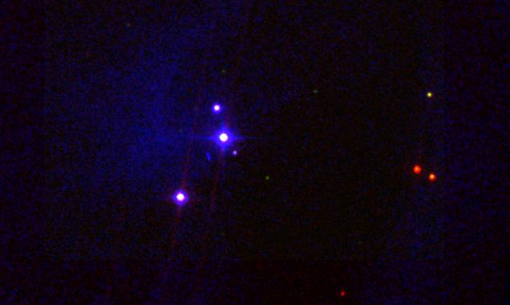
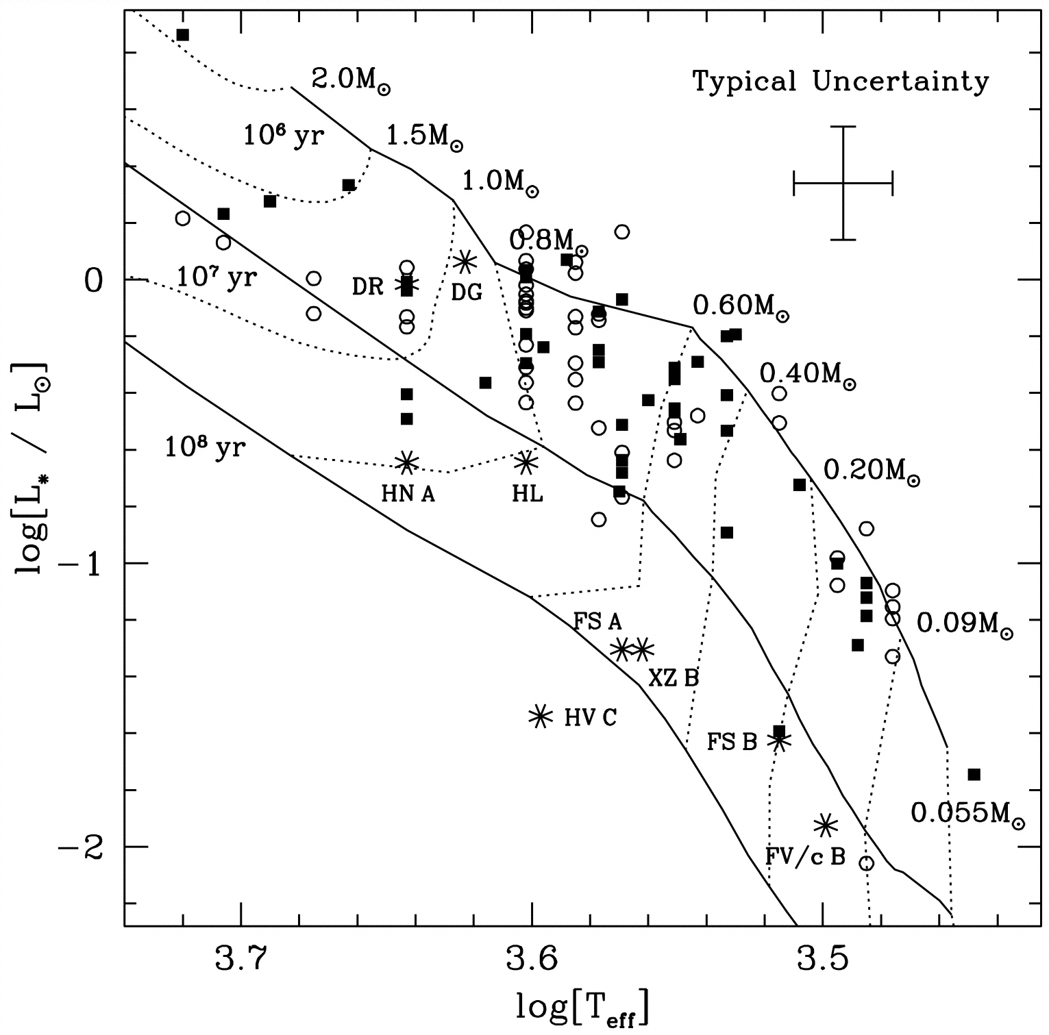
V773 Tau: a PMS quadruple
One of the brightest PMS star in Taurus
M★ ~ 1.5 M, age 3−5 Myr (from HR diagram)
White & Ghez (2001)
DSS R
2MASS K
IRAC 4
V773 Tau
5000 AU

Slide 4
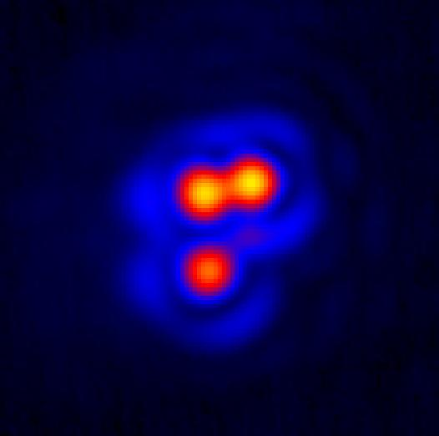
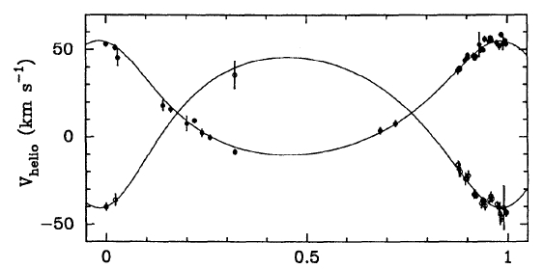
V773 Tau: a PMS quadruple
One of the brightest PMS star in Taurus
M★ ~ 1.5 M, age 3−5 Myr (from HR diagram)
A complex quadruple system
A: SB2 (P = 51d) , q ~ 0.75
B: unknown SpT (early-M?)
Duchêne et al. (2003)
NIRC2
A
B
C
25 AU
V773 Tau A
Welty (1995)

Slide 5
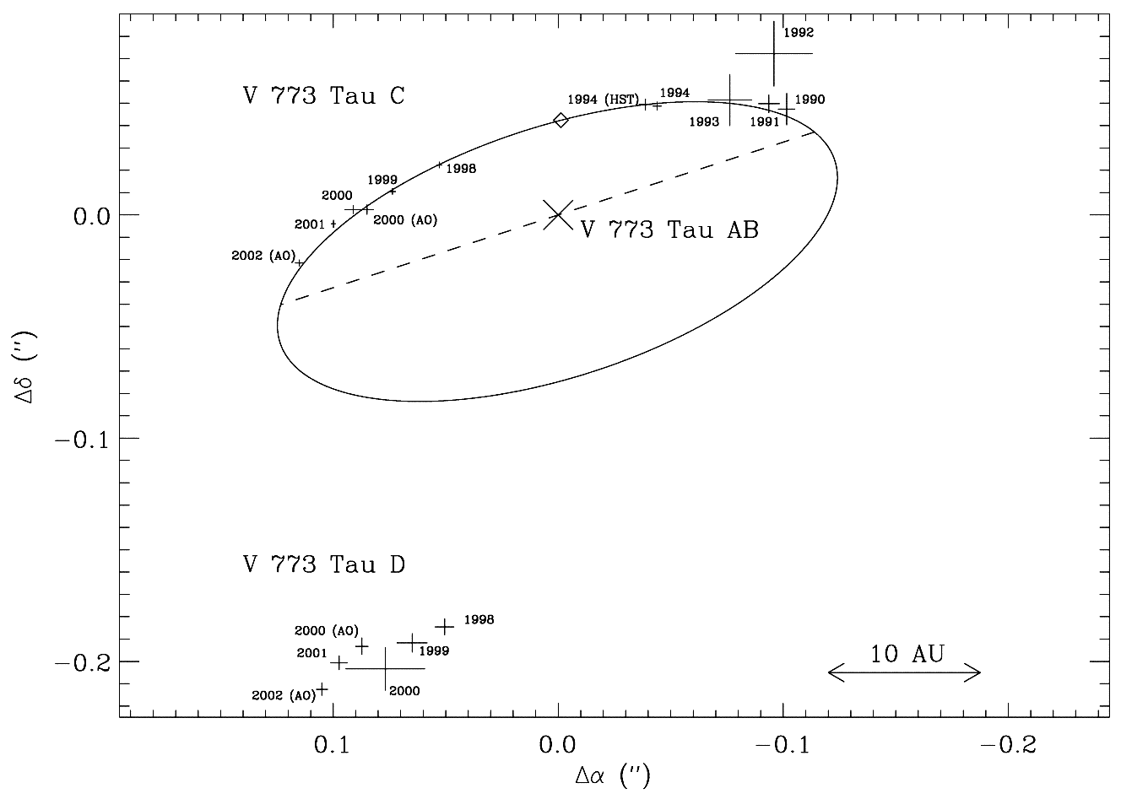
A-B orbit: first estimate
B
A
C
Based on 12 yr of astrometric monitoring
P ~ 46 yr
a ~ 20 AU
M_{AB} ~ 3.7 ± 0.7 M
[ D = 148pc ]
M_{B} ~ 0.7 M
Linear motion for C
a ≥ 115 AU
NIRC + NIRSPAO + NIRC2
B
1990
A
2002
C
Duchêne et al. (2003)

Slide 6
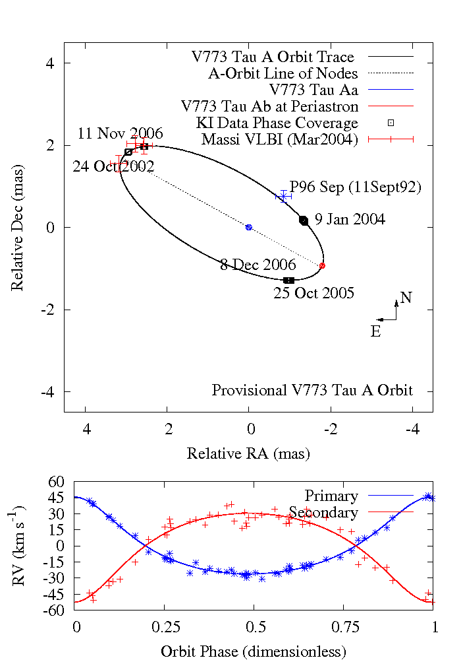
Aa-Ab orbit: 3D modeling
B
A
C
Keck Interferometer
Integrated modeling of the KI V², VLBI separations and RV monitoring
M(Aa) = 1.54 ± 0.14 M
M(Ab) = 1.33 ± 0.10 M
D = 136.2 ± 3.7 pc
Indirect estimate for B :
M(B) ~ 0.1 M (?)
4 mas
~ 0.5 AU
Boden et al. (2007)

Slide 7
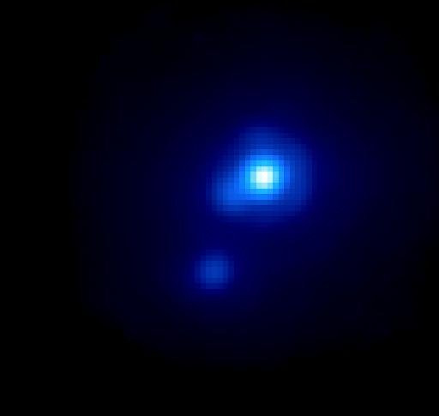
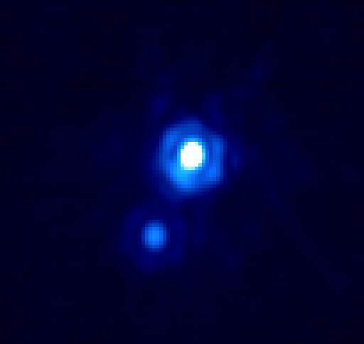
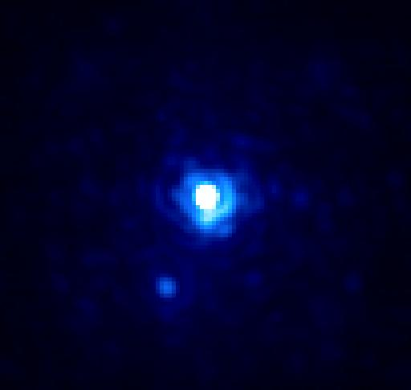
A-B orbit: cont’d monitoring
B
A
C
Goal: improve on dynamical mass of B
V773 Tau B not seen at expected location!
Almost lost in speckle cloud (2-3 mag fainter)
VLT NaCo
NIRC2
NIRC2
0.2”
Dec 2006
Oct 2008
Sep 2009
Boden et al. (in prep.)

Slide 8
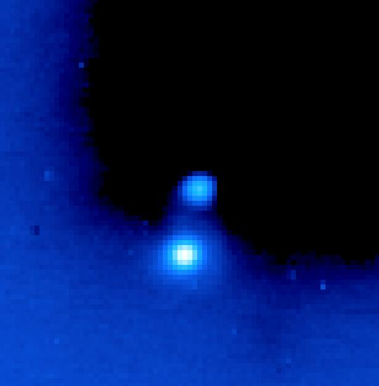
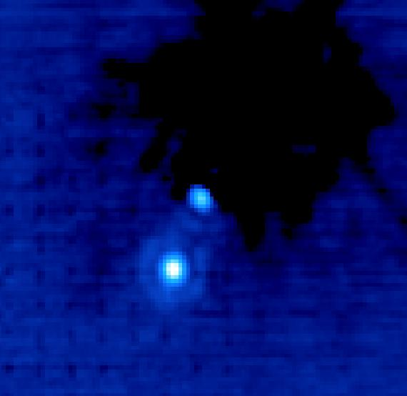
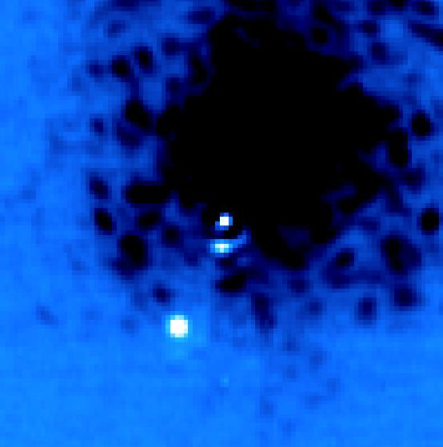
A-B orbit: cont’d monitoring
B
A
C
Goal: improve on dynamical mass of B
V773 Tau B not seen at expected location!
Almost lost in speckle cloud (2-3 mag fainter)
Separation is less than half the expected value!
VLT NaCo
NIRC2
NIRC2
0.2”
Dec 2006
Oct 2008
Sep 2009
Boden et al. (in prep.)

Slide 9
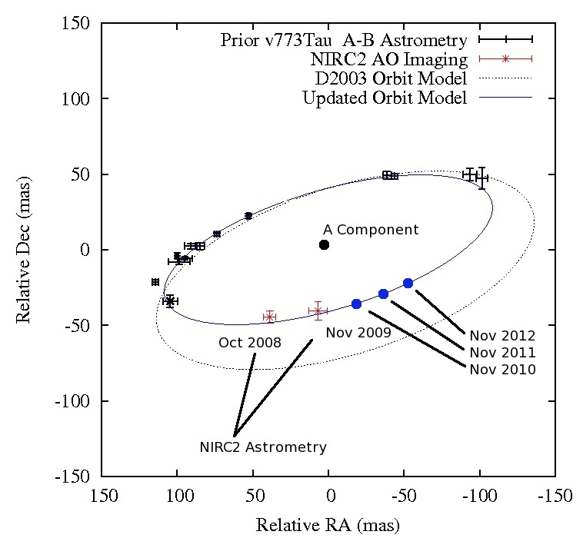
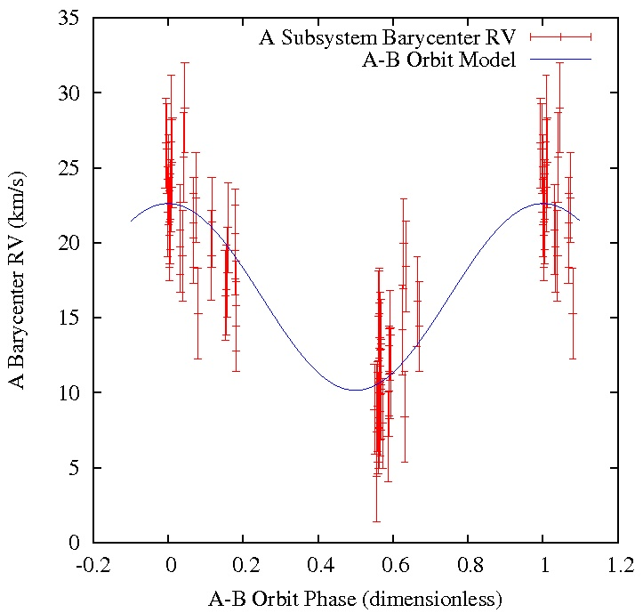
A-B pair: updated orbit
B
A
C
Much better orbital phase coverage
Radial velocity variations of the A barycenter
➔ Fully constrained 3D Keplerian model
Boden et al. (in prep.)

Slide 10
A-B pair: updated orbit
B
A
C
Orbital parameters changed dramatically:
P_{orb} ~ 26 yr (instead of 46 yr), 75% covered
With updated VLBA distance (Loinard et al.), new estimate for M(B) ~ 2.2 ± 0.6 M
How can B be more massive than Aa, yet less luminous (1.5 L vs 2.2 L)?
Is B an unresolved binary as well?

Slide 11
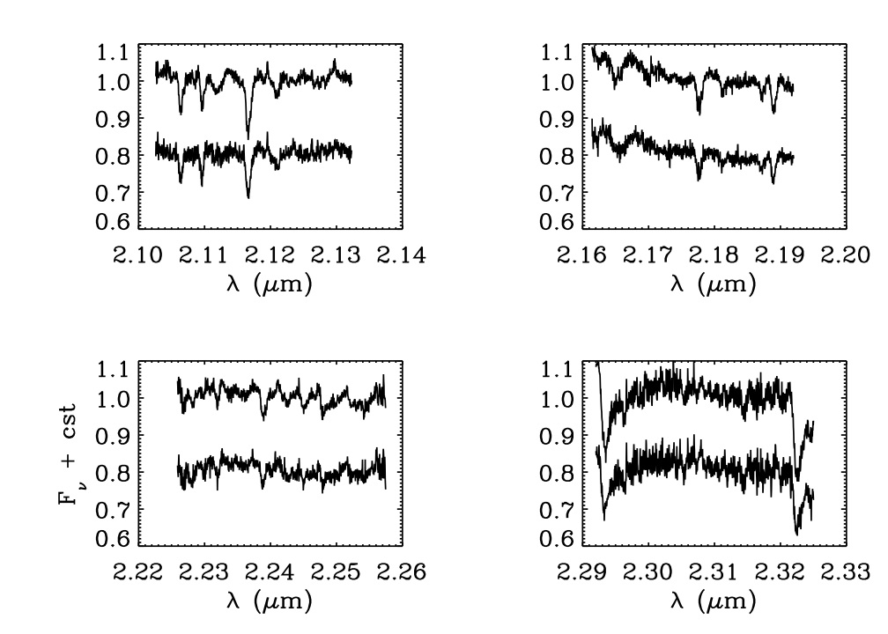
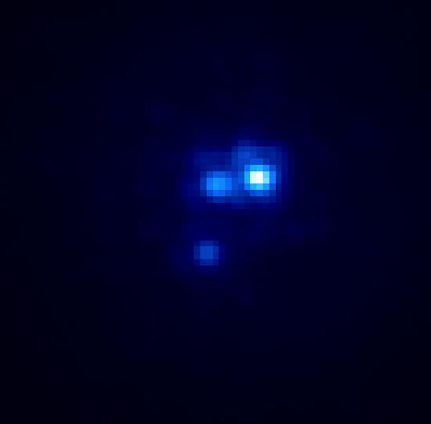
B component: spectroscopy
B
A
C
Goal: constrain the nature of B and estimate RV
SpT (B): K2-K5, very similar to A component
NIRSPAO
A
Dec 2003
B
Boden et al. (in prep.)

Slide 12
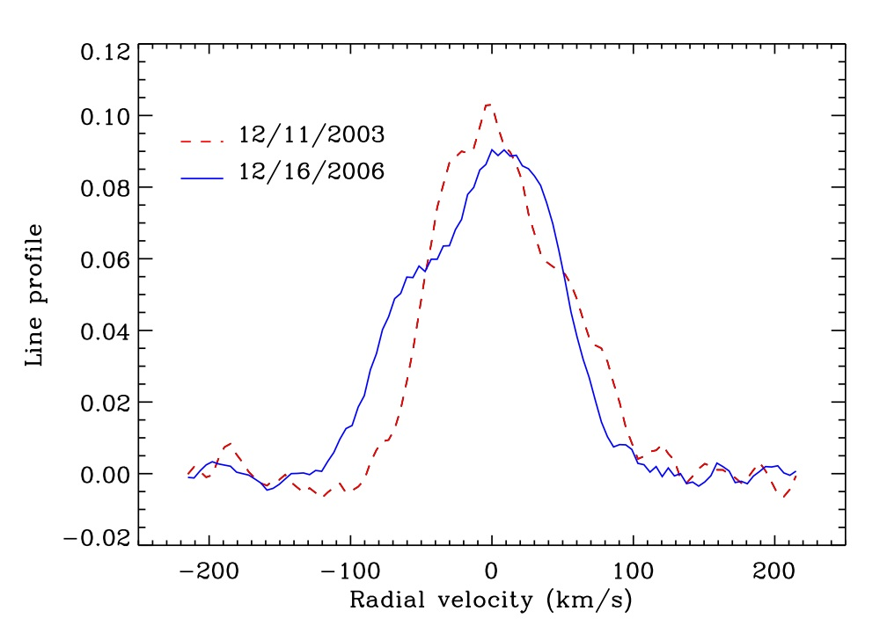
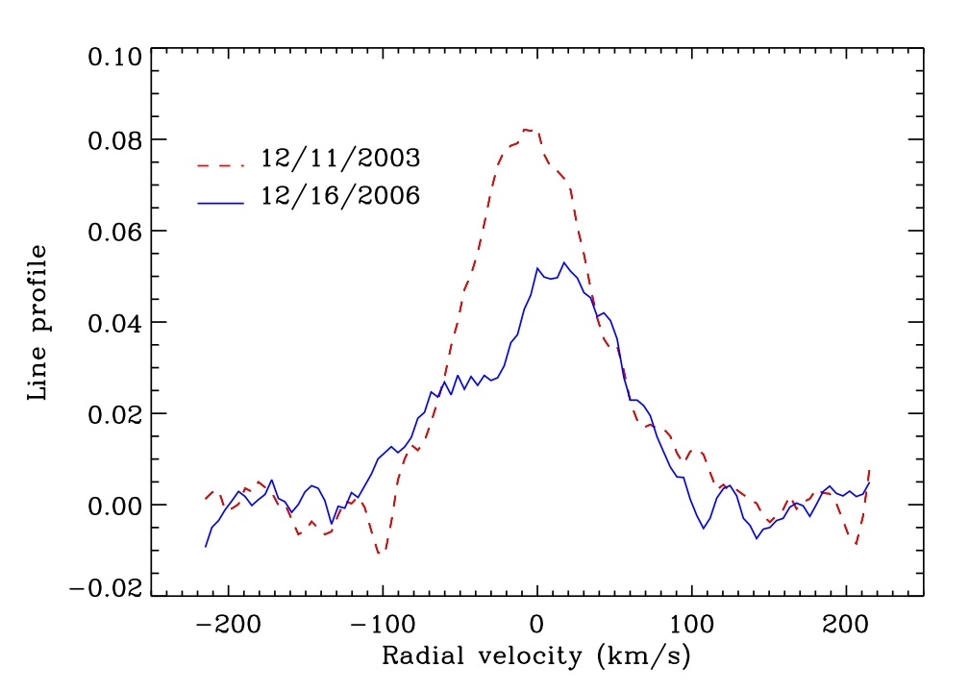
B component: spectroscopy
B
A
C
Goal: constrain the nature of B and estimate RV
SpT (B): K2-K5, very similar to A component
Line profile suggests B is an SB2!
Supports the picture of B being a q > 0.75 binary
V773 Tau A
V773 Tau B
Boden et al.
(in prep.)
NIRSPAO

Slide 13
Putting it all together
V773 Tau likely contains 5 stars within 300 AU !
One of the most compact such system to date
The structure and long-term stability of the dusty environment of B is a fascinating topic
V773 Tau B
apoastron: ~0.5 AU (?)
V773 Tau A
apoastron: 0.5 AU
V773 Tau AB
periastron: 14 AU
V773 Tau C
Separation ≤ 300 AU

Slide 14
Putting it all together
V773 Tau likely contains 5 stars within 300 AU !
One of the most compact such system to date
The structure and long-term stability of the dusty environment of B is a fascinating topic
Actually, V773 Tau could
be a sextuple system !
A faint T Tauri star some
3200 AU away…

