Slide 1
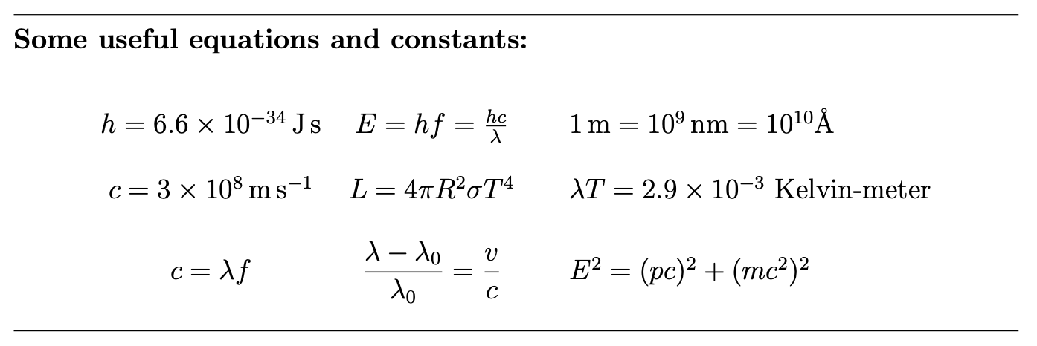

Slide 2
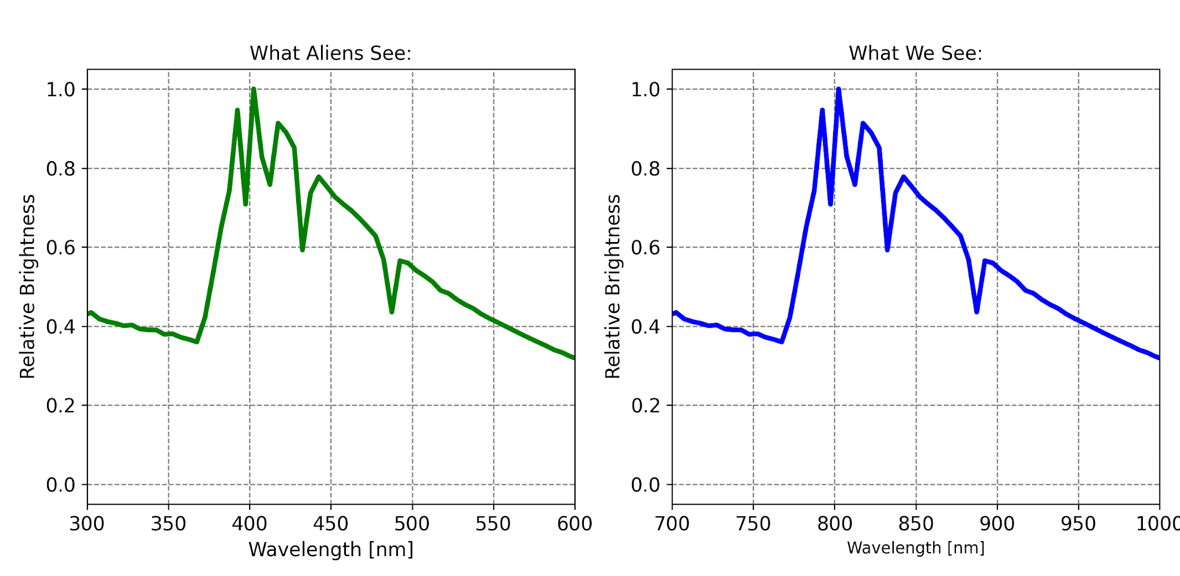
Group 1
The year is 2071, and we have discovered life around a distant star system. Below are two spectra of the star that hosts the alien life: one spectra (right) representing what we see on Earth, and another spectra representing what aliens living around that star would see (left).
What type of spectrum do we see? What can it tell us?
How fast is the alien star moving relative to us?
Is it moving toward or away from us?

Slide 3
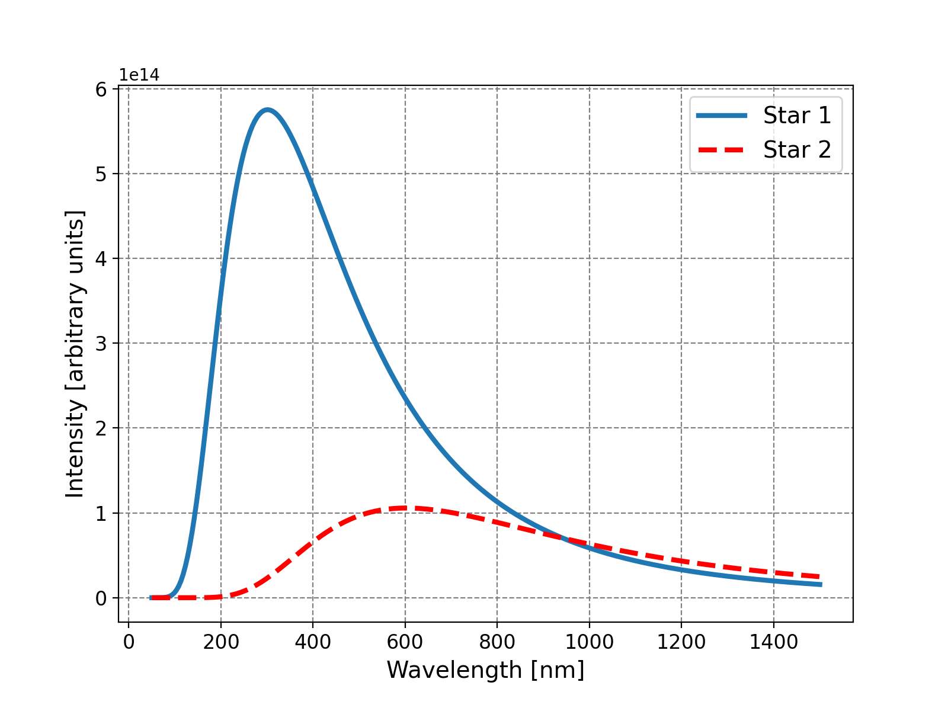
Group 1
Below is a plot of two blackbody curves, and this questions concerns their properties.
Discuss in your group what this plot represents and what we can learn from it.
Which star is hotter and by what factor?
Assume Star 1 has the same radius as Star 2. What is the ratio of the two stars’ luminosities?

Slide 4
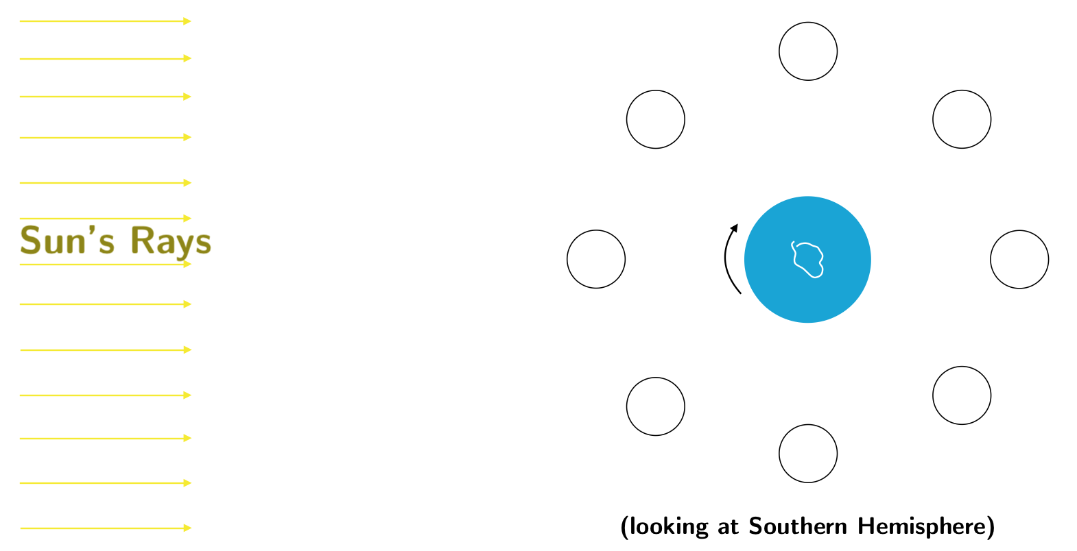
Group 1
Below is a diagram of the Earth-Moon-Sun system as viewed from the Southern Hemisphere (the white blob on the Earth is my attempt at Antarctica). Take a second to absorb the geometry of the situation, including the Earth’s rotation.
Label the phases of the moon.
In what order will these phases happen?
At what time of day or night would you see the full moon directly overhead (if you were standing on the equator)?
Discuss in your group why the Moon can eclipse the Sun.

