Slide 1
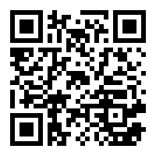
welcome everyone!
https://tinyurl.com/pilawaC10Form
as people come in, please fill out this form:

Slide 2
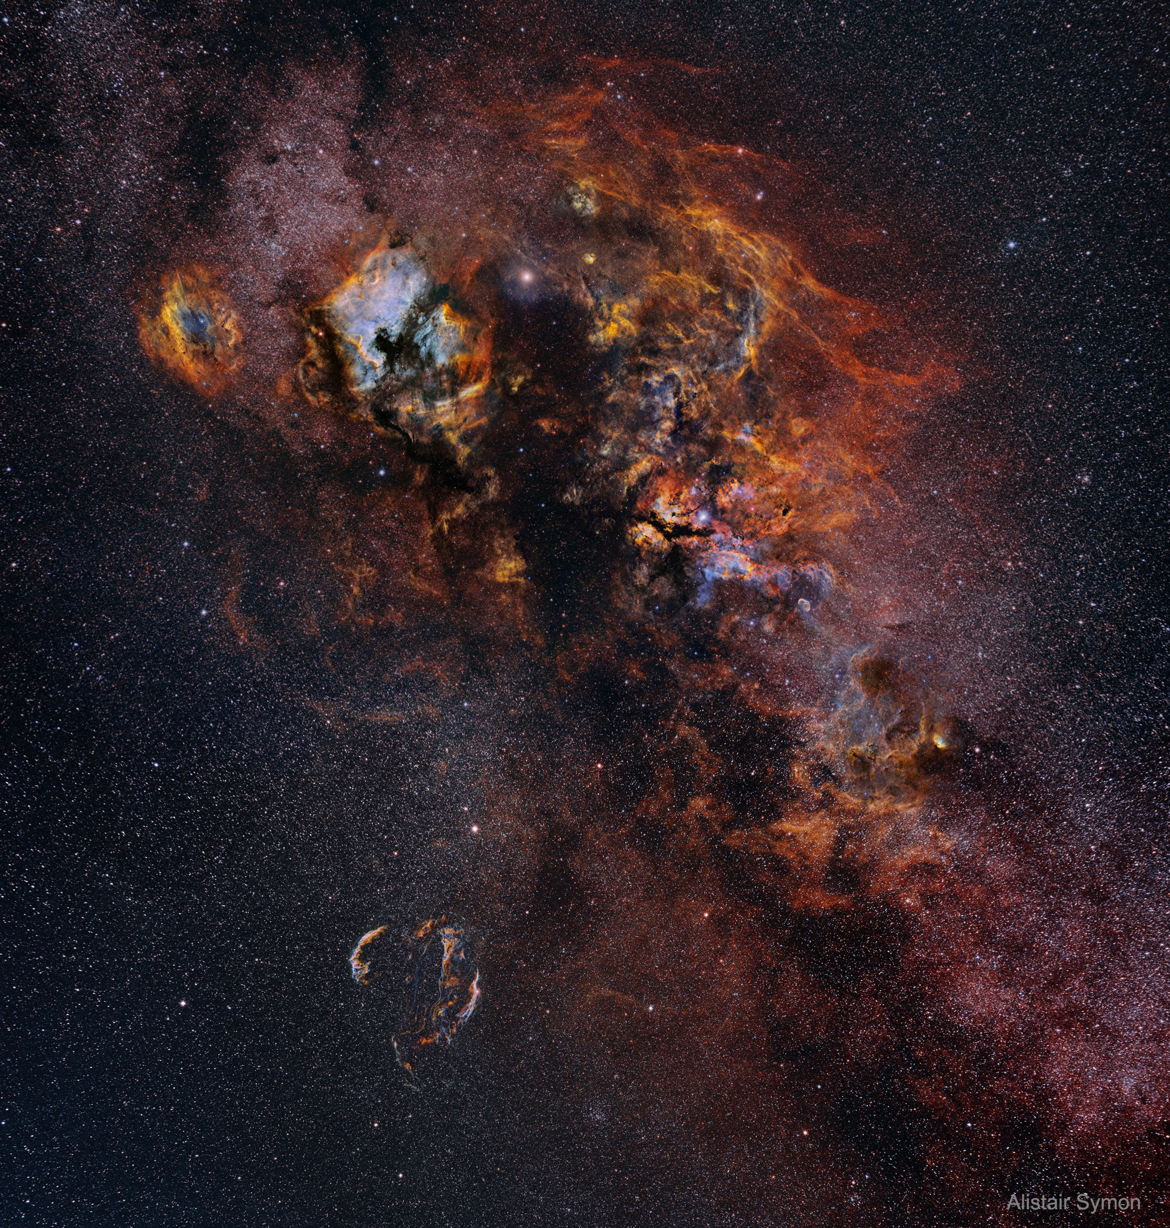
Hydrogen Cloud
in Cygnus

Slide 3
North America Nebula
Pelican
Nebula

