Slide 1
week 13
Notes:
Magellanic mountain APOD

Slide 2
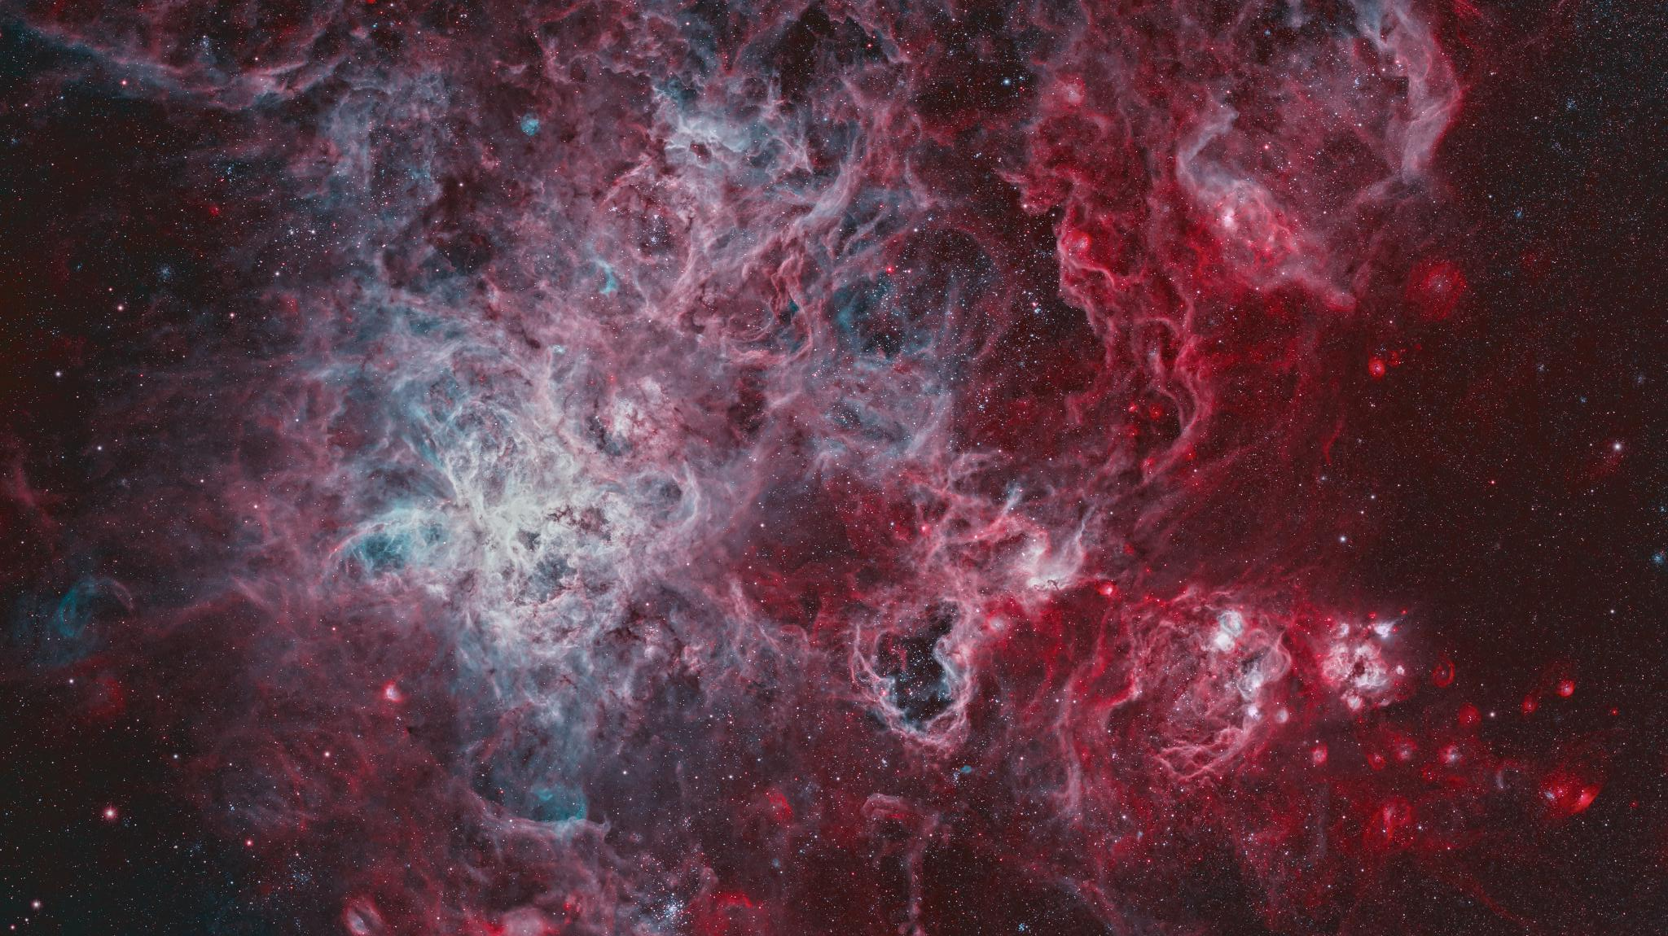
apod
Notes:
This is the TARANTULA nebula -- largest star forming region in the local group of galaxies. Yellow line = longer than 1000 light years.
If this were the same distance as the other nebulae we have been looking at, it would take up half the sky
Blue circle: Central star cluster; intense radiation, stellar winds and supernova shocks from the central young cluster of massive stars, cataloged as R136, energize the nebular glow and shape the spidery filaments.
Green circle: Location of SN 1987A -- closest supernova of our lifetime

Slide 3
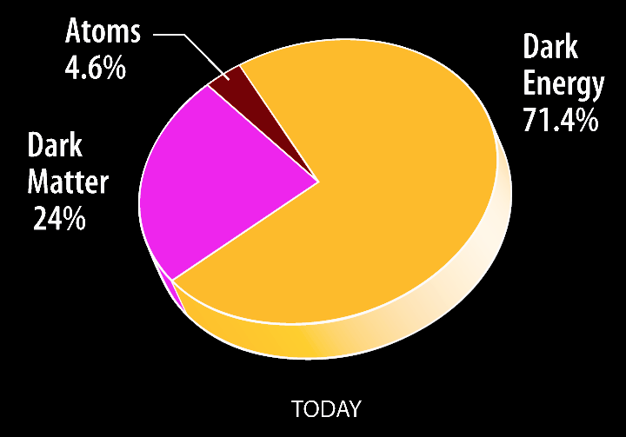
Contents of the Universe
amount of matter in the Universe determines the curvature/geometry
Λ
accelerated expansion/cosmic acceleration parameter:

Slide 4
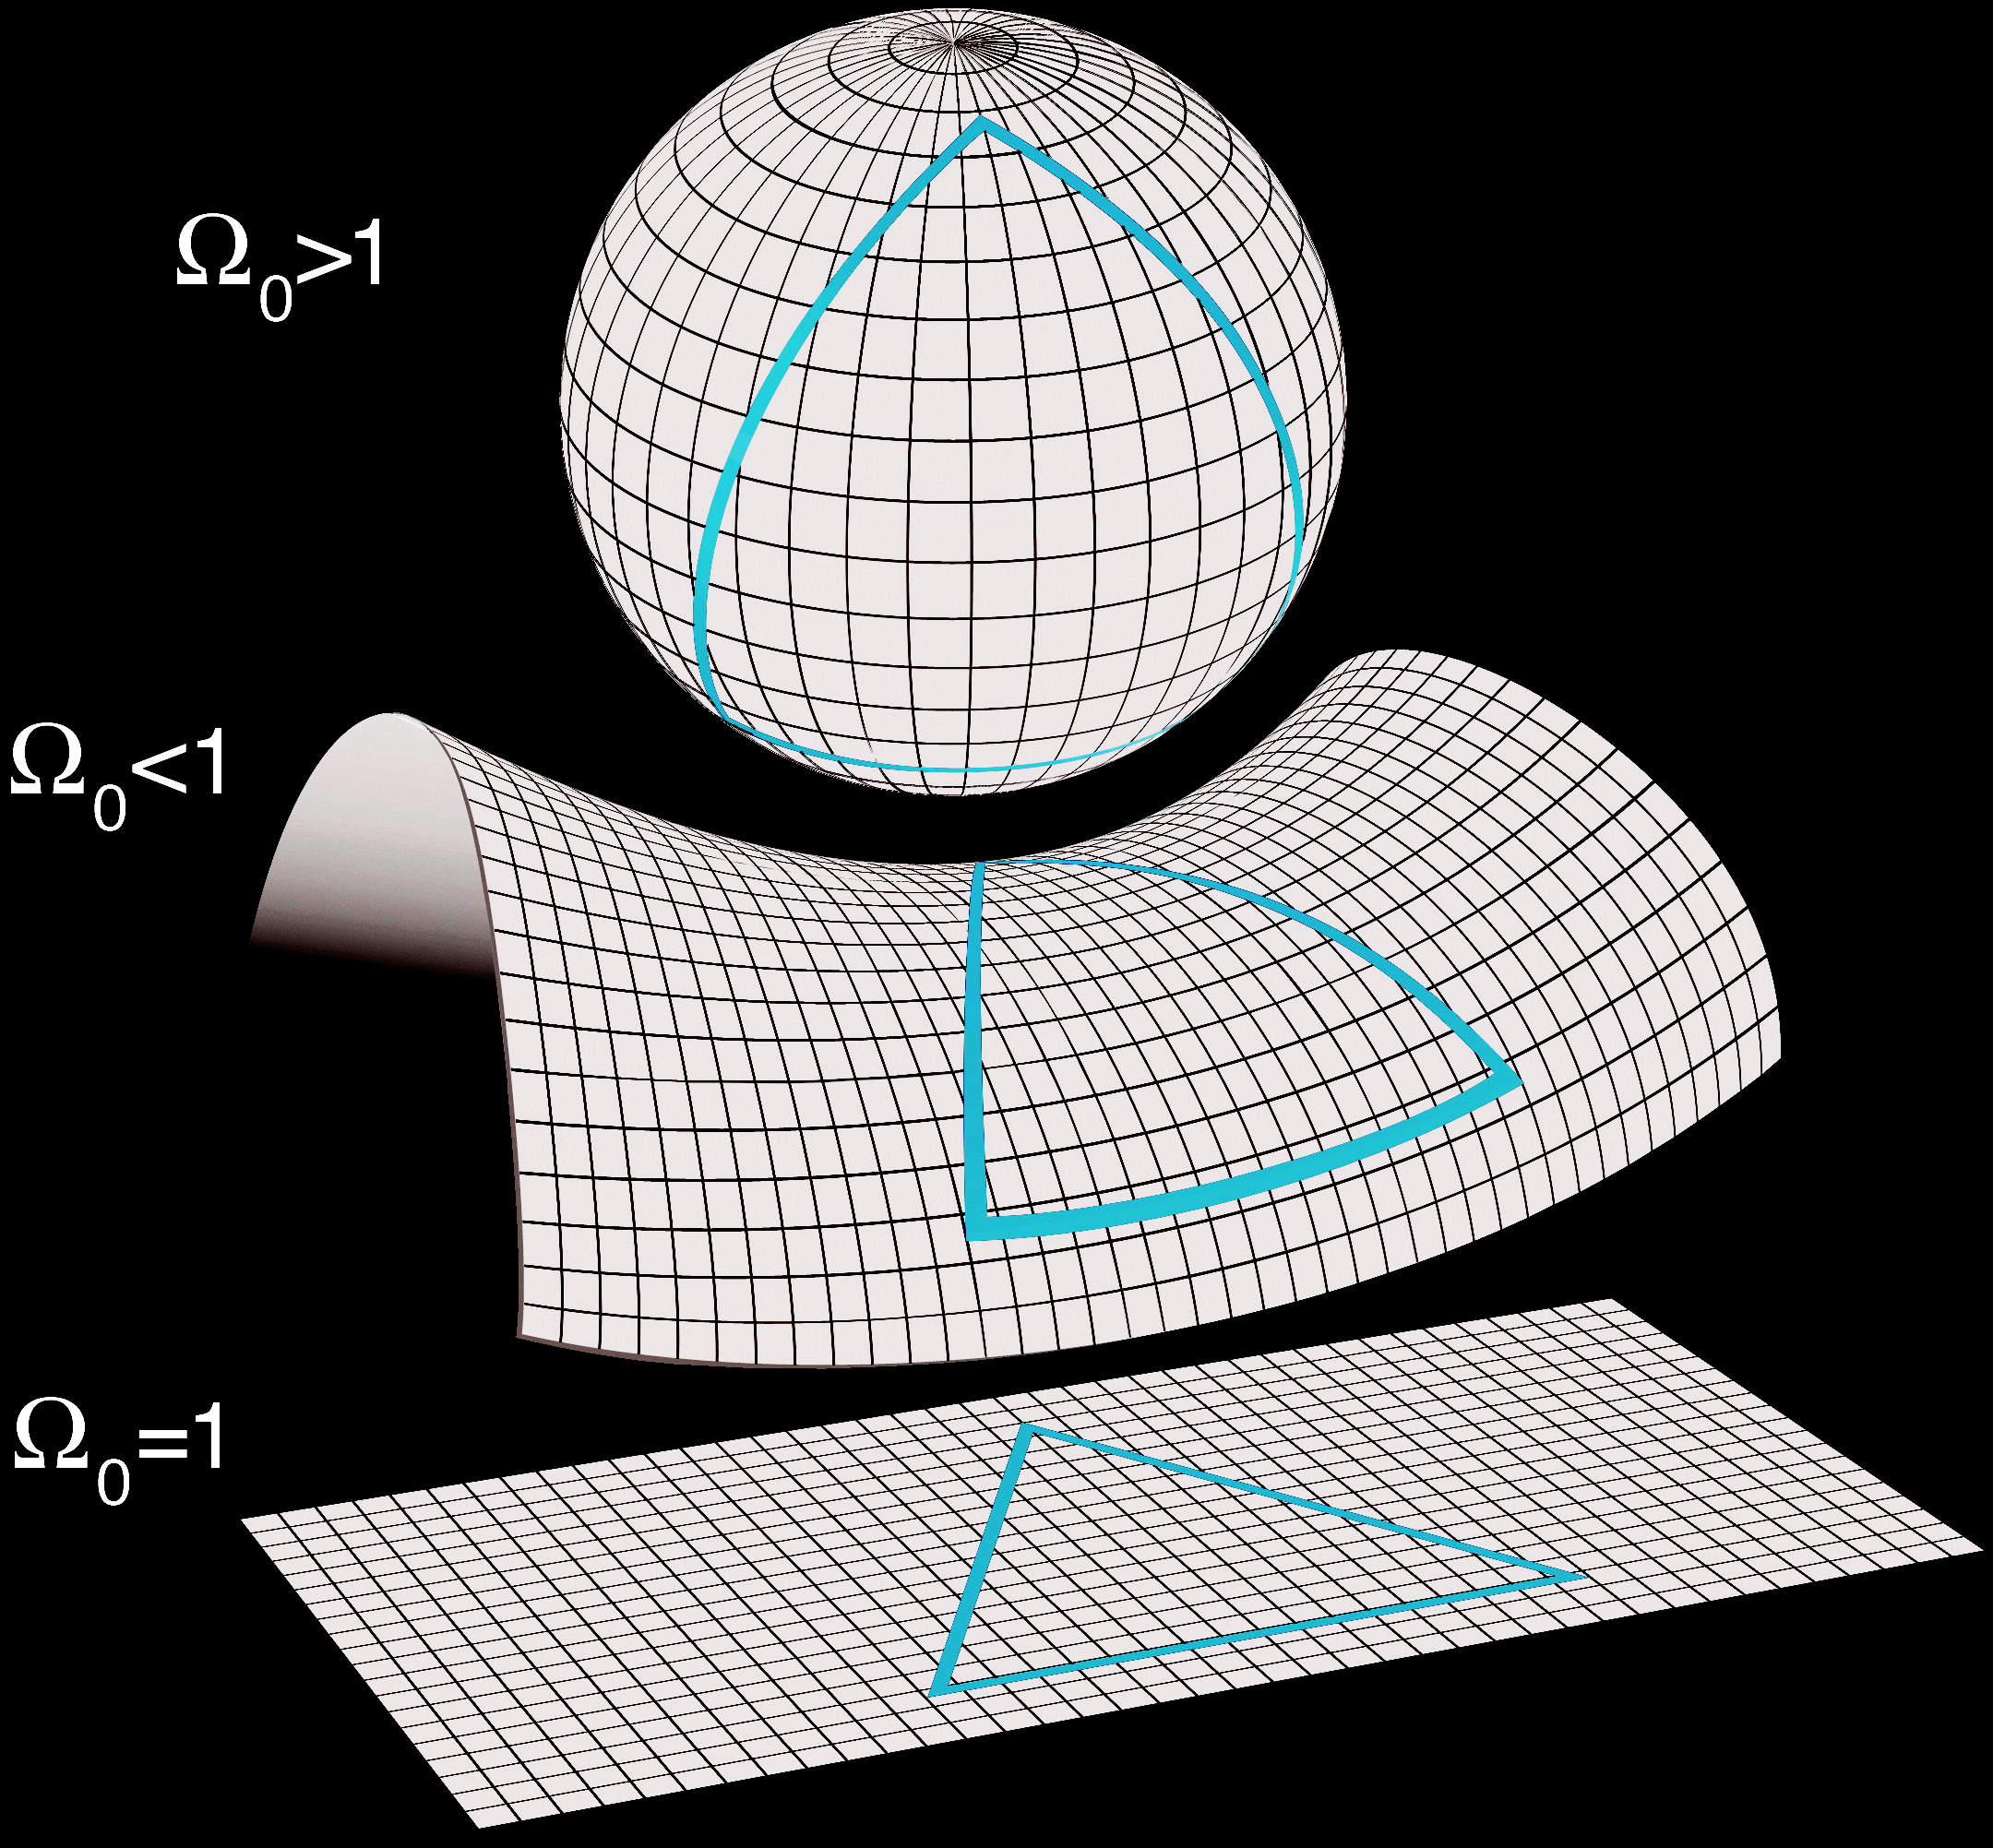
Curvature of the Universe
Depending on how much “stuff” we have in the Universe, we get very different shapes for space and time!

Slide 5
The Cosmological Principle
We are in no special place in the Universe!
Large Scale Structure + Cosmic Microwave Background

Slide 6
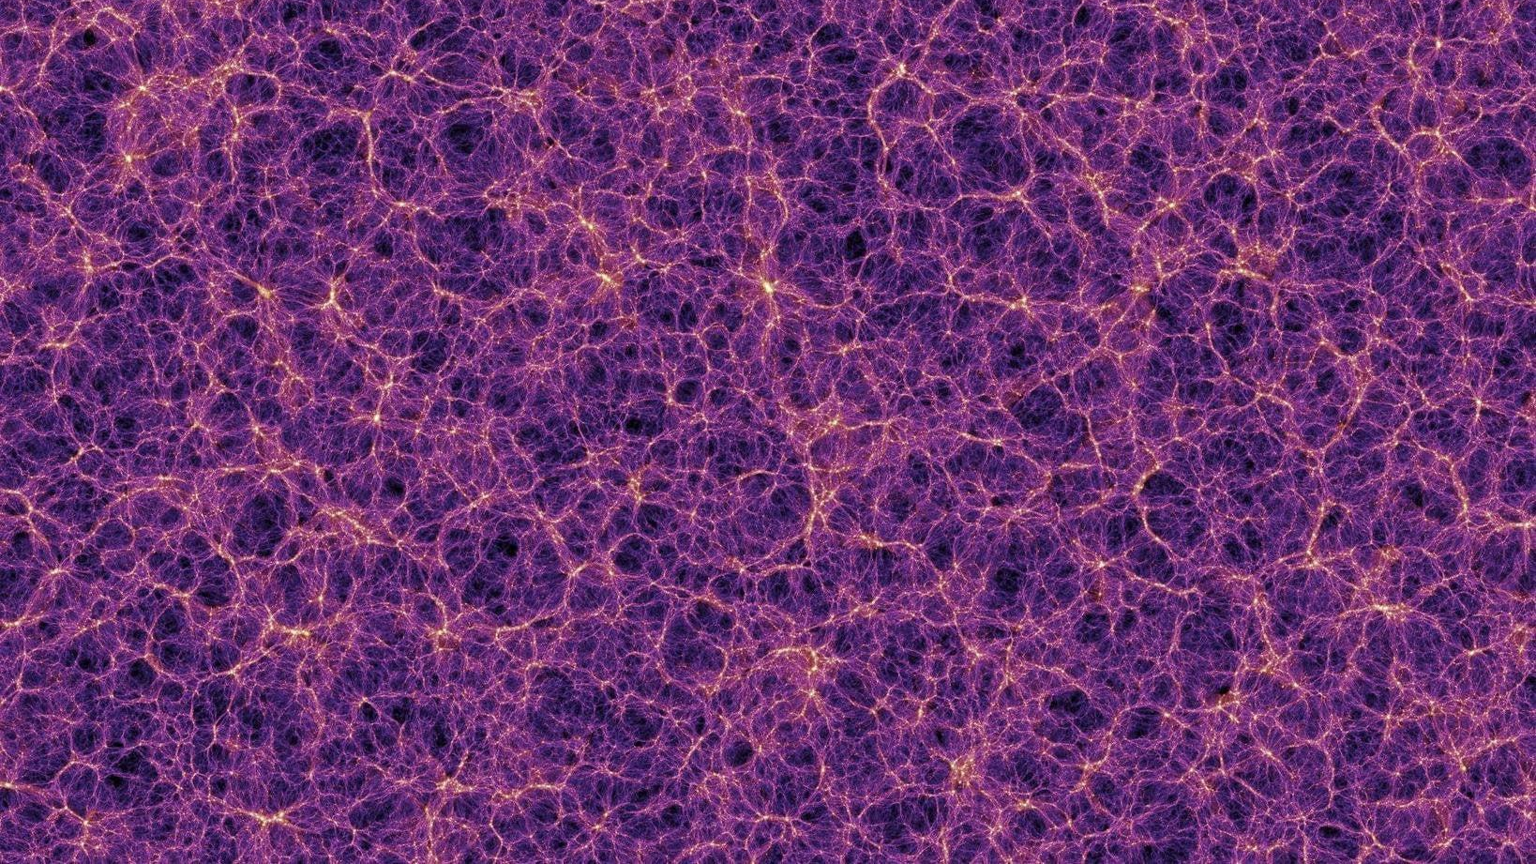
Large Scale Structure

Slide 7
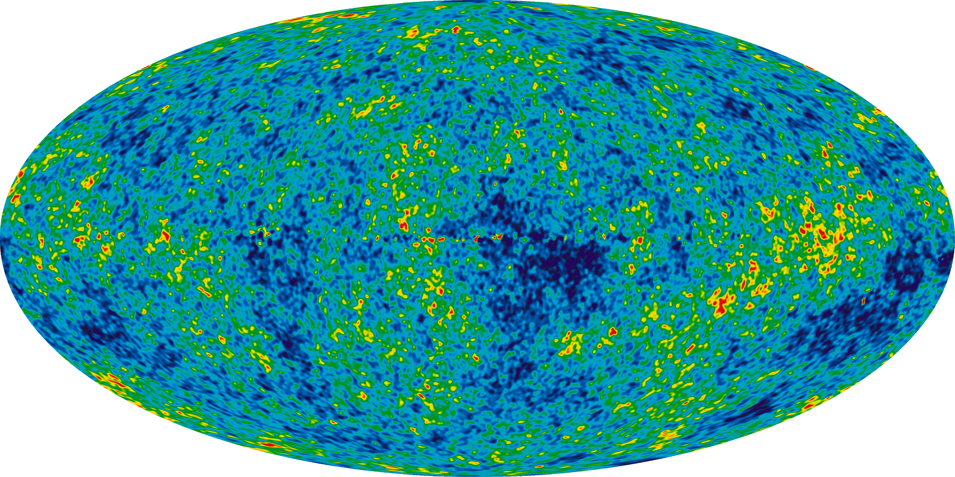
Cosmic Microwave Background

Slide 8
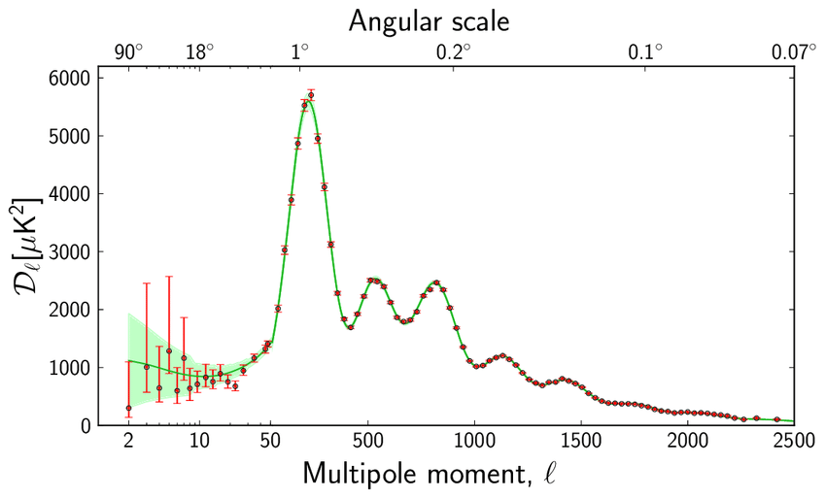
Cosmic Microwave Background

