Slide 1
week 2
good morning everyone!

Slide 2
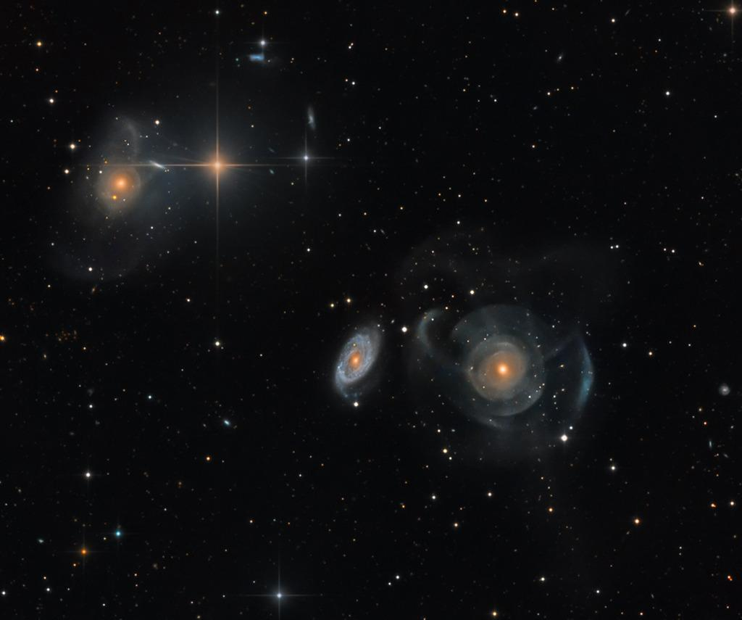
APOD
NGC 474
NGC 470
Notes:
APOD

Slide 3
C. Mihos, Case Western Reserve University

Slide 4
Feedback from Google Form!
“Is the textbook worth it?”
Yes!
“Are we expected to have watched the Friday lecture for your GSI section?”
Short answer: no.
“Where is our bCourses page located?”
Astronomy C10 > Pages > View All Pages > Our Discussion Section
“How would you like to be addressed in class/emails?”
Please just call me Jacob!
“Sorry that I am tired/have video off/am not able to talk loudly/am in a diff. timezone.”
DO NOT WORRY AT ALL!
“Can you post the slides?”
Yes! I will do this from now on at our bCourses page.
“You speak very quickly.”
Apologies! I will try to slow down, and please let me know if you want me to repeat anything!
“I have a question about the labs!”
Direct the question to Sergiy Vasylyev or Alex.
I got some stellar recommendations for restaurants/places in Berkeley, so thank you all!

Slide 5
“electromagnetic radiation”
what comes to your mind?

Slide 6
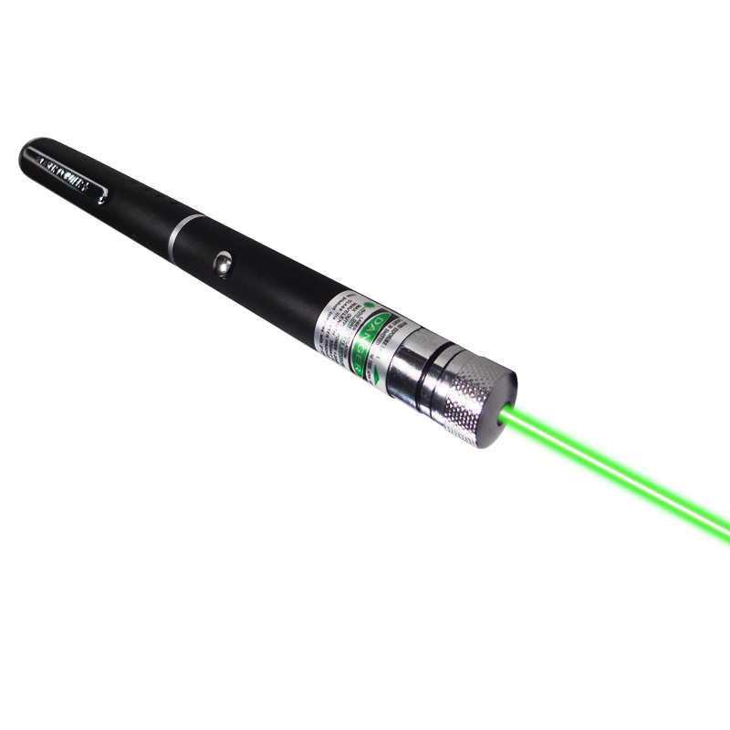
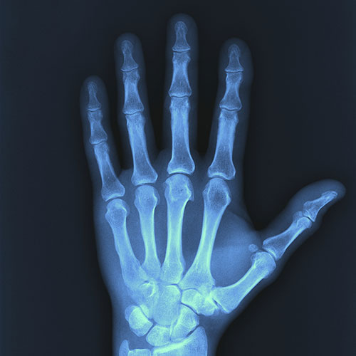
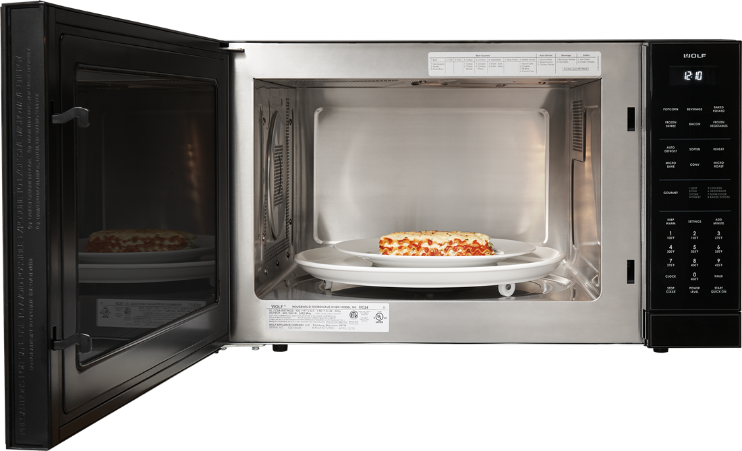
it’s all the same thing! it’s just light!
Notes:
a

Slide 7
what astronomers think of:
short wavelength
long wavelength
high frequency
low frequency
what might be some ways to distinguish the left from the right side above?

Slide 8
terminology and taxonomy:

Slide 9
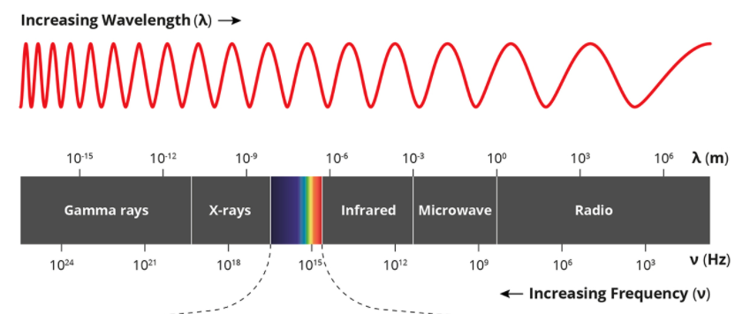
terminology and taxonomy:

Slide 10
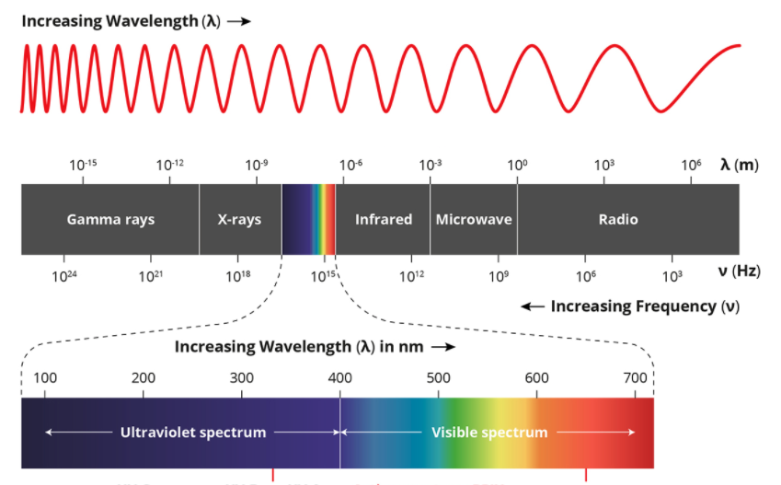
terminology and taxonomy:

Slide 11
break out rooms!
Notes:
https://docs.google.com/presentation/d/1yRzTTAPqwztJx4pq-k5qev8XIRWkDFvZa-x3Ev-W_Ic/edit

Slide 12
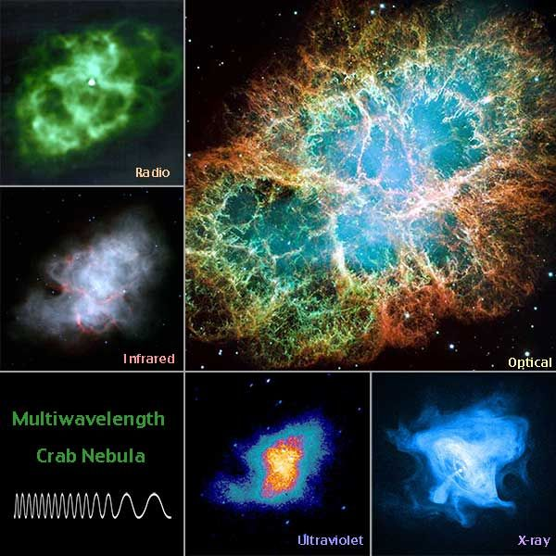
the universe in technicolor
RADIO: Cold gas.
Infrared: Dust, warmer gas.
Visible: Objects, stars, hot things.
UV: Really hot stars, really hot gas.
X-ray: Explosions, stellar deaths, really fast moving particles

Slide 13
why the **** do we care?

Slide 14
why the heck do we care?

Slide 15
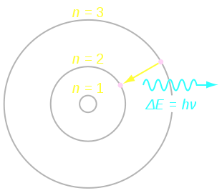

Slide 16
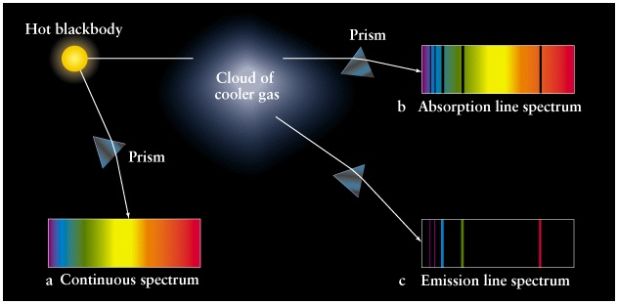

Slide 17
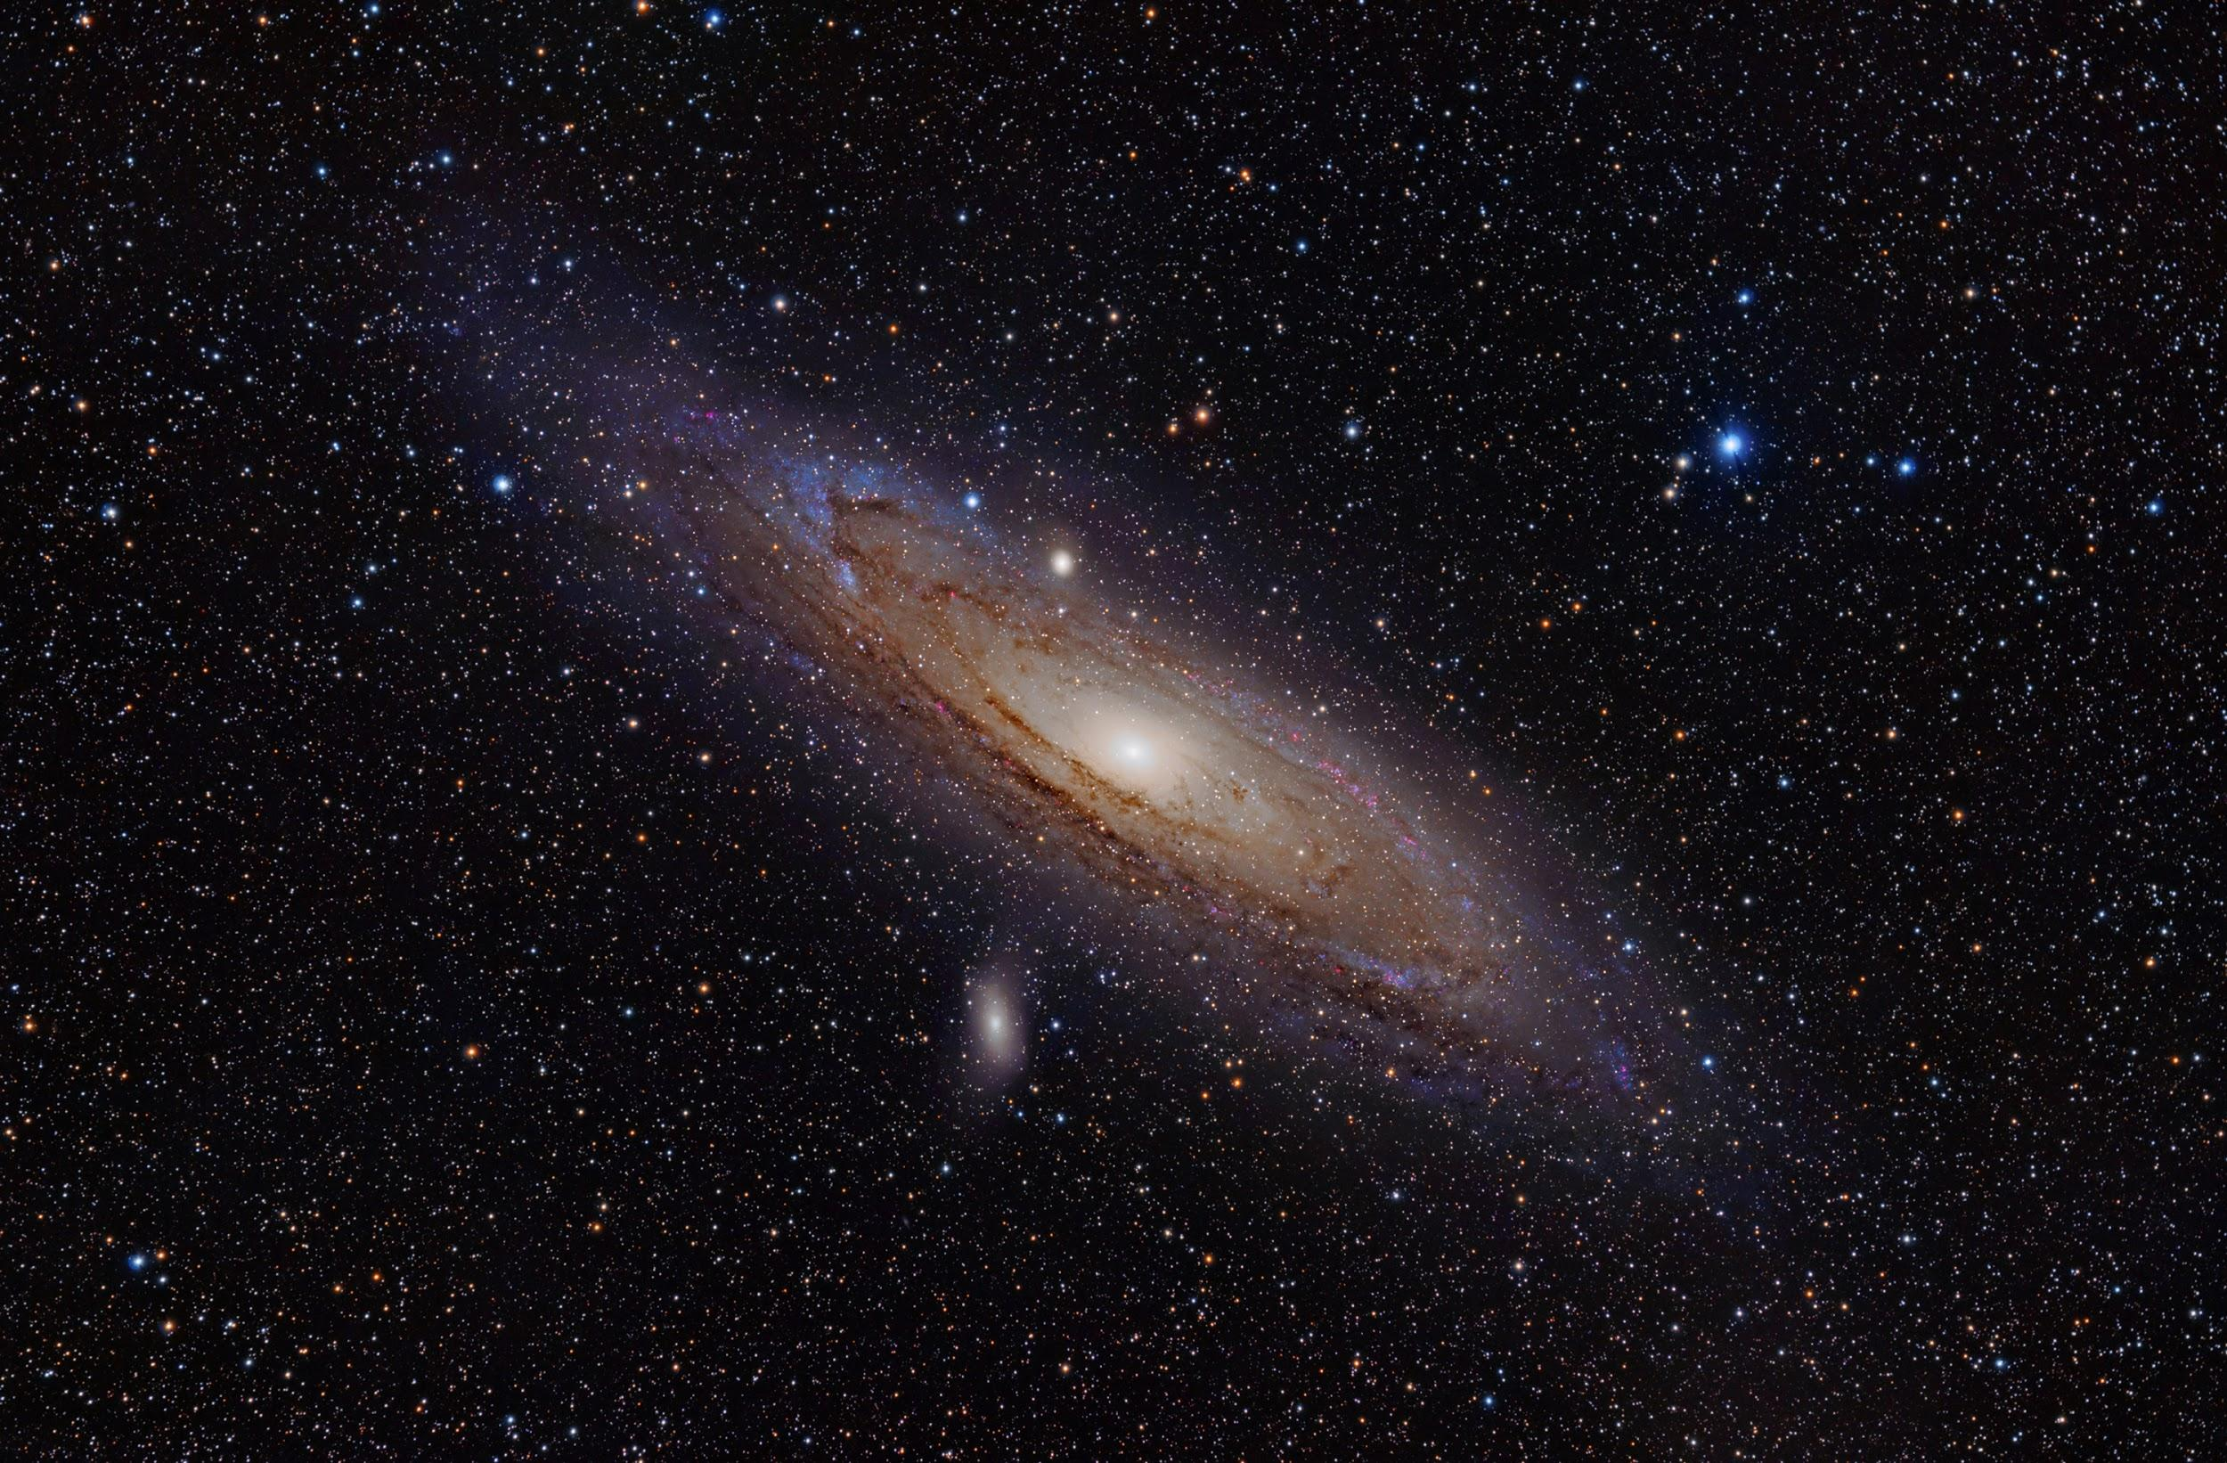
weekly survey!
Thanks everyone!
tinyurl.com/pilawaForm

