Slide 1
week 3
good morning everyone!
we’ll get rolling at 10 after!

Slide 2
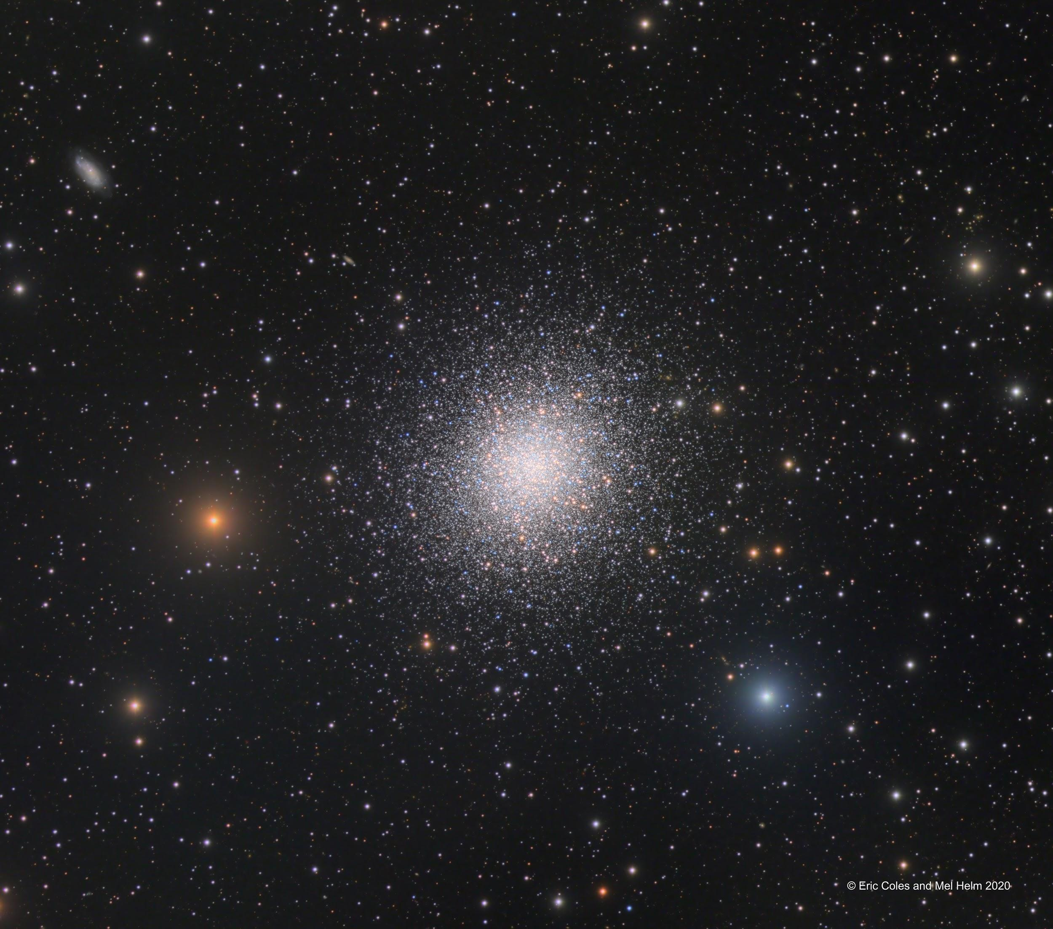
APOD
150 ly
Edmond Halley, 1716:
“This is but a little Patch, but it shews itself to the naked Eye, when the Sky is serene and the Moon absent."
Notes:
Hercules Cluster (M13):

Slide 3
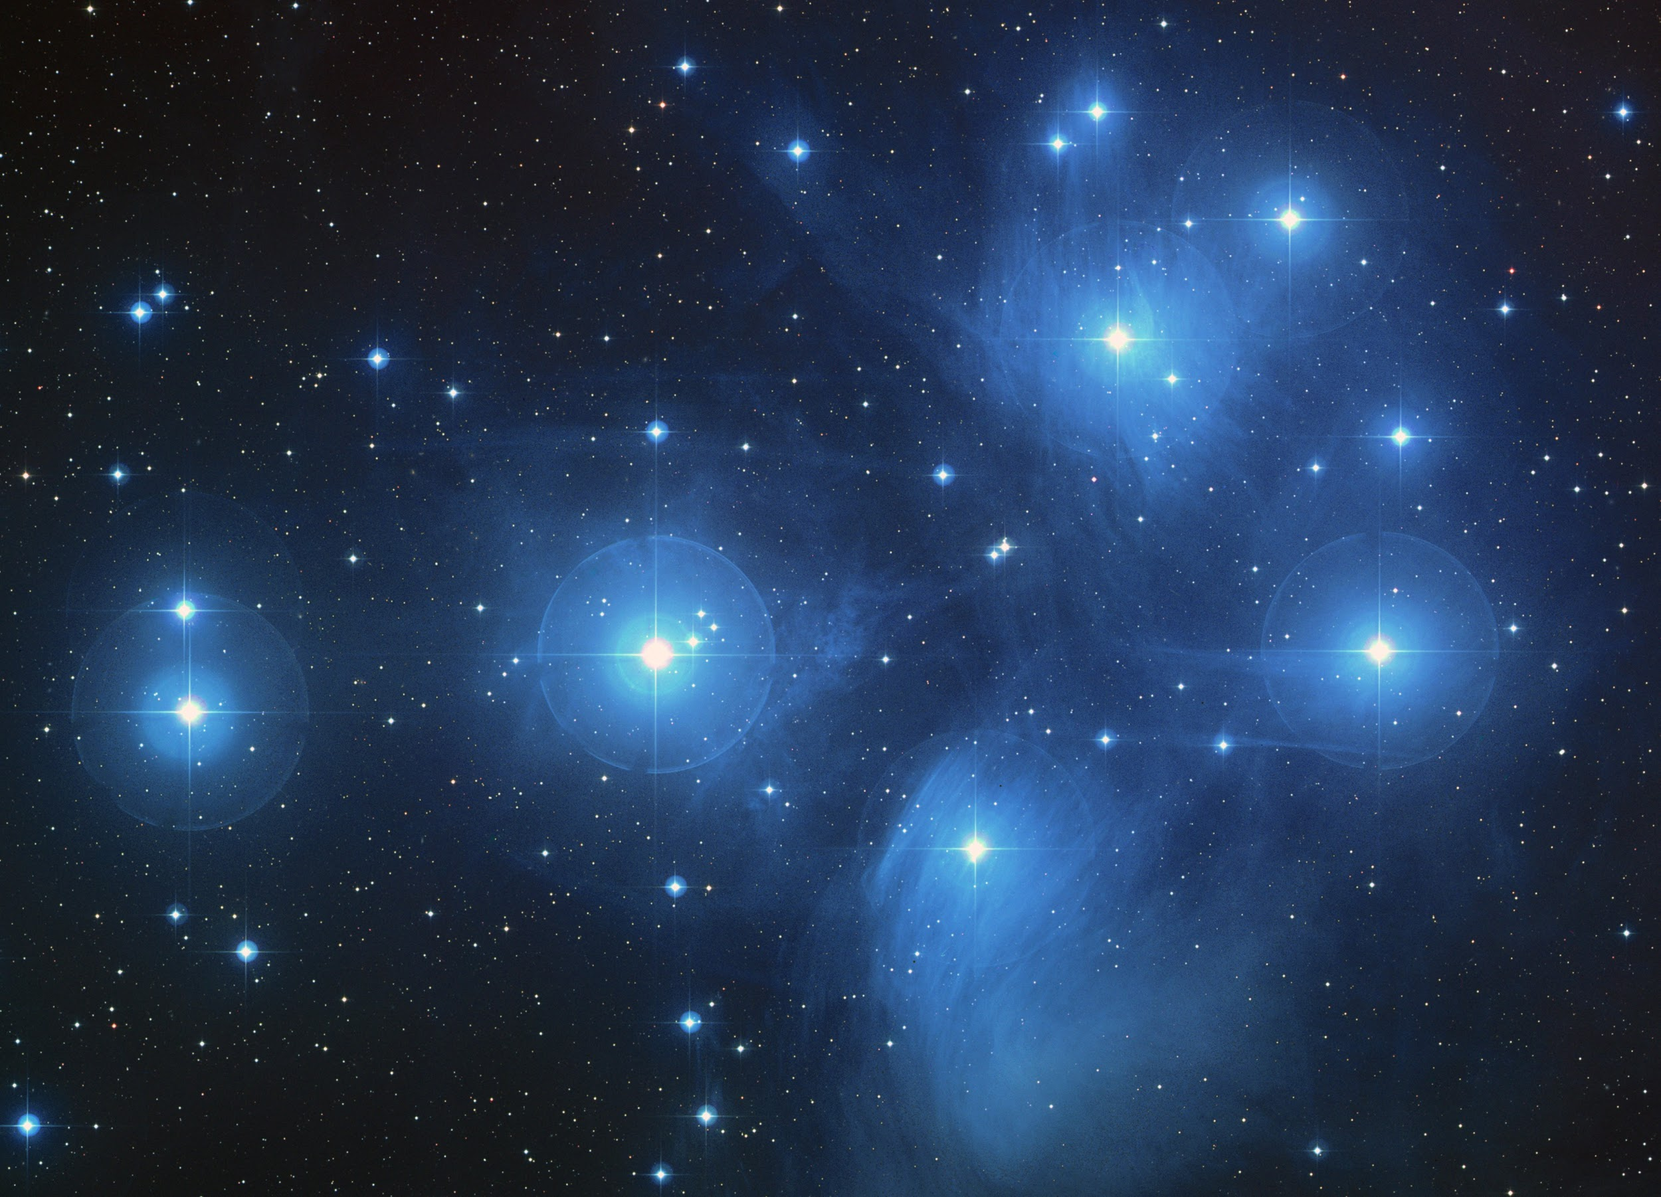
Globular Cluster
Open Cluster
Notes:
Hercules Cluster (M13):

Slide 4
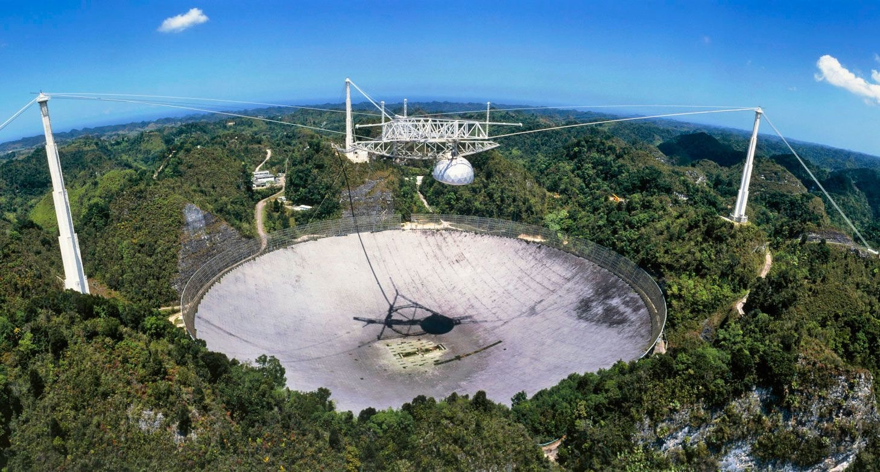
Arecibo Observatory (Puerto Rico)
~ 300 meters
Notes:
Hercules Cluster (M13):

Slide 5
Feedback from Google Form!
“I would have liked more math review!”
Apologies! Hopefully TALC helped/homework helped. Any quick questions? Otherwise, office hours or email.
“Hard to know whether or not we could use computers/outside resources.”
Understood! And you actually gave me a great idea. Feel free to Google stuff (responsibly, not just to find answer) in class. It’s great for curiosity!
“I want more time in the breakout rooms to talk to others!”
Understood! Trying to balance some classes vs. others. Thanks!
“Where are the slides?”
bCourses Page > Link to Slides to download
“Can you share restaurant recs?”
Im’s, Top Dog,
“Will we have test review?”
Yes, and quizzes too!
“Can you leave some more time for questions on course content?”
Really good suggestion about structure of class. Too long to write out.

Slide 6
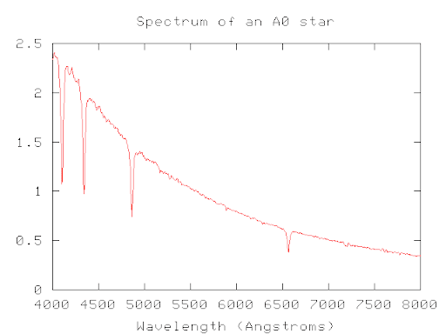
what am i looking at??? 🤔
What can it tell us?
Temperature (peak wavelength)
Composition (spectral lines)
Motion (doppler shift)
Brightness (y-axis) vs. Wavelength (x-axis)

Slide 7
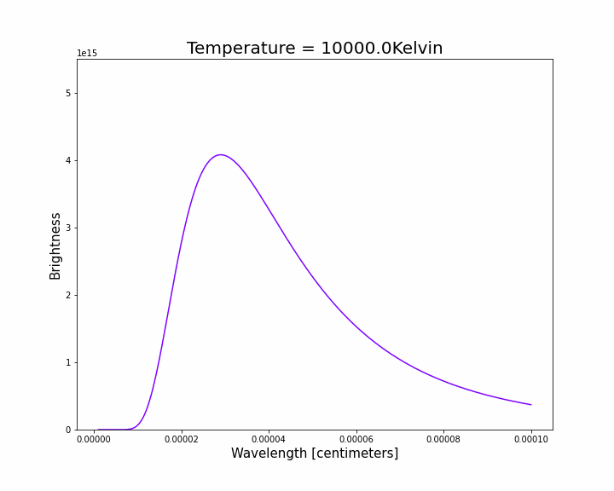
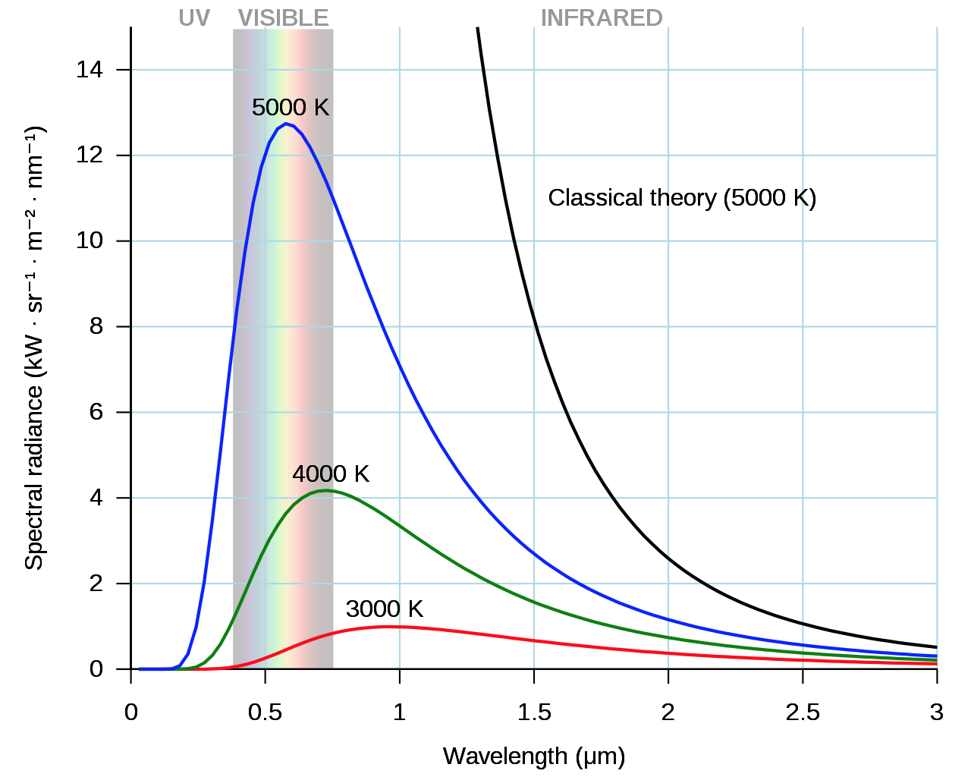
Temperature of Black-bodies (Stars) → Color!
“Wien’s Law”

Slide 8
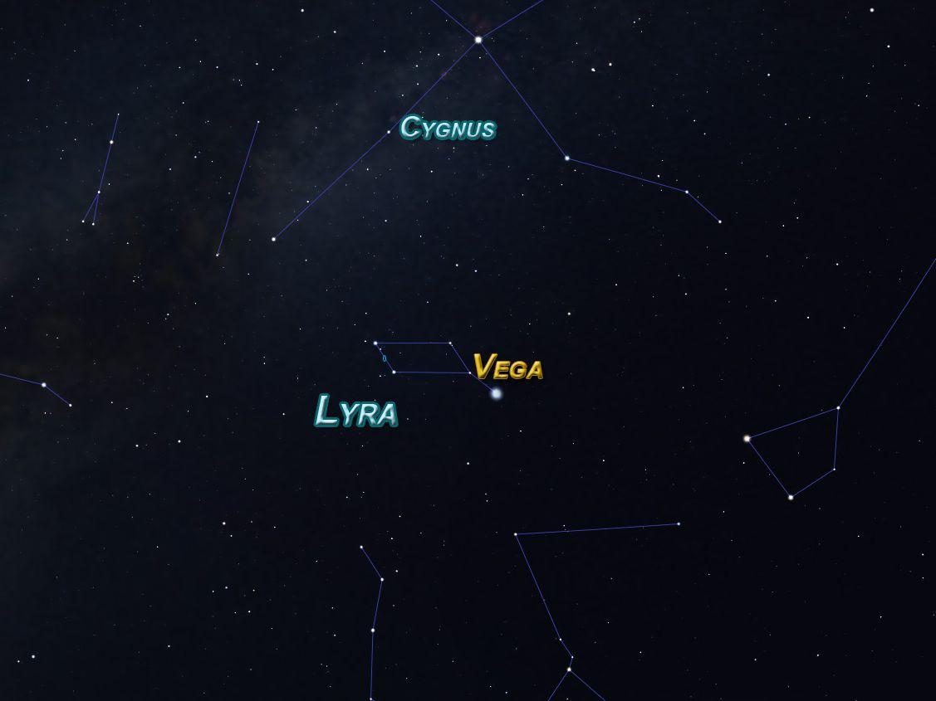
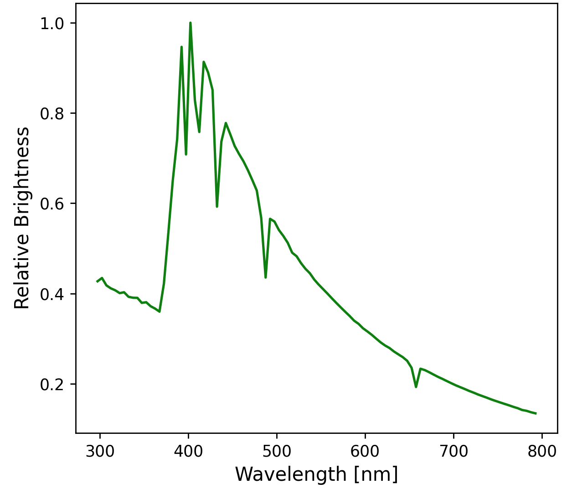
Some Real Data….
Notes:
Real data from spectra of vega, to be used with breakout room activity

Slide 9
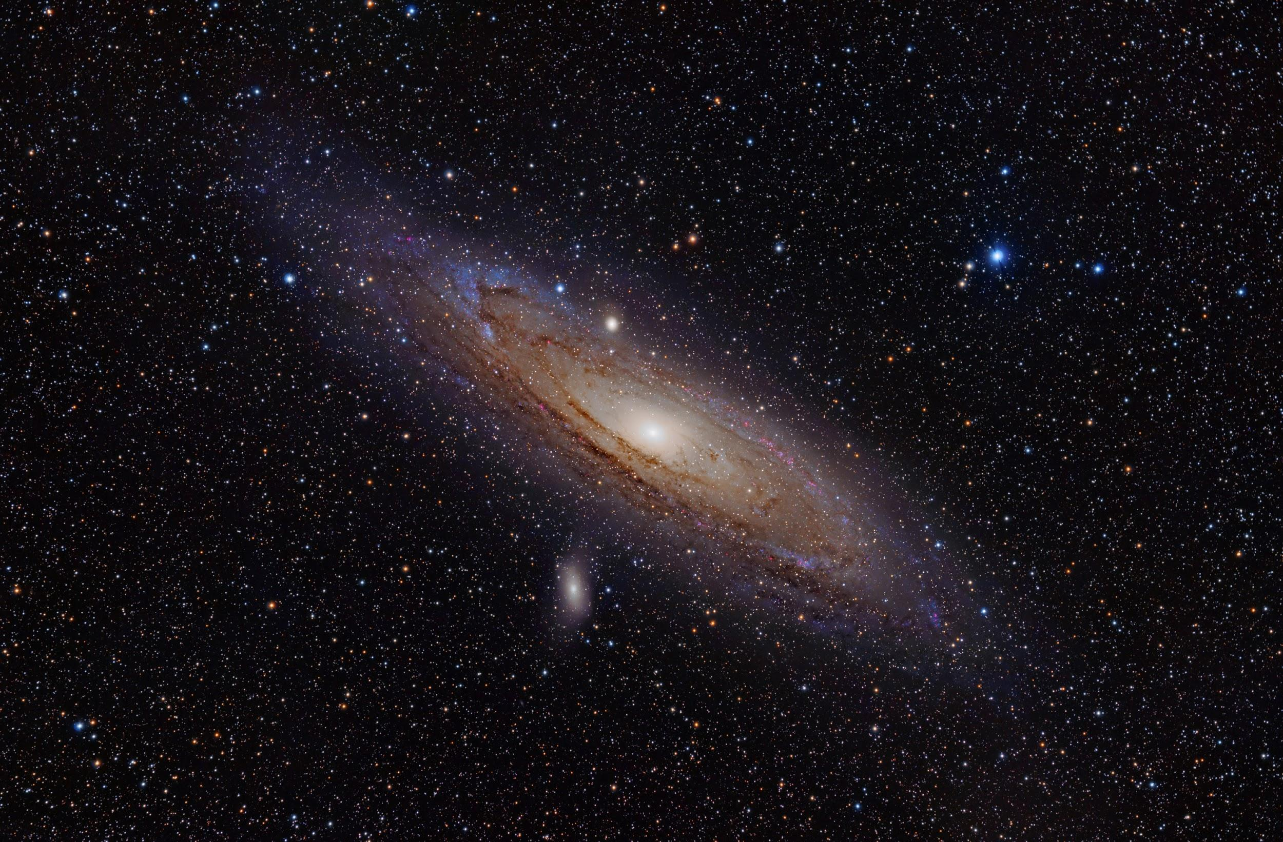
weekly survey!
Thanks everyone!
tinyurl.com/pilawaForm

