Slide 1
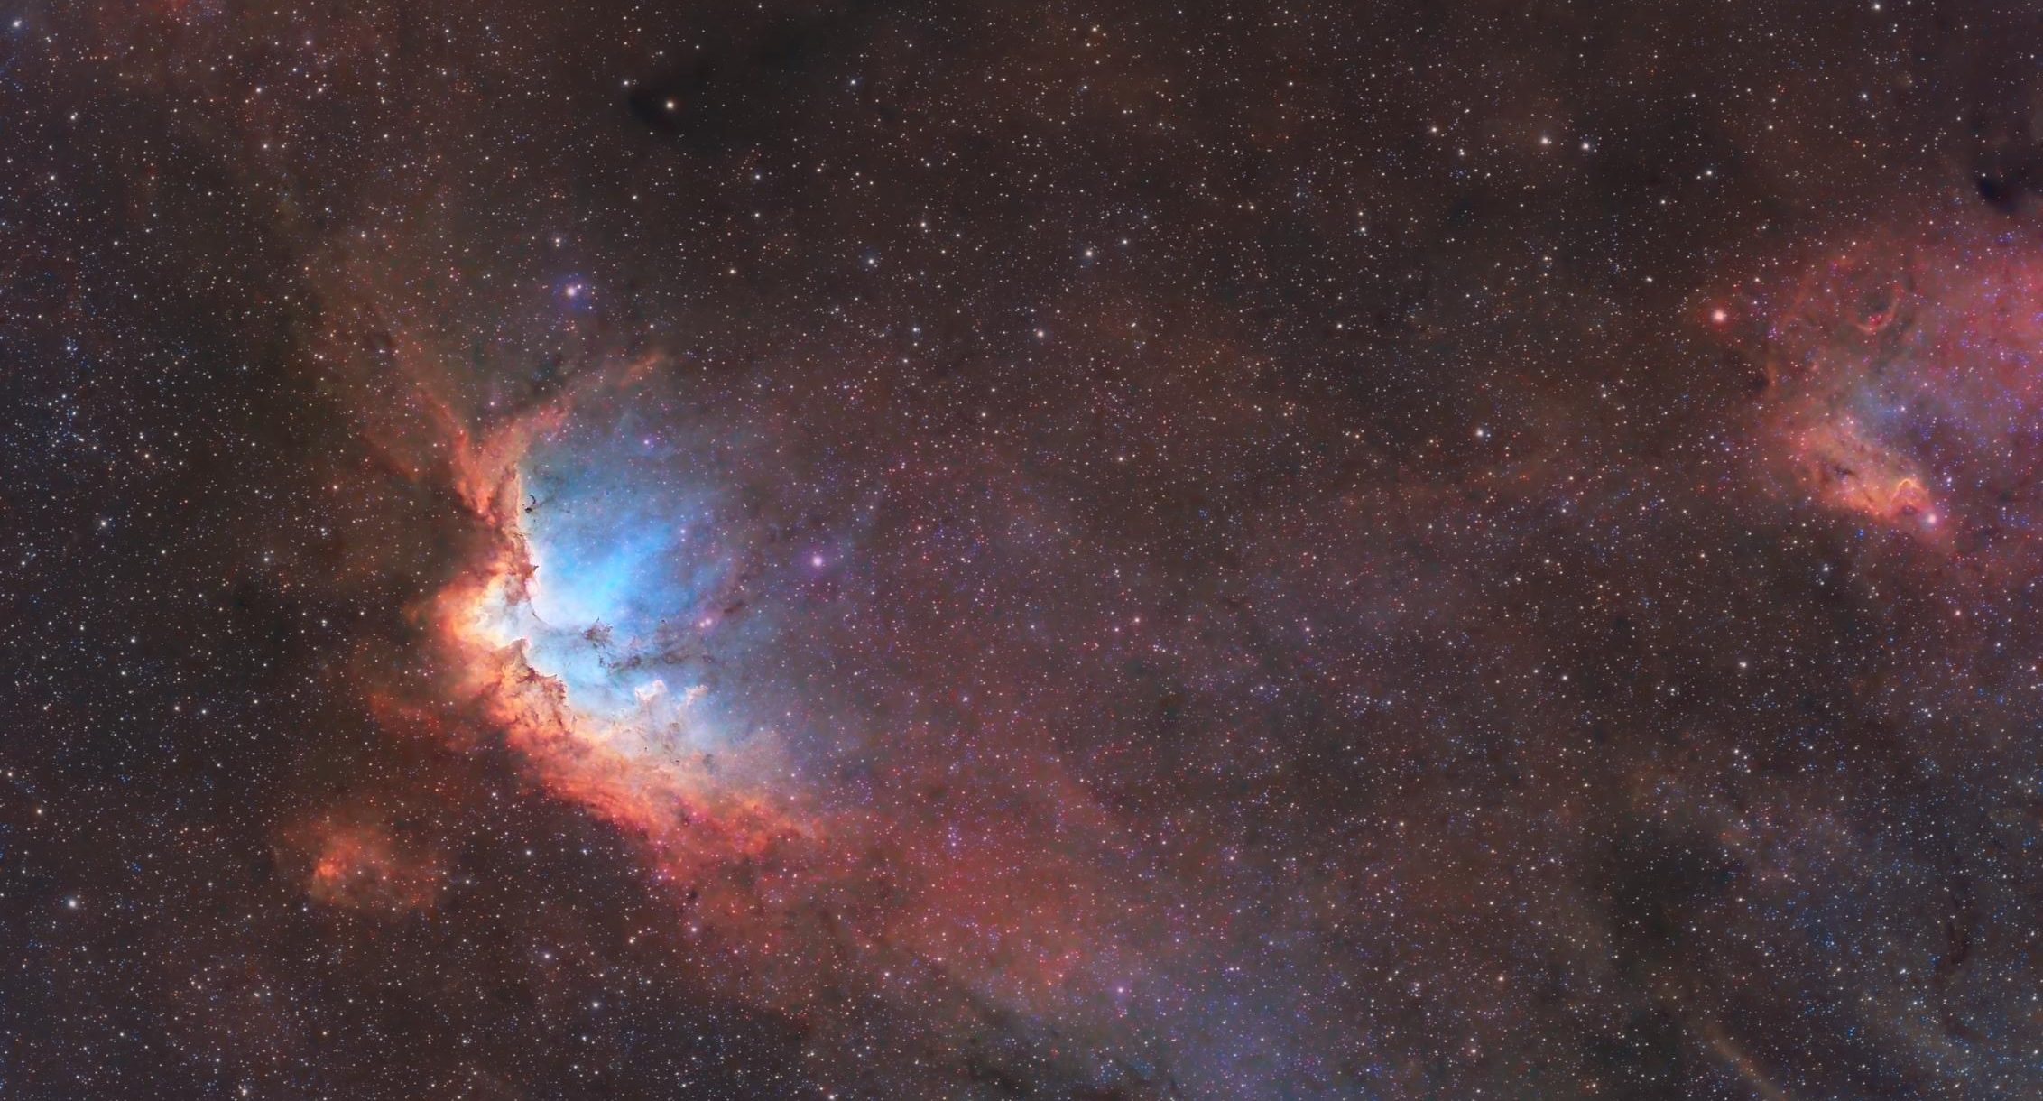
week 4
good morning everyone!
we’ll get rolling at 10 after!

Slide 2
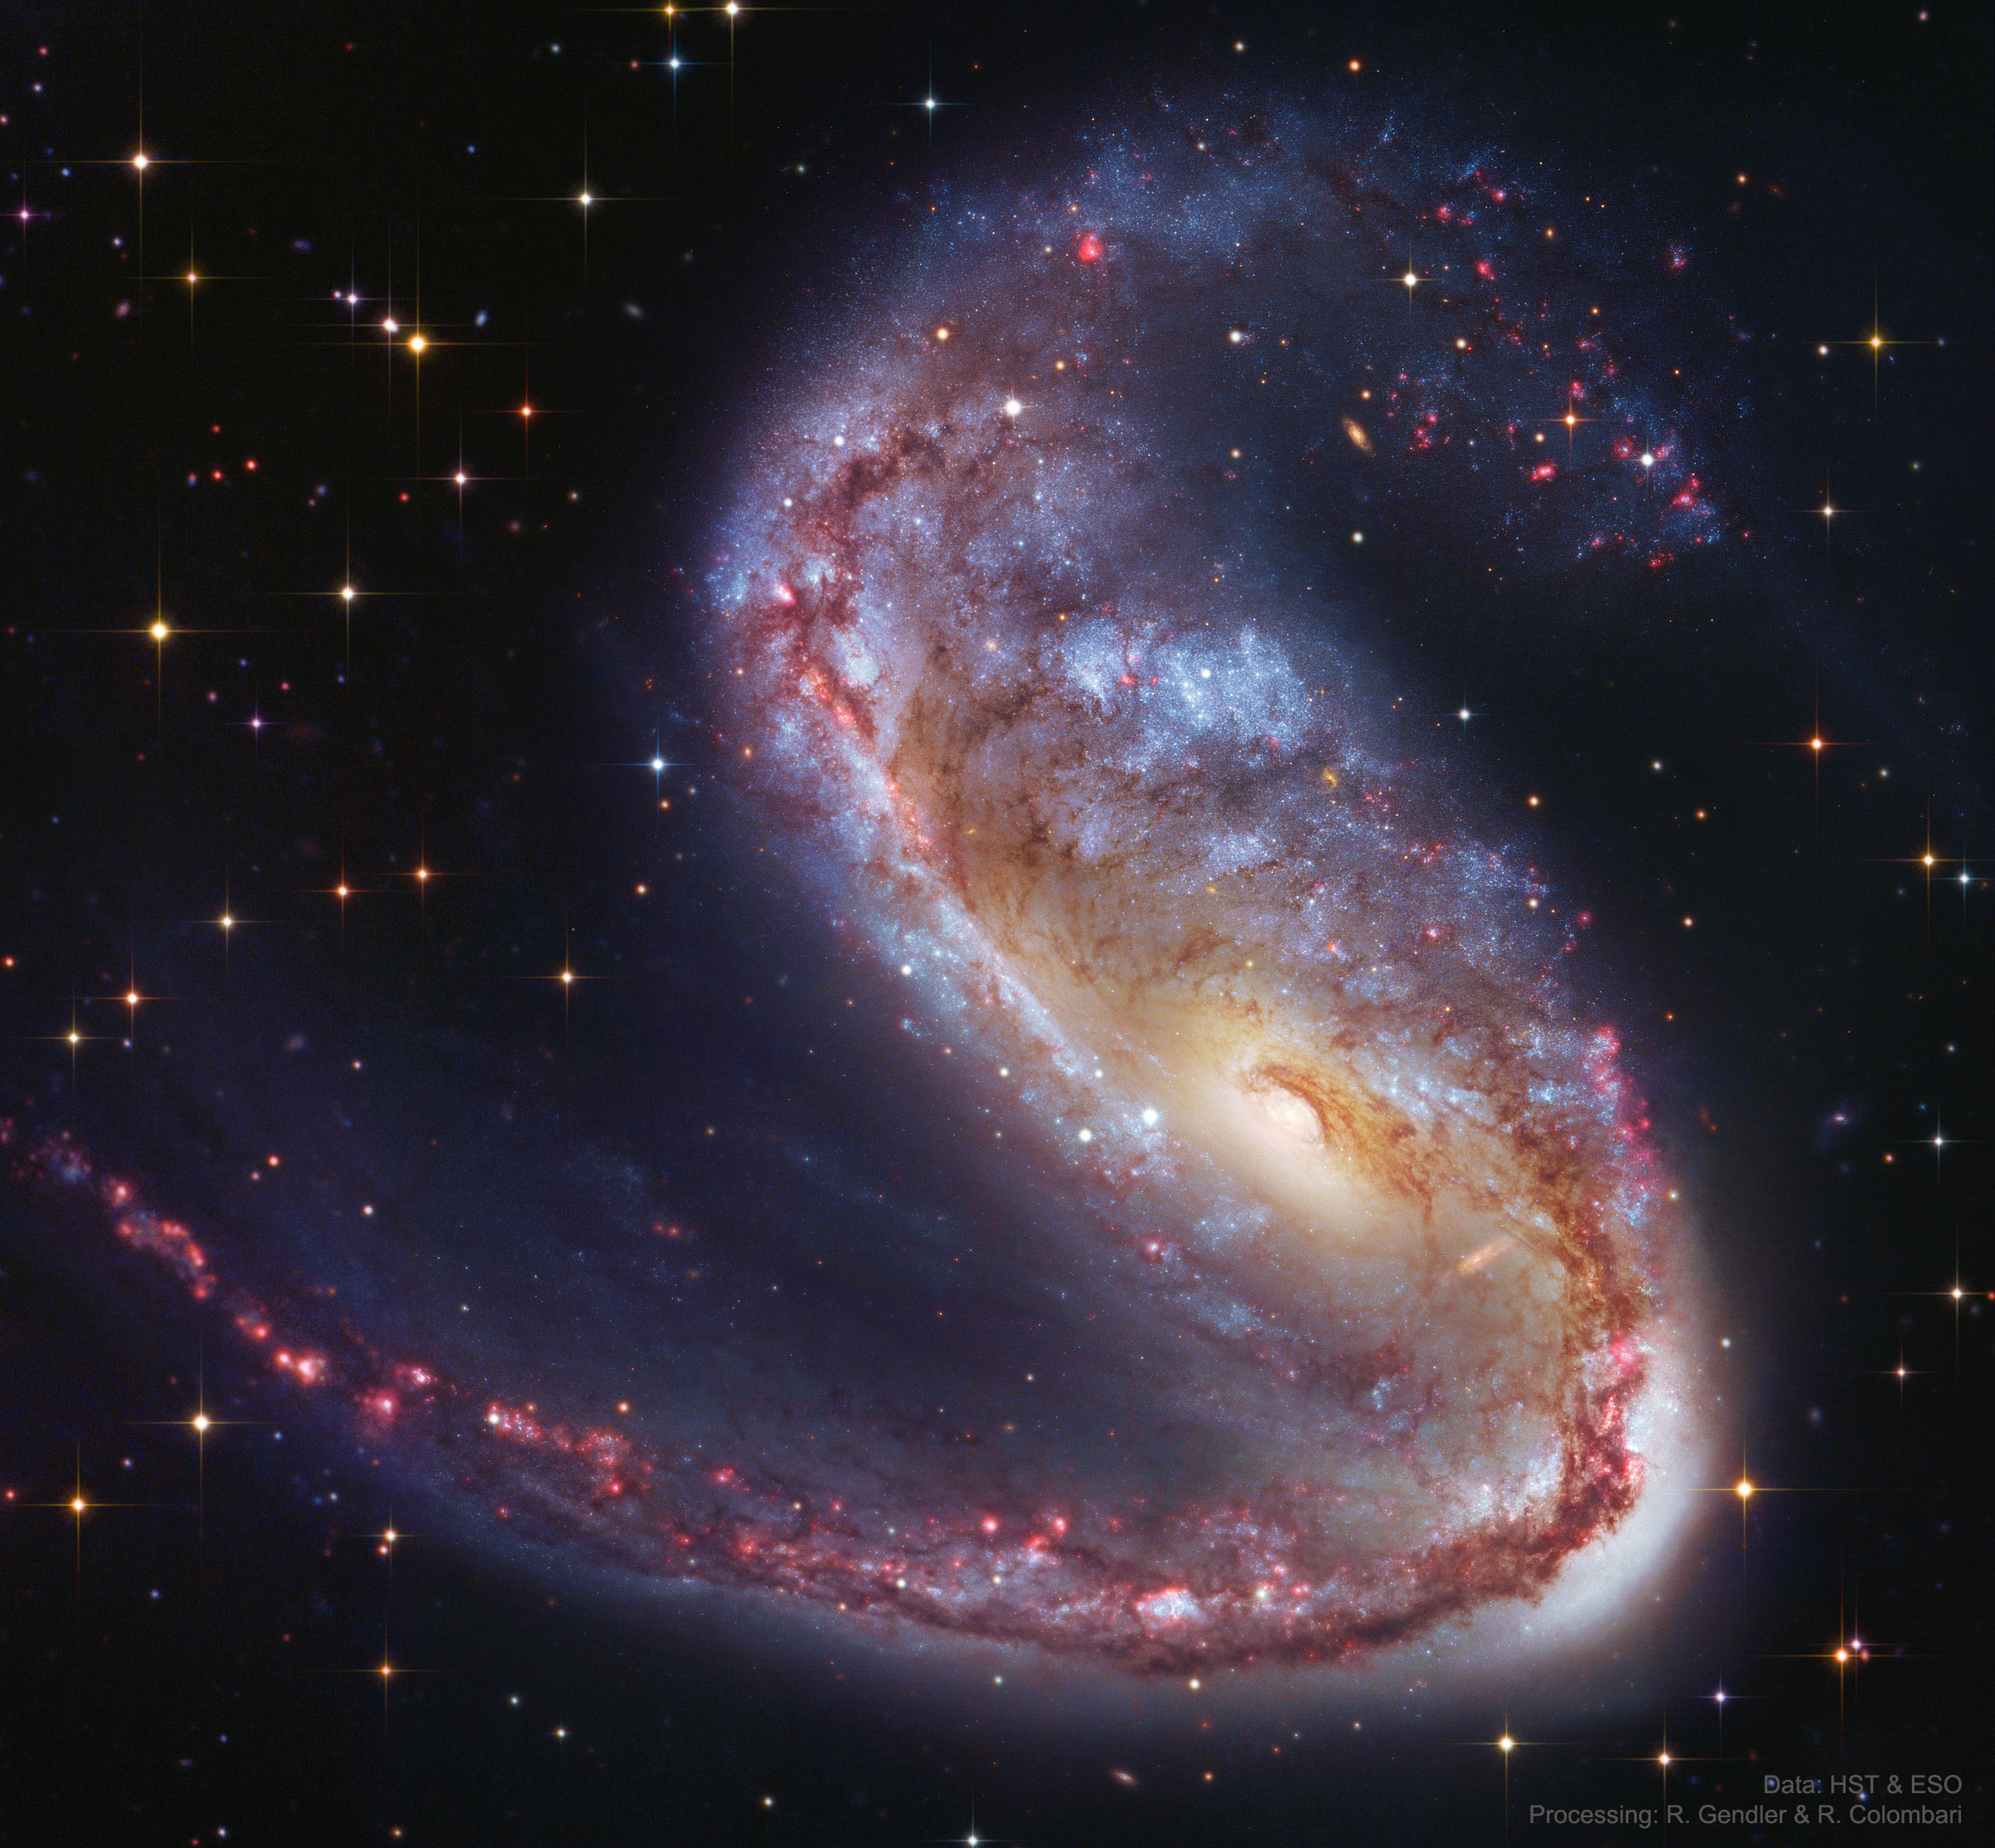
NGC 2442
“The Meathook Galaxy”
75,000 ly
50 Million ly away, in the constellation Volans (the flying fish)
Look familiar?
Before we zoom in, how big is it?

Slide 3
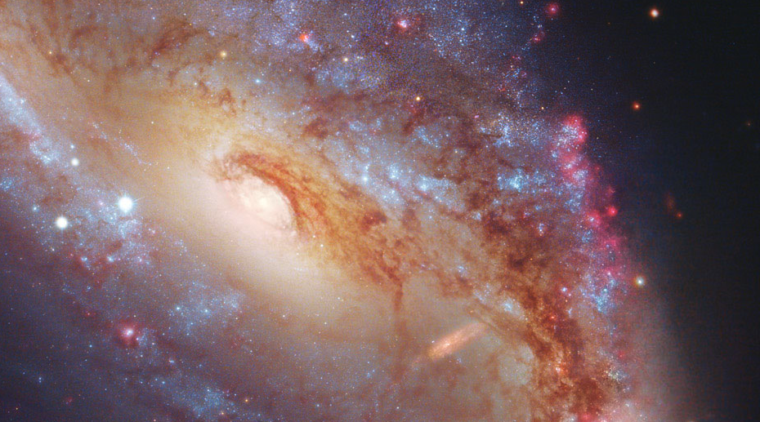
Red = Star Forming Regions
Emission spectra
Red because hydrogen
What do you see?
Yellow Core = Old, cooler stars
Blue = Young, hot stars
Stars give absorption spectra
Wien’s Law tells us they’re blue because they’re hot!
Dust Lanes
Glow in the infrared since they are cooler

Slide 4
Feedback from Google Form!
~also~ please do feel free to roast me in the google form
Almost all of the questions were specific topics or logistics of the quiz! That’s what today is for.
Some really quick information:
Quiz will be 20 minutes. 3 questions. Free response including math.
Calculators are not allowed! All the math can be done with ratios.
You will be give all the necessary equations, so no need to memorize any numbers or equations -- just how to use them!
There were then lots of questions on specific topics. That’s for today!
Lots of fun questions, too, but I want to stay on top of things this week to get as much review in as possible.
People seem overall happy with the structure!

Slide 5
any questions?
🤔
🧐
Notes:
General questions before activity

Slide 6
break out rooms!
😎
Notes:
General questions before activity

Slide 7
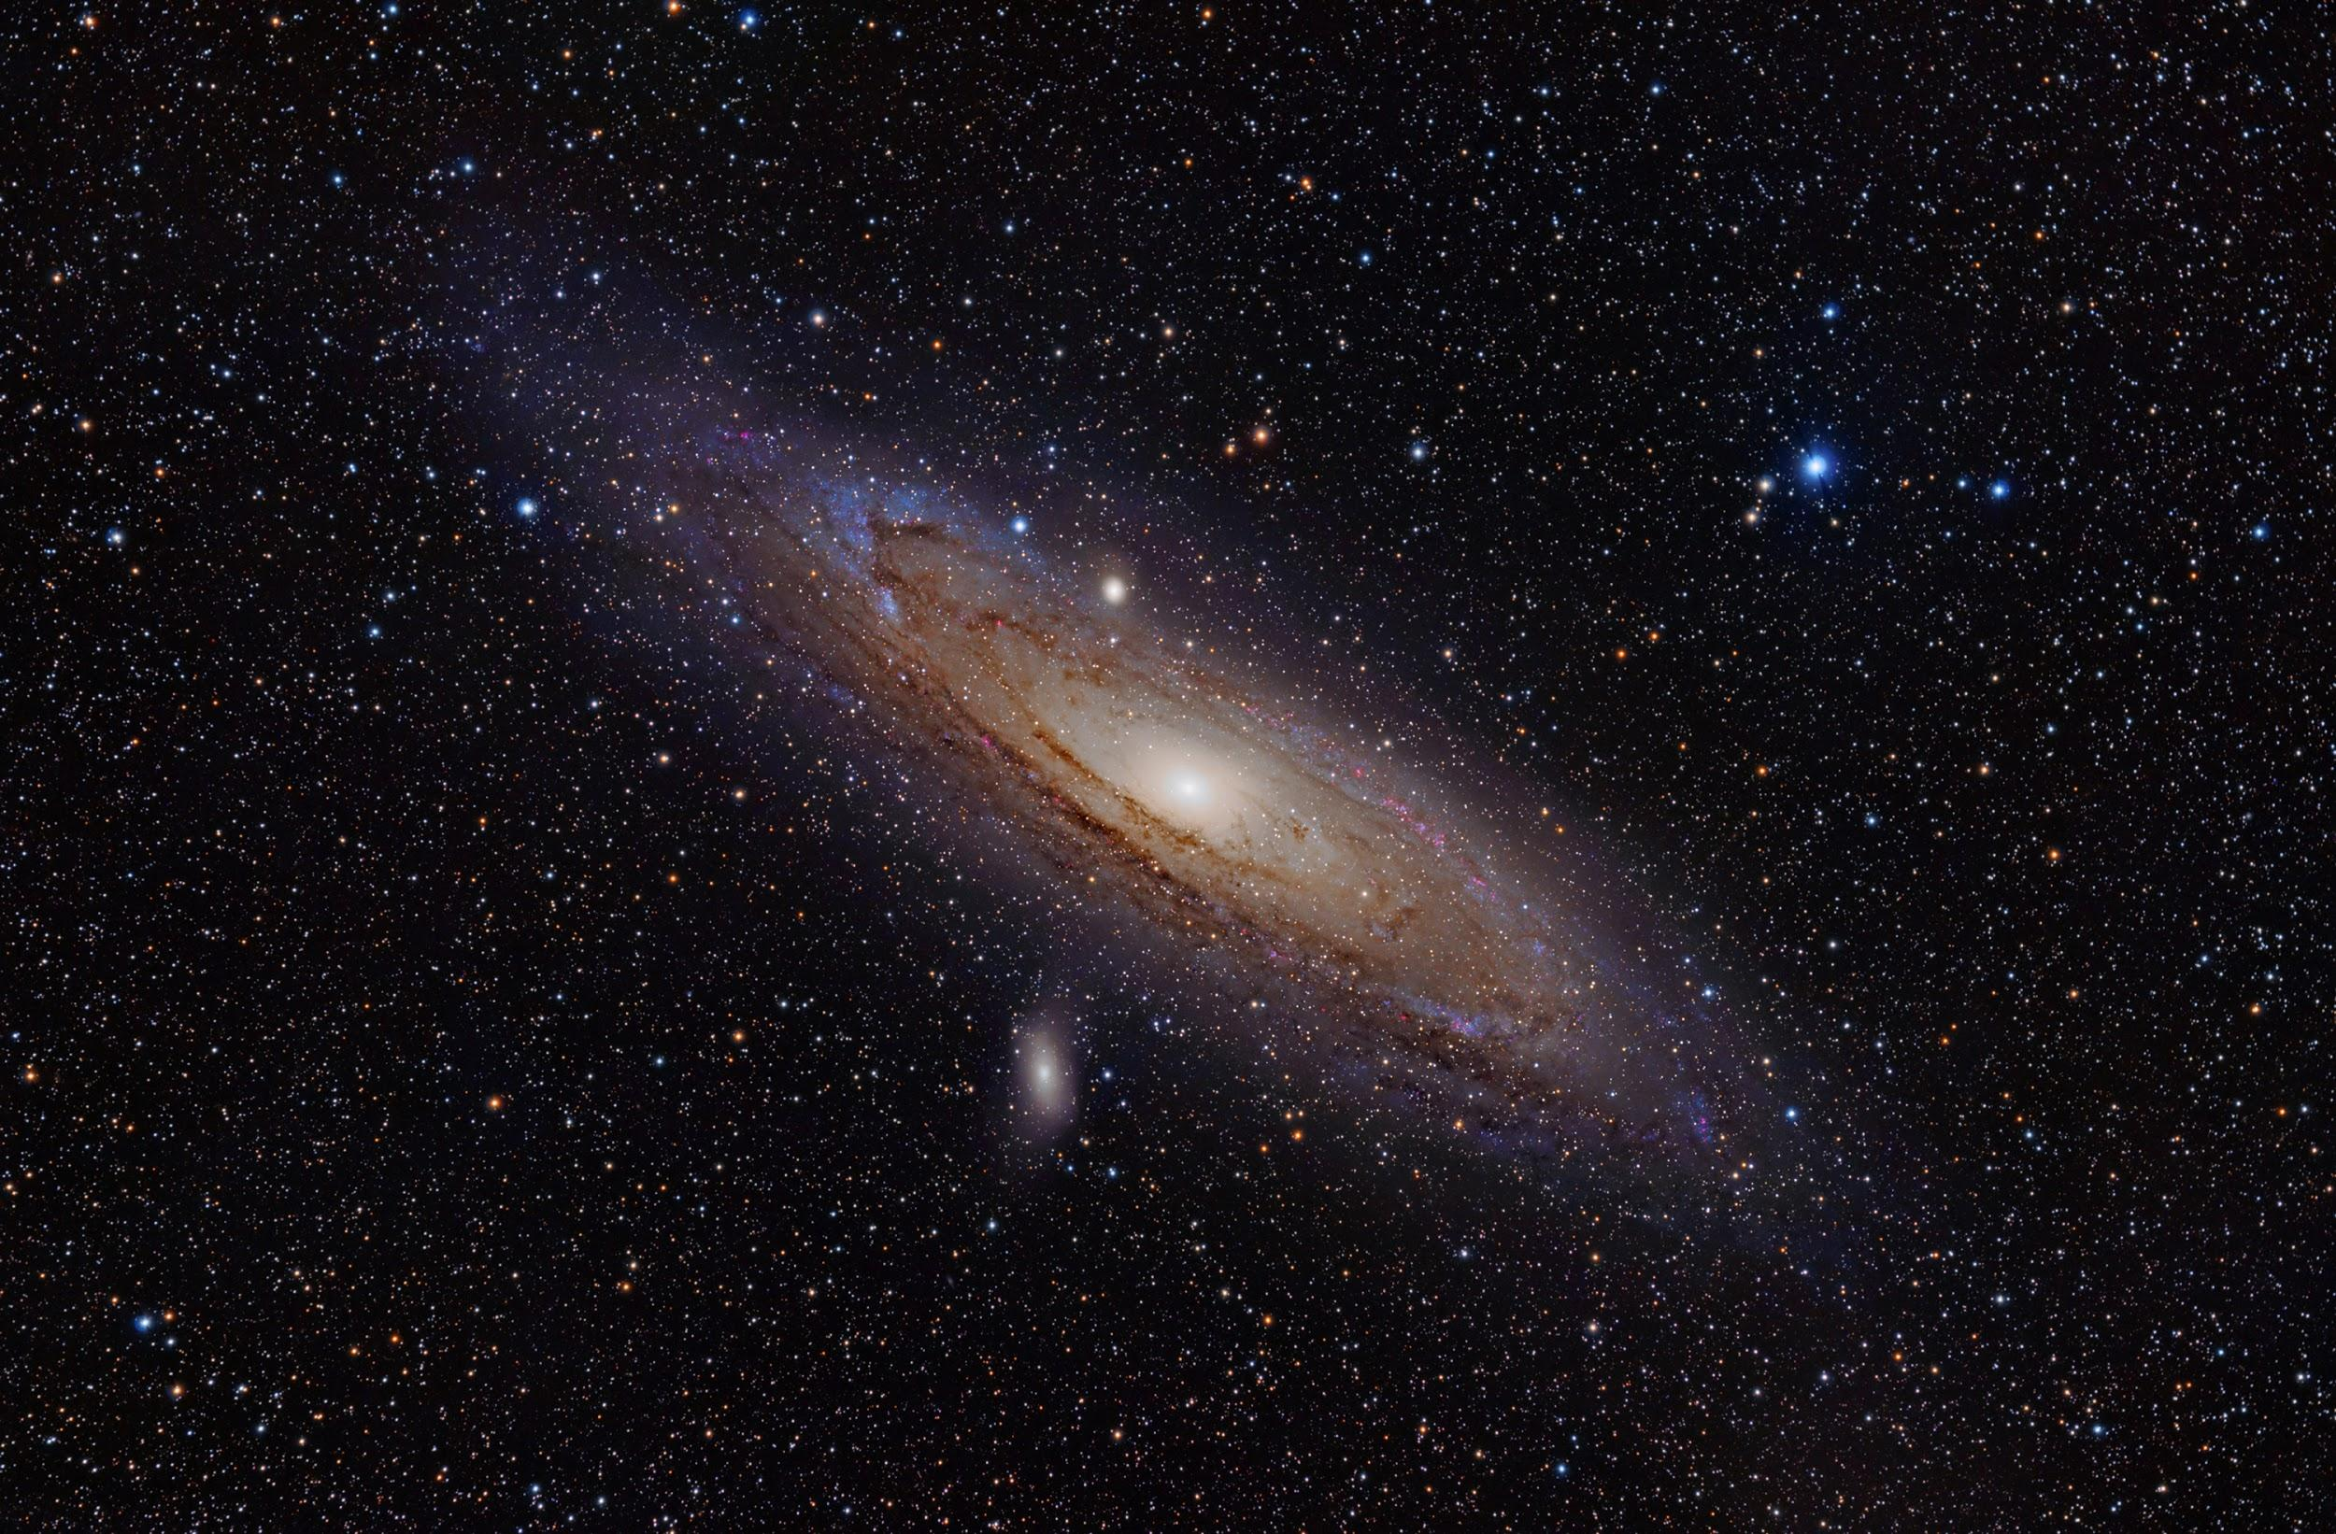
weekly survey!
Thanks everyone!
tinyurl.com/pilawaForm

