Slide 1
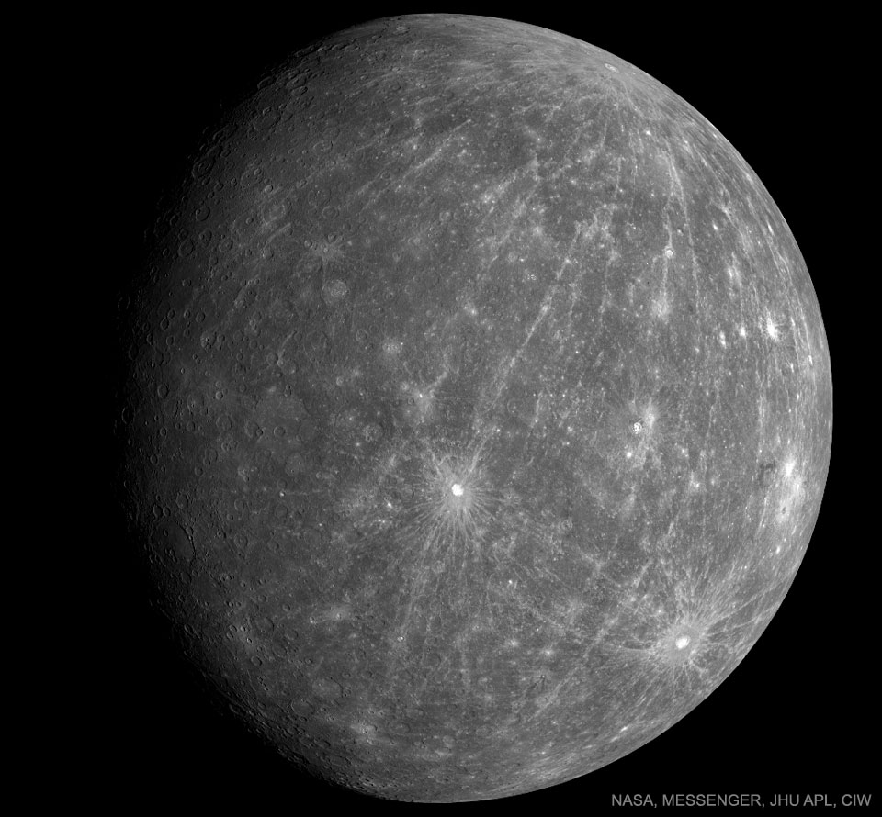
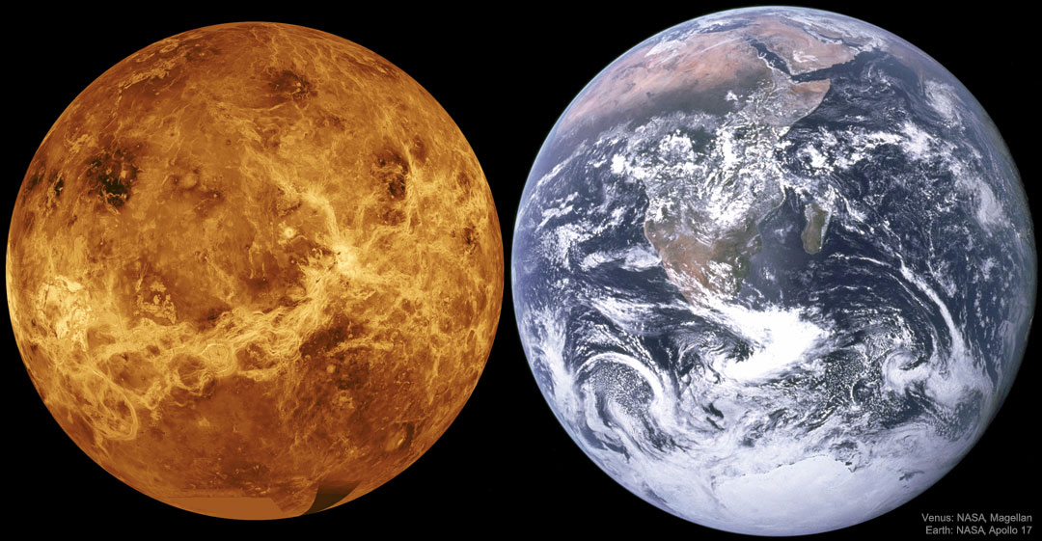
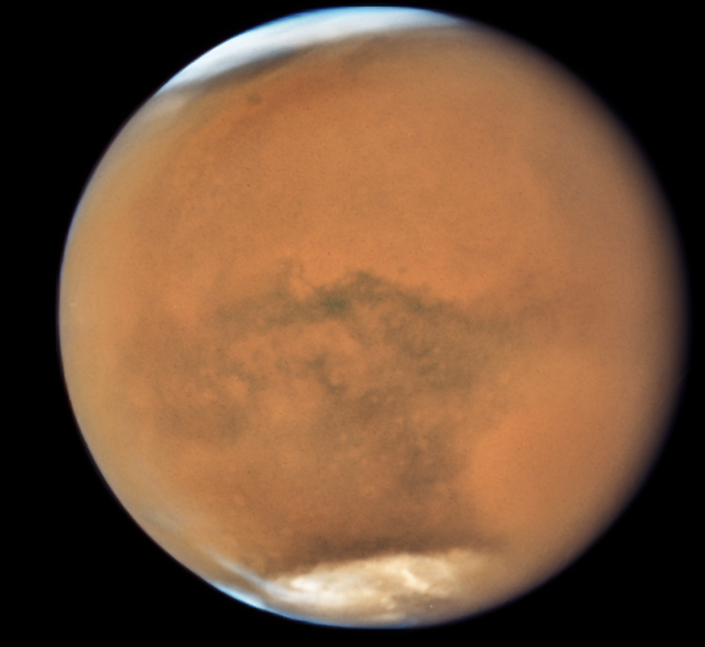
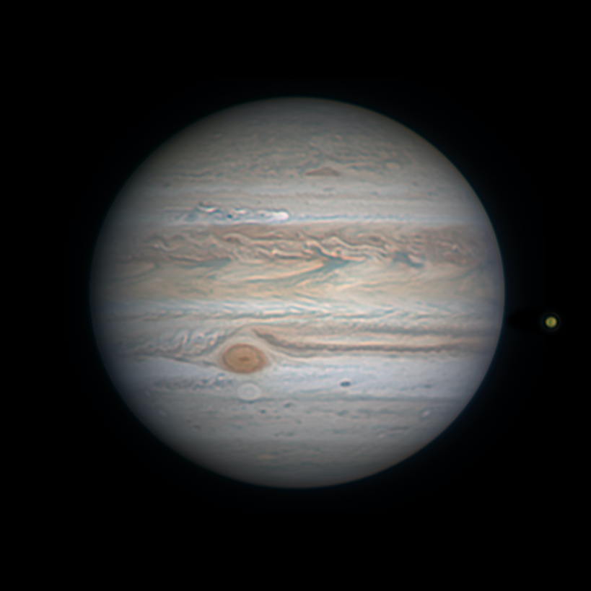
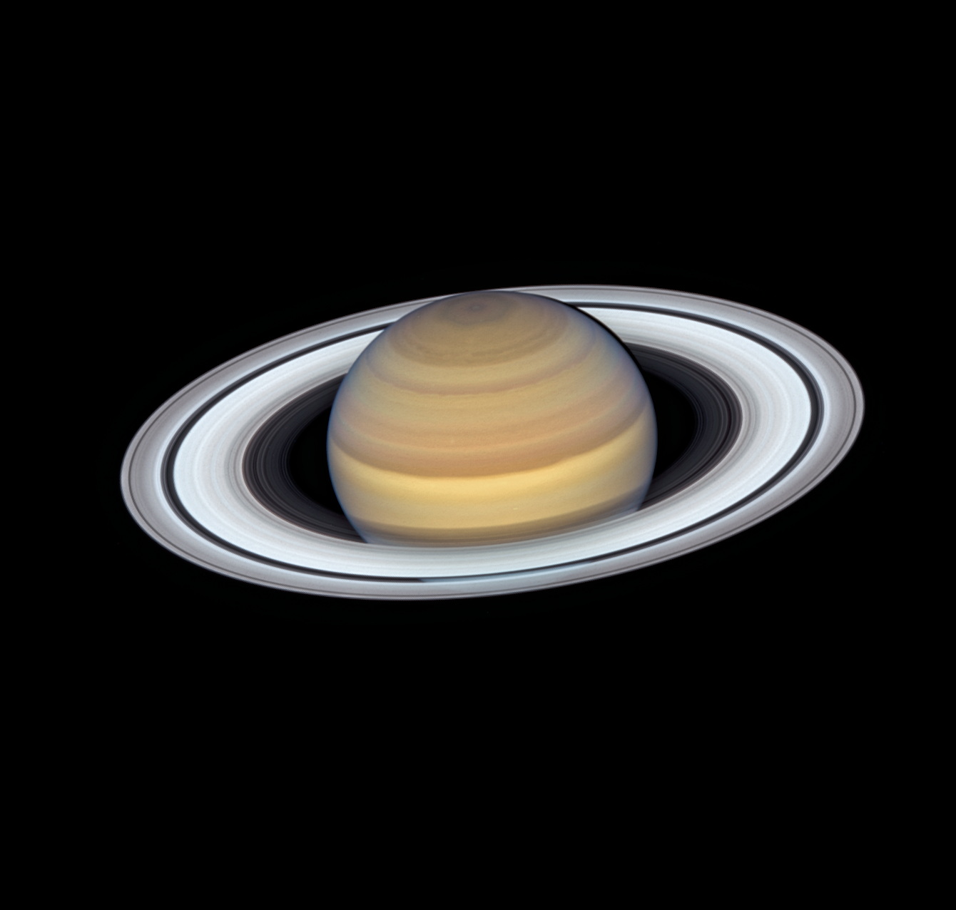
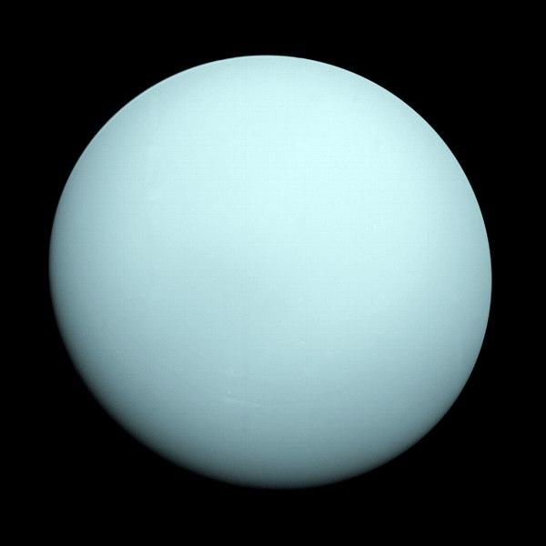
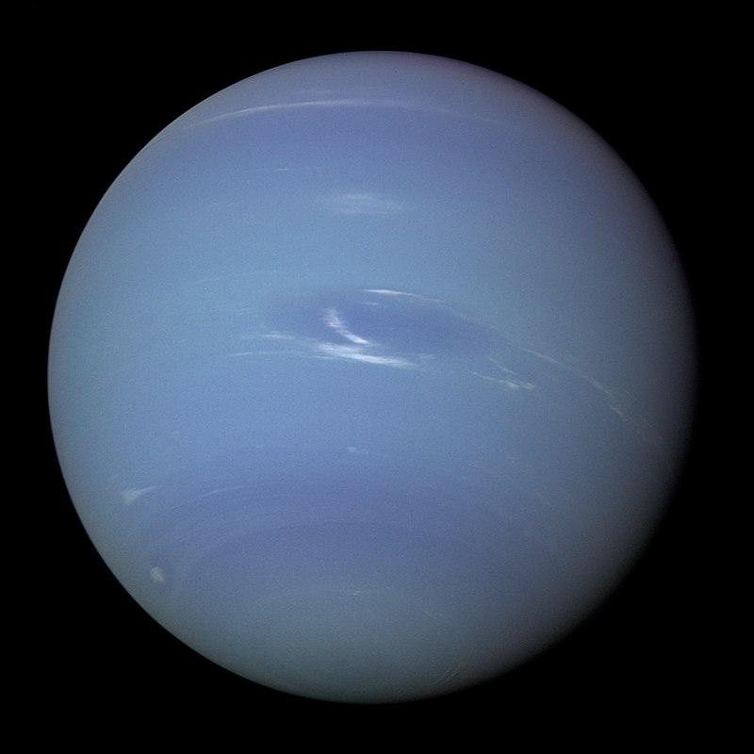
week 6

Slide 2
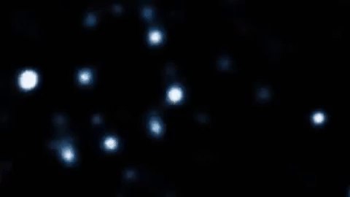
Sagittarius A*
What are we looking at?
Black Hole Mass: 4,100,000x the mass of the Sun Period of Orbit: 16.0518 years
Semi-major Axis: 970 au

Slide 3
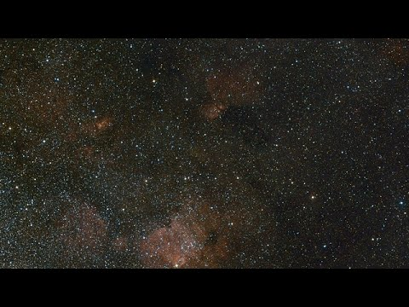
Zoom In...

Slide 4
Another Shot

Slide 5
Any questions before we begin?

Slide 6
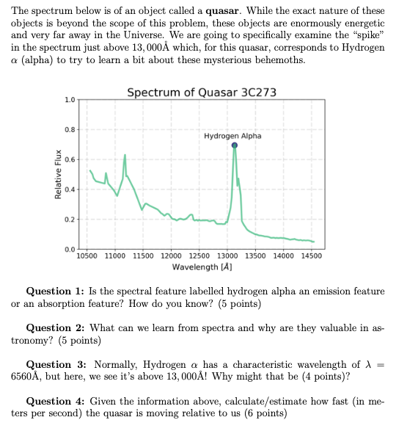
Let’s do the quiz!
Q1: Emission feature! Mention of spike-like shape, higher flux relative to adjacent wavelengths, contrast with absorption, etc.
Q2: Temperature, composition, motion, luminosity, radius, metallicity, lots of options.
Q3: If the observed wavelength is longer, we say it is redshifted. This is a characteristic of objects moving away from us, so the quasar must be moving away!
Q4: Normally: ~6500Å which is λ, observed at ~13,000Å which is λ₀. Plugging into Doppler equation, we get v = 3*10⁸ m/s,

Slide 7
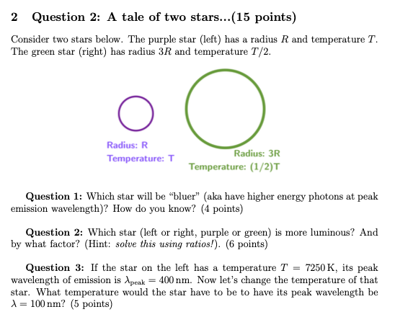
Question 2
Q1: The star with the higher temperature will be bluer, so the star on the left must be bluer. We know this from Wien’s Law.
Q2: We know that L = 4πR²σT⁴. We can use ratios to find that L₁/L₂ = (⅓)²(2)⁴ = 16/9. The left star is more luminous.
Q3: From Wien’s Law, we have λ_{peak}T = (constant). Using ratios, we know that a factor of 4 decrease in peak wavelength requires a factor of 4 increase in temperature, giving us T = 4*7250K = 28,000K.

Slide 8
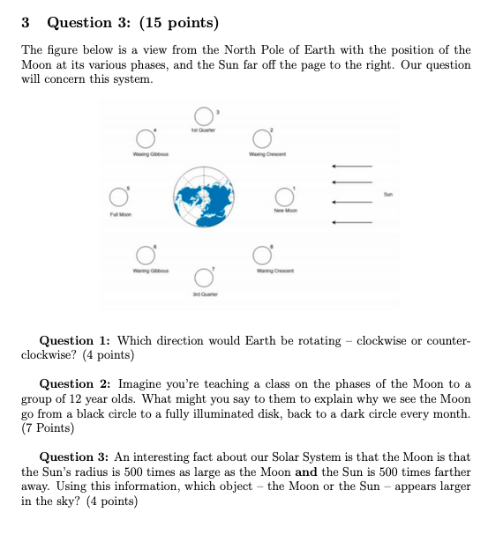
Question 3
Q1: The Earth must be moving counterclockwise. We can see this either from the Sun rising in the East and setting in the West, the Moon doing the same thing, or any other reasonable explanation (such as phases of the Moon).
Q2: The Moon completes an orbit around the Earth about once a Month. Sometimes, the Moon is between us and the Sun and so the Sun shines only on the Moon’s back. Other times, the Earth is between the Moon and the Sun so we see the illuminated face. The Moon isn’t exactly in line with the Earth or the Sun, otherwise the Moon would hide in the Earth’s shadow sometimes!
Q3: We learned in class that a consequence of being the same factor farther and larger is that the Sun and the Moon are the same apparent size. This coincidence leads to what we know as “eclipses” of the Moon and the Sun!

Slide 9
Any questions on the quiz? I’ll grade them as soon as I can!
✨
🤔

Slide 10
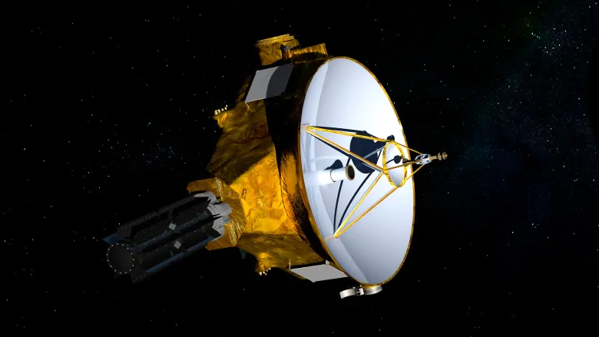
A quick detour to the outer Solar System….
New Horizons (2015) [Note: Pluto demoted in 2006 to ``dwarf planet’’ status.]

Slide 11
So let’s see what a hypothetical Planet Nine would look like!

Slide 12
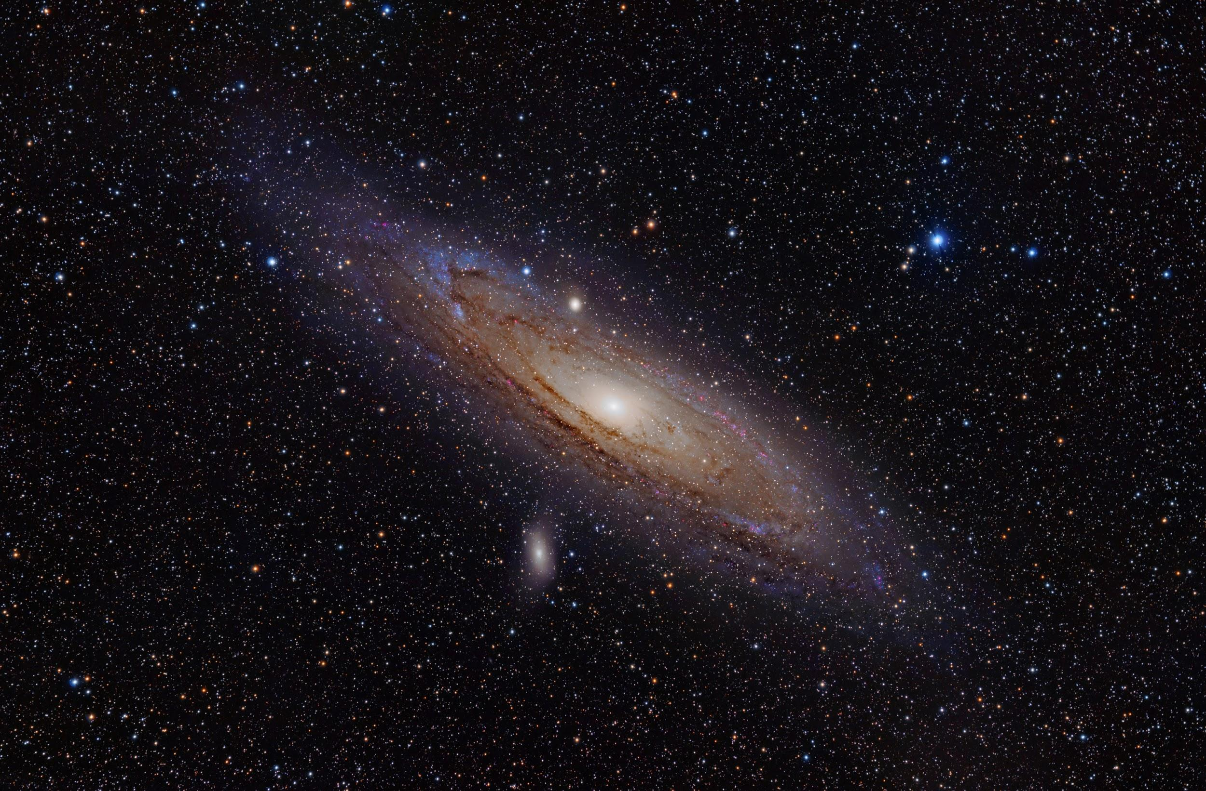
weekly survey!
Thanks everyone!
tinyurl.com/pilawaForm

