Slide 1
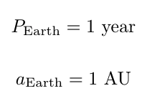
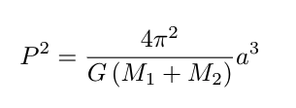
Some helpful numbers and formulae

Slide 2
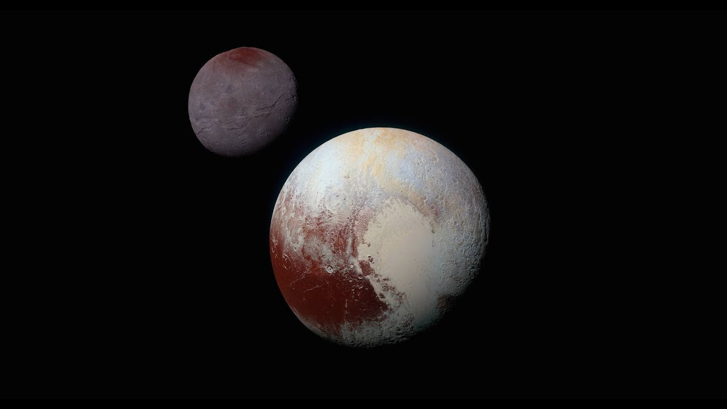
Group 1
Pluto and its moon, Charon, taken by New Horizons in 2015
There is some evidence from distant Solar System objects of a large massive body very far from the Sun, often referred to as “Planet Nine.” Astronomers predict that, if this body were to exist, Planet Nine would be on a moderately elliptical orbit; additionally, it would be 4 times more massive than the Earth. Astronomers also predict a semi-major axis of 600 AU and a semi-minor axis of 500 AU.
What would the period of Planet Nine’s orbit be?
Let’s imagine replacing the Sun with a black hole of the same mass as the sun. How does this change the orbit of Planet Nine?
Now imagine that Planet Nine were 4 times more massive than the Sun. Using Newton’s version of Kepler’s Law, calculate the new period of Planet Nine assuming the semi-major and semi-minor axes.

Slide 3
Group 2
Pluto and its moon, Charon, taken by New Horizons in 2015
There is some evidence from distant Solar System objects of a large massive body very far from the Sun, often referred to as “Planet Nine.” Astronomers predict that, if this body were to exist, Planet Nine would be on a moderately elliptical orbit; additionally, it would be 4 times more massive than the Earth. Astronomers also predict a semi-major axis of 600 AU and a semi-minor axis of 500 AU.
What would the period of Planet Nine’s orbit be?
Let’s imagine replacing the Sun with a black hole of the same mass as the sun. How does this change the orbit of Planet Nine?
Now imagine that Planet Nine were 4 times more massive than the Sun. Using Newton’s version of Kepler’s Law, calculate the new period of Planet Nine assuming the semi-major and semi-minor axes.

Slide 4
Group 3
Pluto and its moon, Charon, taken by New Horizons in 2015
There is some evidence from distant Solar System objects of a large massive body very far from the Sun, often referred to as “Planet Nine.” Astronomers predict that, if this body were to exist, Planet Nine would be on a moderately elliptical orbit; additionally, it would be 4 times more massive than the Earth. Astronomers also predict a semi-major axis of 600 AU and a semi-minor axis of 500 AU.
What would the period of Planet Nine’s orbit be?
Let’s imagine replacing the Sun with a black hole of the same mass as the sun. How does this change the orbit of Planet Nine?
Now imagine that Planet Nine were 4 times more massive than the Sun. Using Newton’s version of Kepler’s Law, calculate the new period of Planet Nine assuming the semi-major and semi-minor axes.

Slide 5
Group 4
Pluto and its moon, Charon, taken by New Horizons in 2015
There is some evidence from distant Solar System objects of a large massive body very far from the Sun, often referred to as “Planet Nine.” Astronomers predict that, if this body were to exist, Planet Nine would be on a moderately elliptical orbit; additionally, it would be 4 times more massive than the Earth. Astronomers also predict a semi-major axis of 600 AU and a semi-minor axis of 500 AU.
What would the period of Planet Nine’s orbit be?
Let’s imagine replacing the Sun with a black hole of the same mass as the sun. How does this change the orbit of Planet Nine?
Now imagine that Planet Nine were 4 times more massive than the Sun. Using Newton’s version of Kepler’s Law, calculate the new period of Planet Nine assuming the semi-major and semi-minor axes.

Slide 6
Group 5
Pluto and its moon, Charon, taken by New Horizons in 2015
There is some evidence from distant Solar System objects of a large massive body very far from the Sun, often referred to as “Planet Nine.” Astronomers predict that, if this body were to exist, Planet Nine would be on a moderately elliptical orbit; additionally, it would be 4 times more massive than the Earth. Astronomers also predict a semi-major axis of 600 AU and a semi-minor axis of 500 AU.
What would the period of Planet Nine’s orbit be?
Let’s imagine replacing the Sun with a black hole of the same mass as the sun. How does this change the orbit of Planet Nine?
Now imagine that Planet Nine were 4 times more massive than the Sun. Using Newton’s version of Kepler’s Law, calculate the new period of Planet Nine assuming the semi-major and semi-minor axes.

Slide 7
Group 6
Pluto and its moon, Charon, taken by New Horizons in 2015
There is some evidence from distant Solar System objects of a large massive body very far from the Sun, often referred to as “Planet Nine.” Astronomers predict that, if this body were to exist, Planet Nine would be on a moderately elliptical orbit; additionally, it would be 4 times more massive than the Earth. Astronomers also predict a semi-major axis of 600 AU and a semi-minor axis of 500 AU.
What would the period of Planet Nine’s orbit be?
Let’s imagine replacing the Sun with a black hole of the same mass as the sun. How does this change the orbit of Planet Nine?
Now imagine that Planet Nine were 4 times more massive than the Sun. Using Newton’s version of Kepler’s Law, calculate the new period of Planet Nine assuming the semi-major and semi-minor axes.

Slide 8
Group 1
Pluto and its moon, Charon, taken by New Horizons in 2015
There is some evidence from distant Solar System objects of a large massive body very far from the Sun, often referred to as “Planet Nine.” Astronomers predict that, if this body were to exist, Planet Nine would be on a moderately elliptical orbit; additionally, it would be 4 times more massive than the Earth. Astronomers also predict a semi-major axis of 600 AU and a semi-minor axis of 500 AU.
What would the period of Planet Nine’s orbit be?
Let’s imagine replacing the Sun with a black hole of the same mass as the sun. How does this change the orbit of Planet Nine?
Now imagine that Planet Nine were 4 times more massive than the Sun. Using Newton’s version of Kepler’s Law, calculate the new period of Planet Nine assuming the semi-major and semi-minor axes.

Slide 9
Group 2
Pluto and its moon, Charon, taken by New Horizons in 2015
There is some evidence from distant Solar System objects of a large massive body very far from the Sun, often referred to as “Planet Nine.” Astronomers predict that, if this body were to exist, Planet Nine would be on a moderately elliptical orbit; additionally, it would be 4 times more massive than the Earth. Astronomers also predict a semi-major axis of 600 AU and a semi-minor axis of 500 AU.
What would the period of Planet Nine’s orbit be?
Let’s imagine replacing the Sun with a black hole of the same mass as the sun. How does this change the orbit of Planet Nine?
Now imagine that Planet Nine were 4 times more massive than the Sun. Using Newton’s version of Kepler’s Law, calculate the new period of Planet Nine assuming the semi-major and semi-minor axes.

Slide 10
Group 3
Pluto and its moon, Charon, taken by New Horizons in 2015
There is some evidence from distant Solar System objects of a large massive body very far from the Sun, often referred to as “Planet Nine.” Astronomers predict that, if this body were to exist, Planet Nine would be on a moderately elliptical orbit; additionally, it would be 4 times more massive than the Earth. Astronomers also predict a semi-major axis of 600 AU and a semi-minor axis of 500 AU.
What would the period of Planet Nine’s orbit be?
Let’s imagine replacing the Sun with a black hole of the same mass as the sun. How does this change the orbit of Planet Nine?
Now imagine that Planet Nine were 4 times more massive than the Sun. Using Newton’s version of Kepler’s Law, calculate the new period of Planet Nine assuming the semi-major and semi-minor axes.

Slide 11
Group 4
Pluto and its moon, Charon, taken by New Horizons in 2015
There is some evidence from distant Solar System objects of a large massive body very far from the Sun, often referred to as “Planet Nine.” Astronomers predict that, if this body were to exist, Planet Nine would be on a moderately elliptical orbit; additionally, it would be 4 times more massive than the Earth. Astronomers also predict a semi-major axis of 600 AU and a semi-minor axis of 500 AU.
What would the period of Planet Nine’s orbit be?
Let’s imagine replacing the Sun with a black hole of the same mass as the sun. How does this change the orbit of Planet Nine?
Now imagine that Planet Nine were 4 times more massive than the Sun. Using Newton’s version of Kepler’s Law, calculate the new period of Planet Nine assuming the semi-major and semi-minor axes.

Slide 12
Group 5
Pluto and its moon, Charon, taken by New Horizons in 2015
There is some evidence from distant Solar System objects of a large massive body very far from the Sun, often referred to as “Planet Nine.” Astronomers predict that, if this body were to exist, Planet Nine would be on a moderately elliptical orbit; additionally, it would be 4 times more massive than the Earth. Astronomers also predict a semi-major axis of 600 AU and a semi-minor axis of 500 AU.
What would the period of Planet Nine’s orbit be?
Let’s imagine replacing the Sun with a black hole of the same mass as the sun. How does this change the orbit of Planet Nine?
Now imagine that Planet Nine were 4 times more massive than the Sun. Using Newton’s version of Kepler’s Law, calculate the new period of Planet Nine assuming the semi-major and semi-minor axes.

Slide 13
Group 6
Pluto and its moon, Charon, taken by New Horizons in 2015
There is some evidence from distant Solar System objects of a large massive body very far from the Sun, often referred to as “Planet Nine.” Astronomers predict that, if this body were to exist, Planet Nine would be on a moderately elliptical orbit; additionally, it would be 4 times more massive than the Earth. Astronomers also predict a semi-major axis of 600 AU and a semi-minor axis of 500 AU.
What would the period of Planet Nine’s orbit be?
Let’s imagine replacing the Sun with a black hole of the same mass as the sun. How does this change the orbit of Planet Nine?
Now imagine that Planet Nine were 4 times more massive than the Sun. Using Newton’s version of Kepler’s Law, calculate the new period of Planet Nine assuming the semi-major and semi-minor axes.

