Slide 1
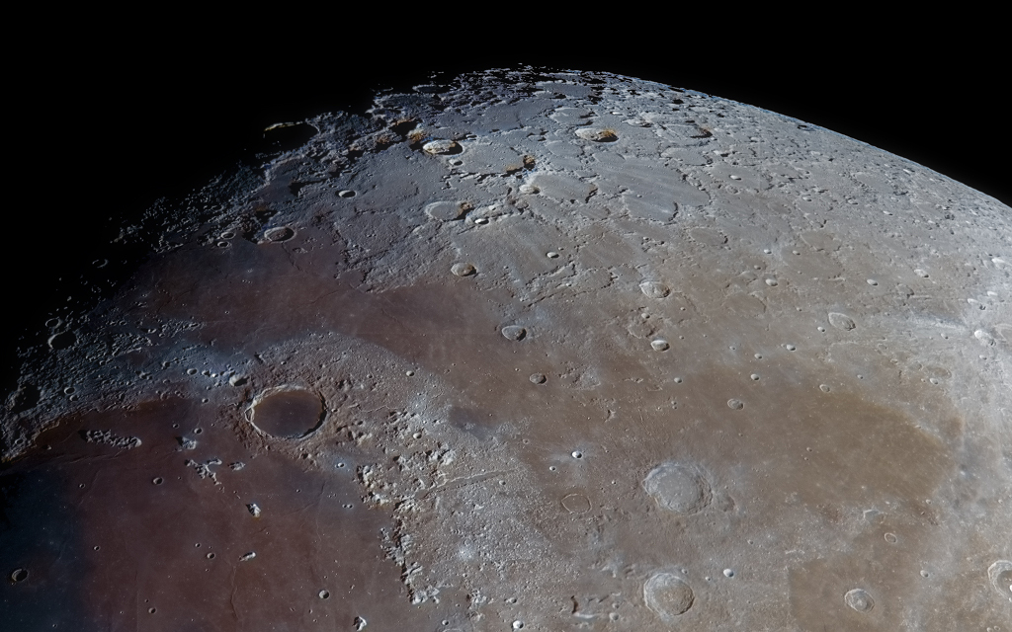
week 7

Slide 2
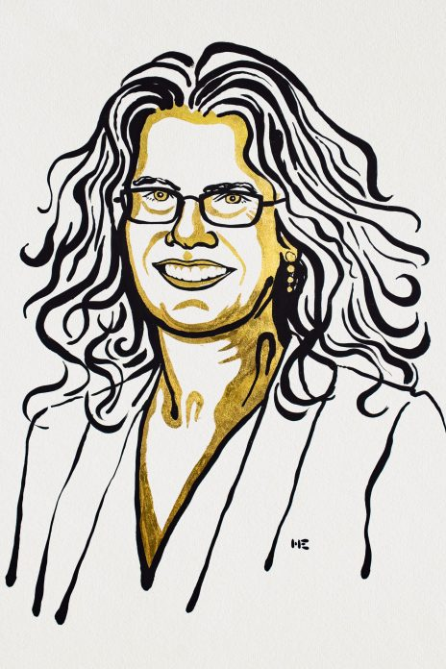
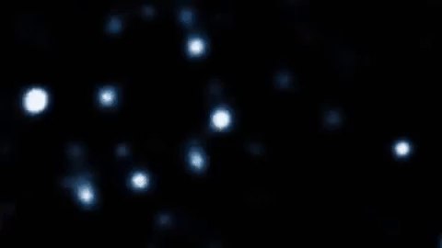
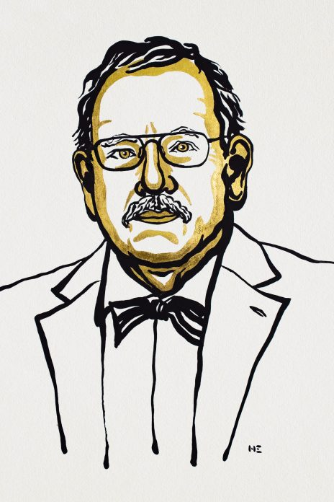
SOME NOBEL PRIZE NEWS!
Andrea
Gehz -- took these data!
(UCLA)
Reinhard Genzel
(Berkeley!)

Slide 3
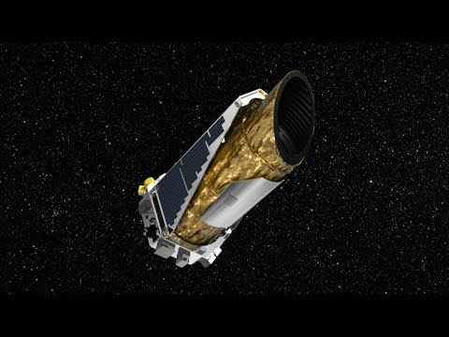
Astronomy Video of the Day!

Slide 4
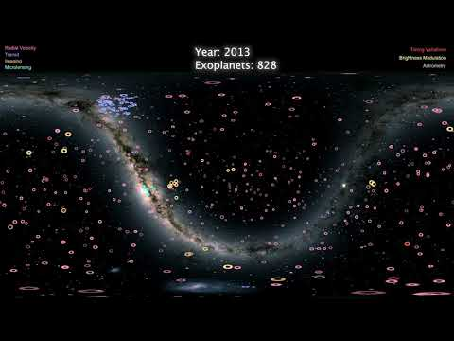
Astronomy Video of the Day (part 2)

Slide 5
MIDTERM INFORMATION
0) Please ADD ASTRO C10 in PrairieLearn. https://cbt-dev.berkeley.edu/pl links to an external site.
1) Midterm October 9th 3:10-4pm. Please use the regular lecture zoom link.
2) However, you are NOT required to take Midterm while on zoom!
3) Students should have a few pieces of scratch paper and writing utensil ready.
4) Please try out the Practice Midterm 1 on PrairieLearn. It is not for a grade; it is only to test the system!
5) NO CALCULATORS! If you use it on the next quiz, I will give a zero straight away.
6) The format and topics for the midterm are outlined explicity in the Course Reader. You will be examined up through CS-142.

Slide 6
Let’s do some review!
Notes:
https://create.kahoot.it/kahoots/my-kahoots/folder/0f3b4aa5-f9ff-4050-8f11-911009dbfb57

Slide 7
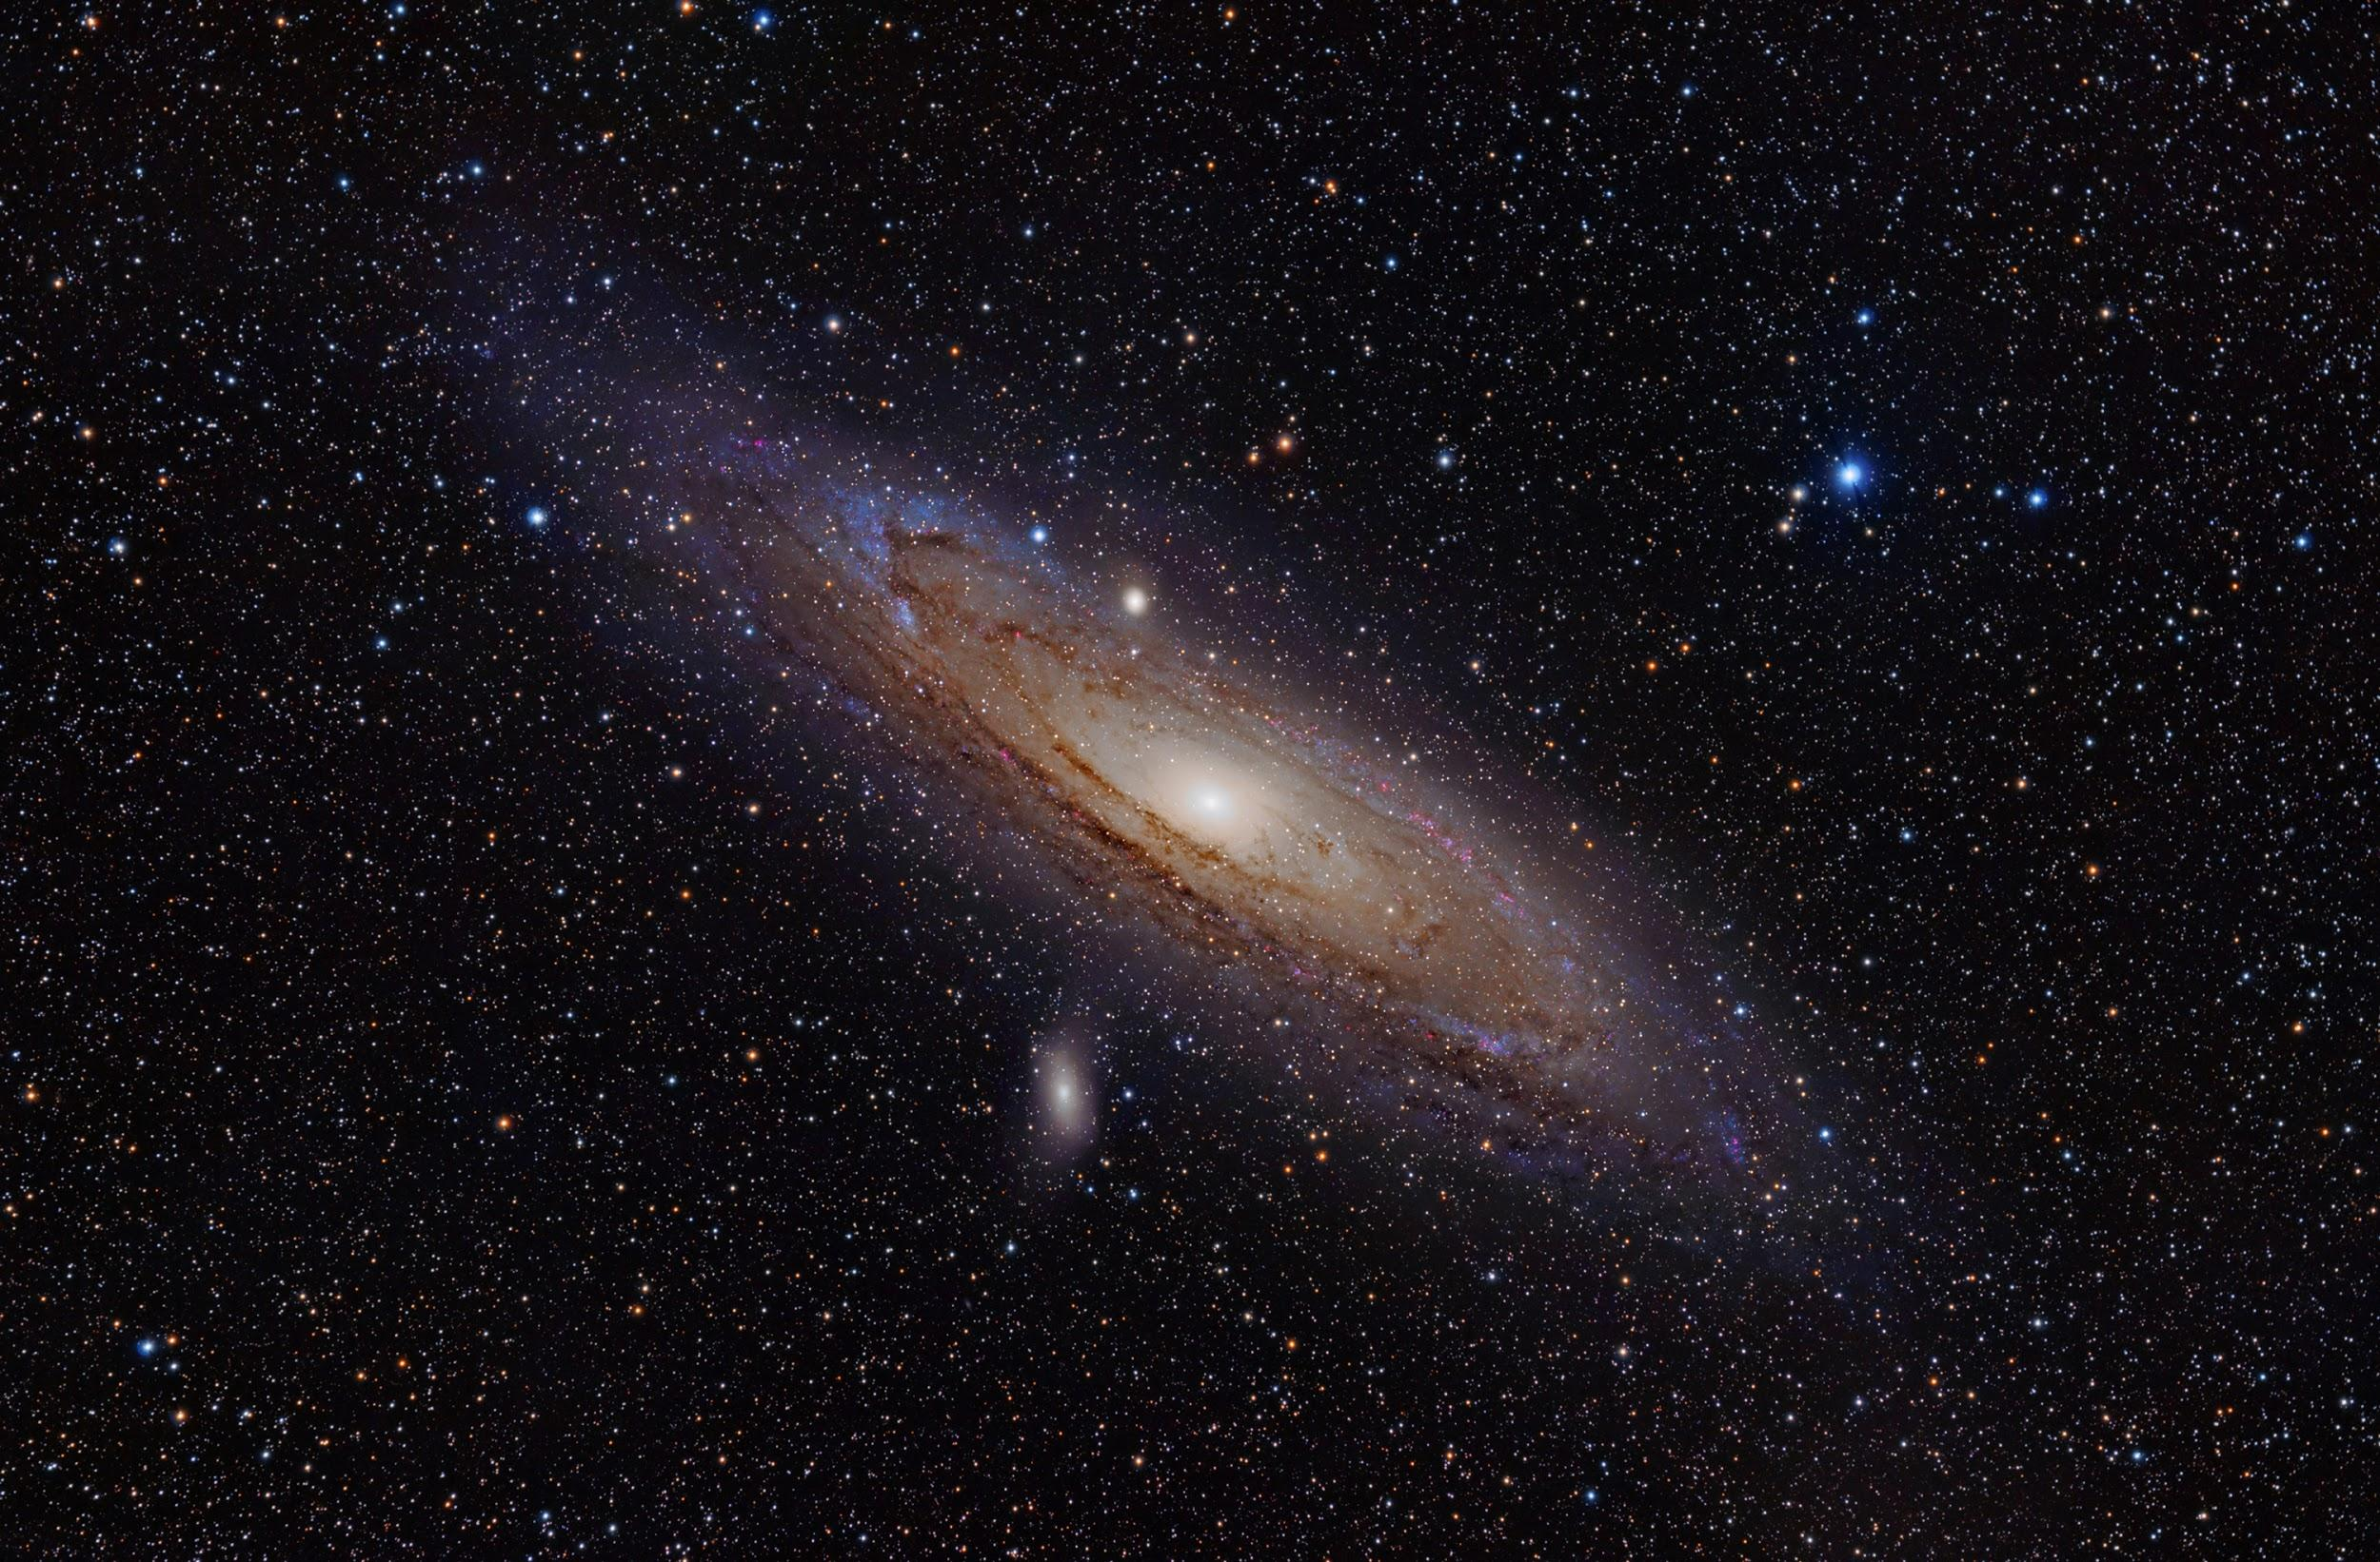
weekly survey!
Thanks everyone!
tinyurl.com/pilawaForm

