Slide 1
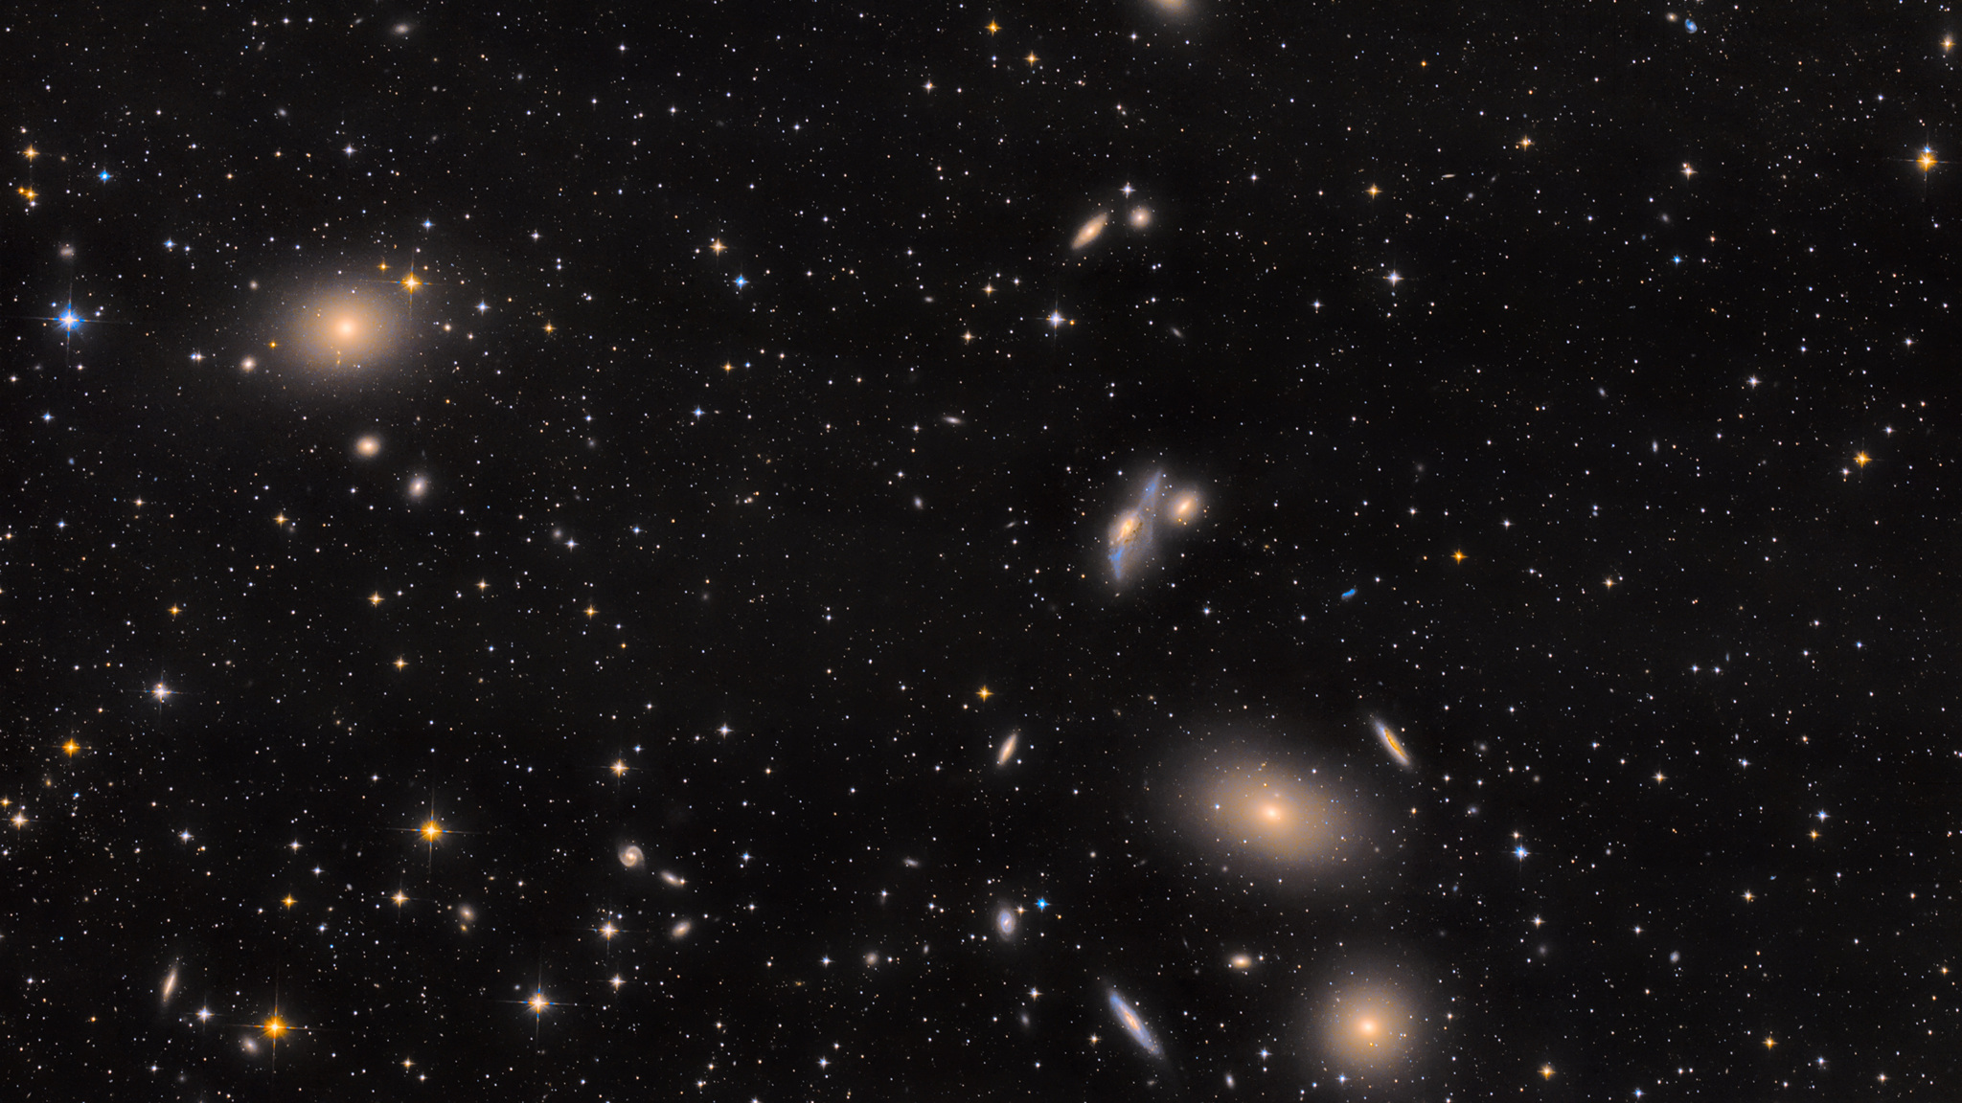
Week 8

Slide 2
what is this?
Mass:
1.2 x 10¹⁵ M_{sun}
1,200,000,000,000,0000 M_{sun}
M87
Virgo Galaxy Cluster
50 Mly away
~1300 galaxies
APOD

Slide 3
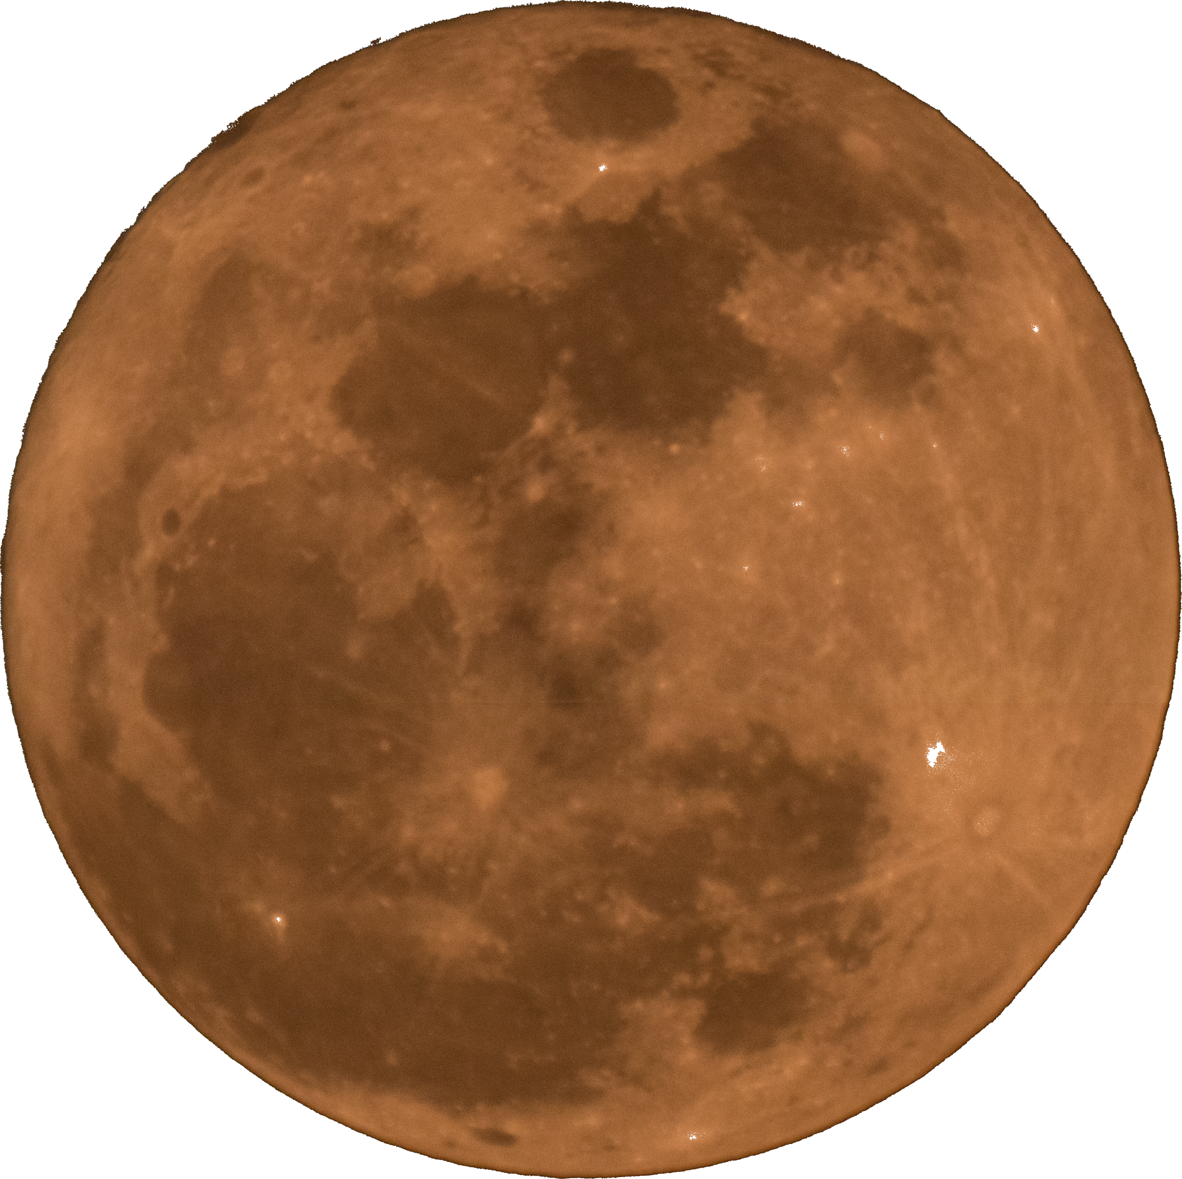
APOD

Slide 4
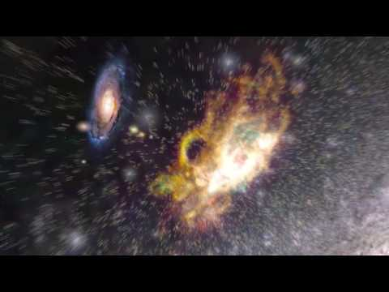
Cheesy, but amazing AVOD --
Journey through the Virgo Supercluster

Slide 5
Feedback from Google Form + Logistics
Great feedback on the Kahoot! Noted, and I had fun, too!
Very sorry about the complications on the midterm -- I’ll let you know anything Alex/Sergiy says about future exams and whatnot!
Did you all get the bCourses message I sent?
any questions?
🤔
🧐

Slide 6
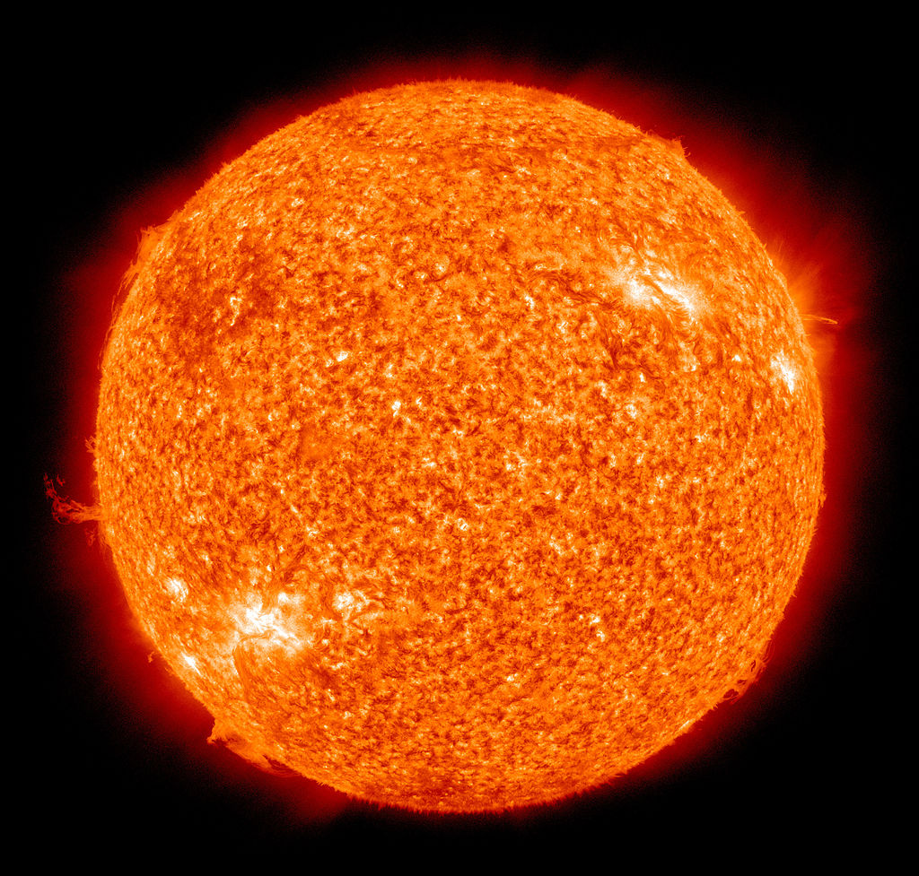
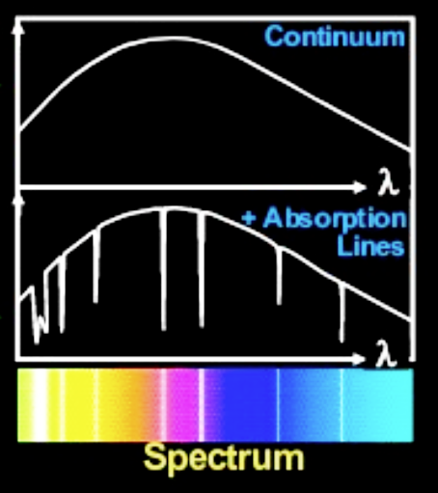
gravity
two parts:
hot inner layers
pressure
cooler
outer
layers
STARS

Slide 7
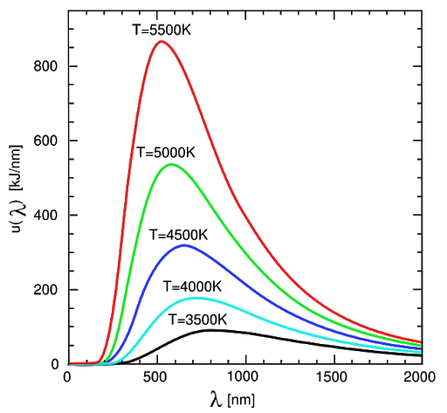
star = blackbody + absorption features
λ_{peak}T = (constant).
intensity
L = 4πR²σT⁴
b = L/(4πd²)
wavelength
STARS

Slide 8
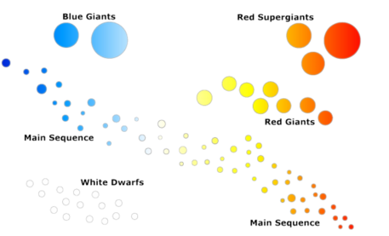
BRIGHT
luminosity
Main Sequence:
Hydrogen fusing in core
Luminosity and temperature relatively constant for lifetime on MS
dim
HOT
COOL
temperature
STARS: The HR Diagram

Slide 9
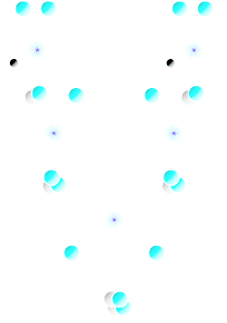
4H → He + (energy)
luminosity
temperature
STARS: The Main Sequence

Slide 10
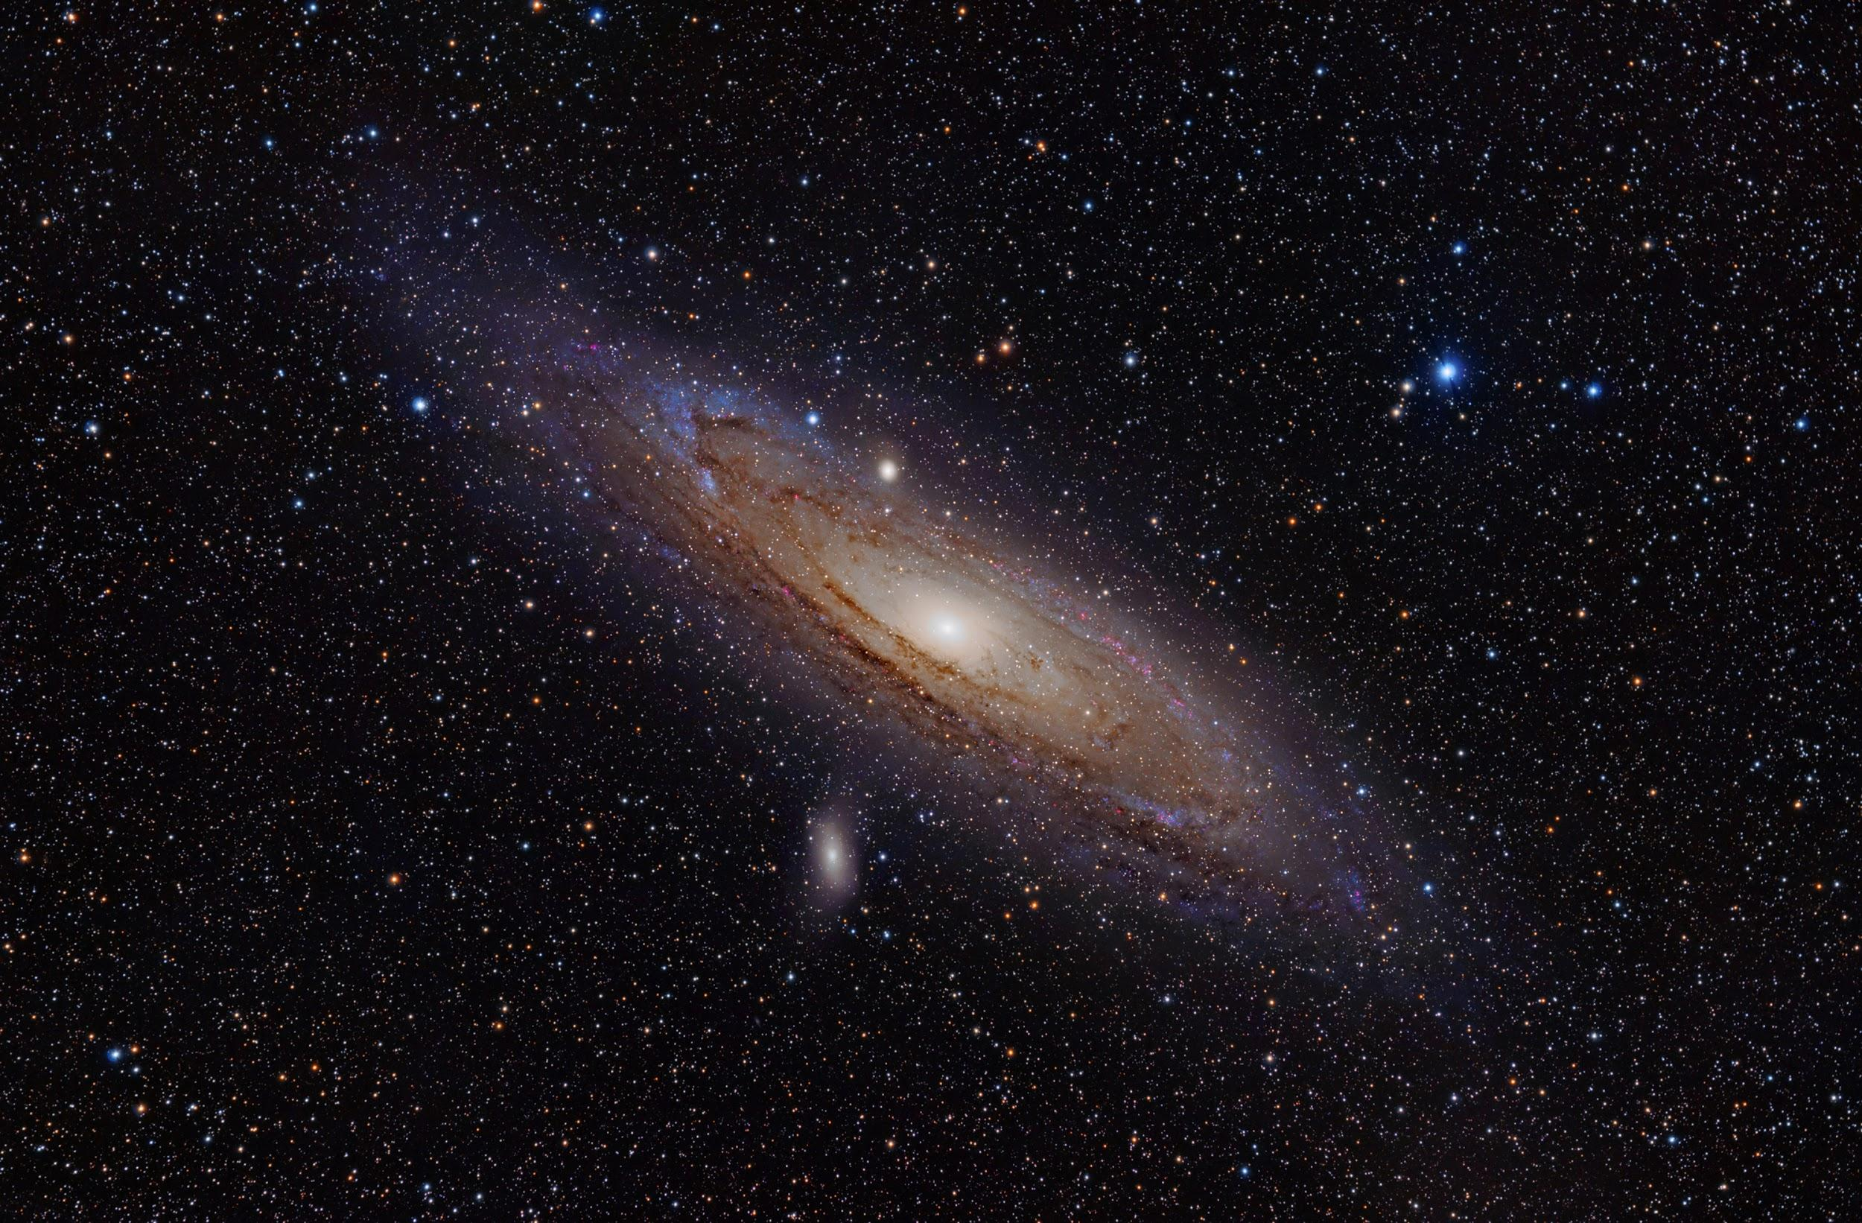
weekly survey!
Thanks everyone!
tinyurl.com/pilawaForm

