Slide 1
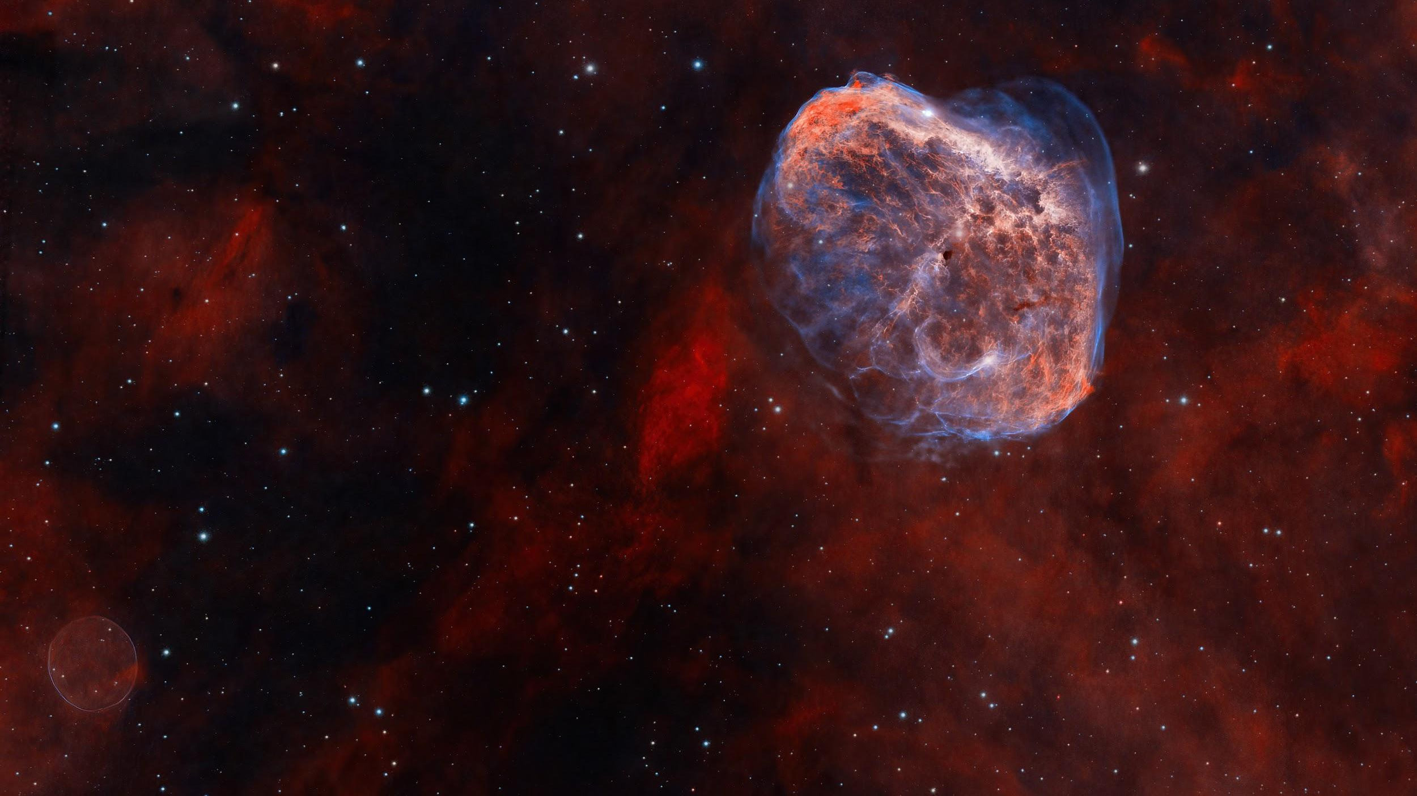
Week 9

Slide 2
two things to spot:
The Soap Bubble Nebula
(PN G75.5+1.7)
The Crescent Nebula
(NGC6888)
APOD
Notes:
Right: Crescent Nebula
Emission nebula, but different
Whereas soap bubble is just a planetary nebula, this is formed by a shock wave of two different soruces of gas
There’s a hot Wolf-Rayet star that has a really fast stellar find -- it is colliding with material from a red giant star that died and spewed ejecta around 400,000 years ago
5,000 light years from Earth
Left: Soap Bubble Nebula
Discovered by an amateur astronomer
Emission Nebula (planetary nebula)
Not much information on this one

Slide 3
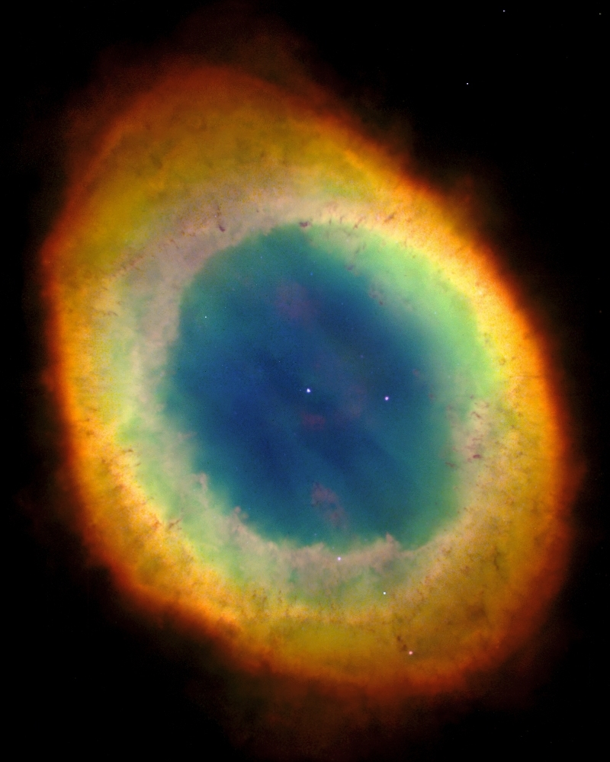
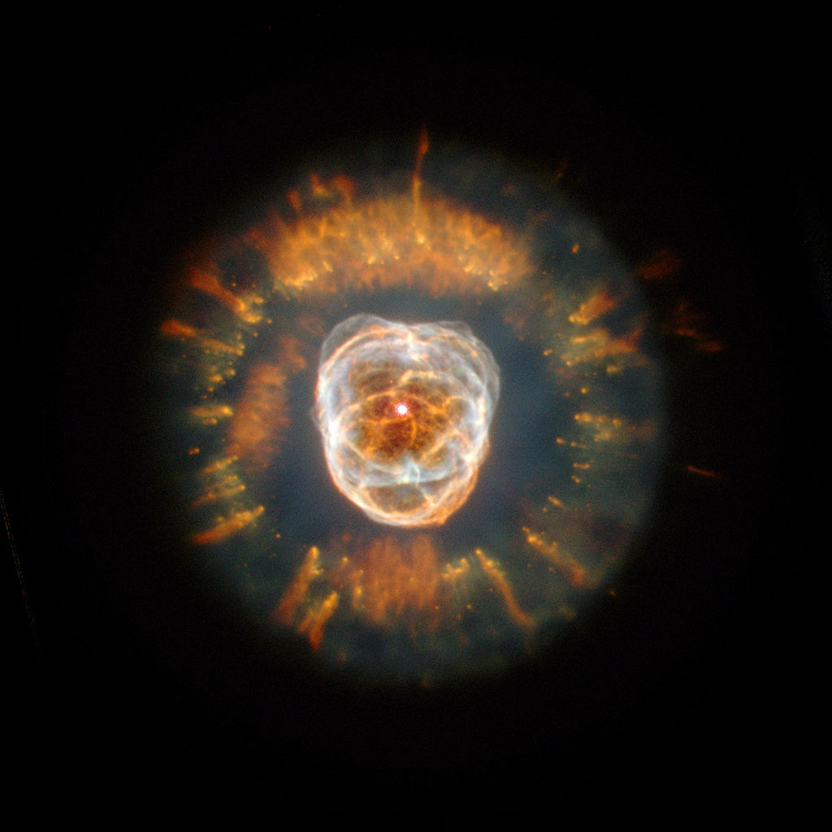
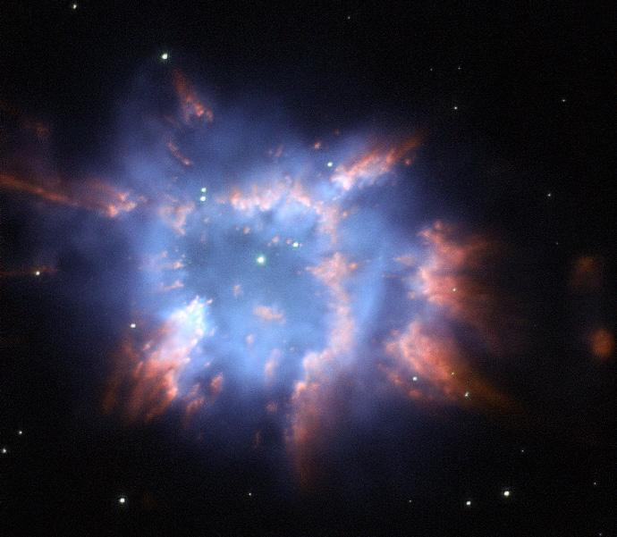
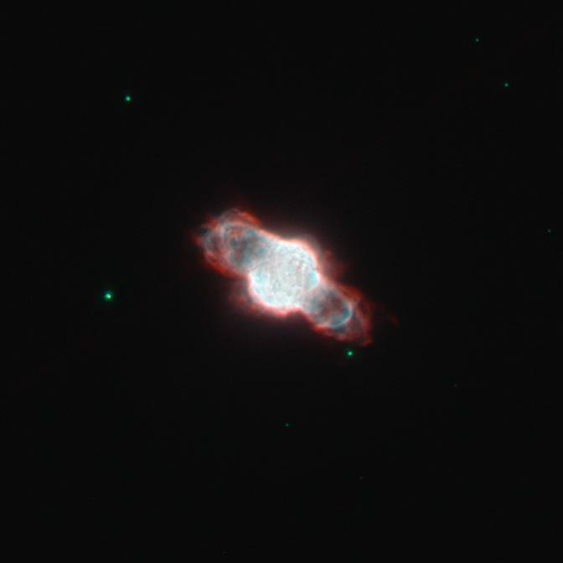
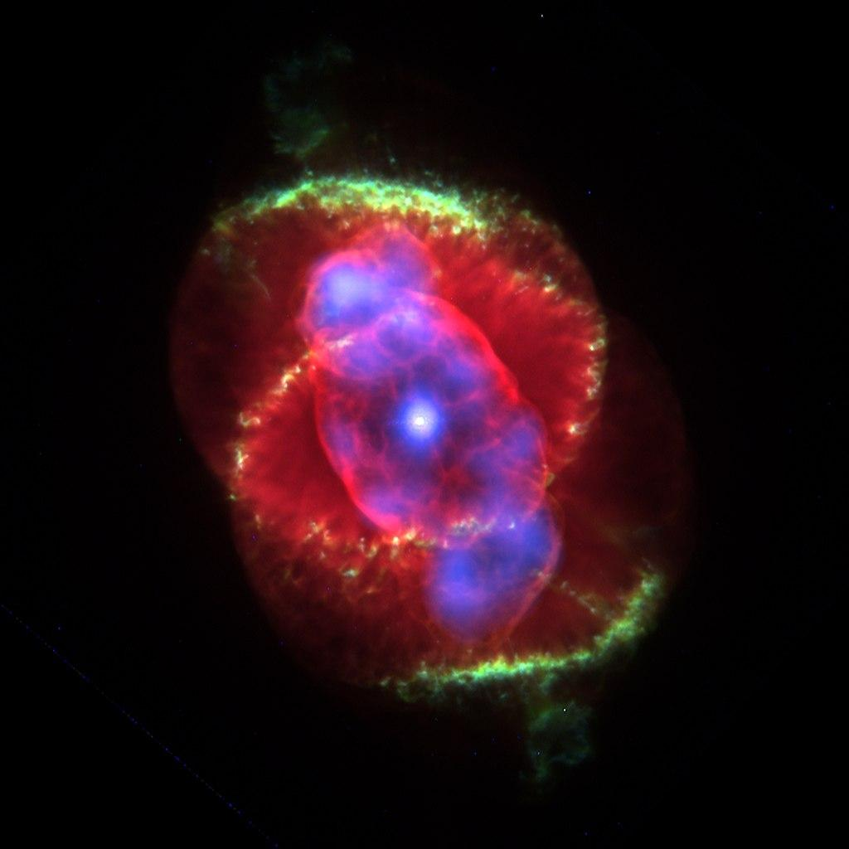
The Lion Nebula
The Ring Nebula
NGC 6326
NGC 6886
The Helix Nebula
some other pretty nebulae

Slide 4
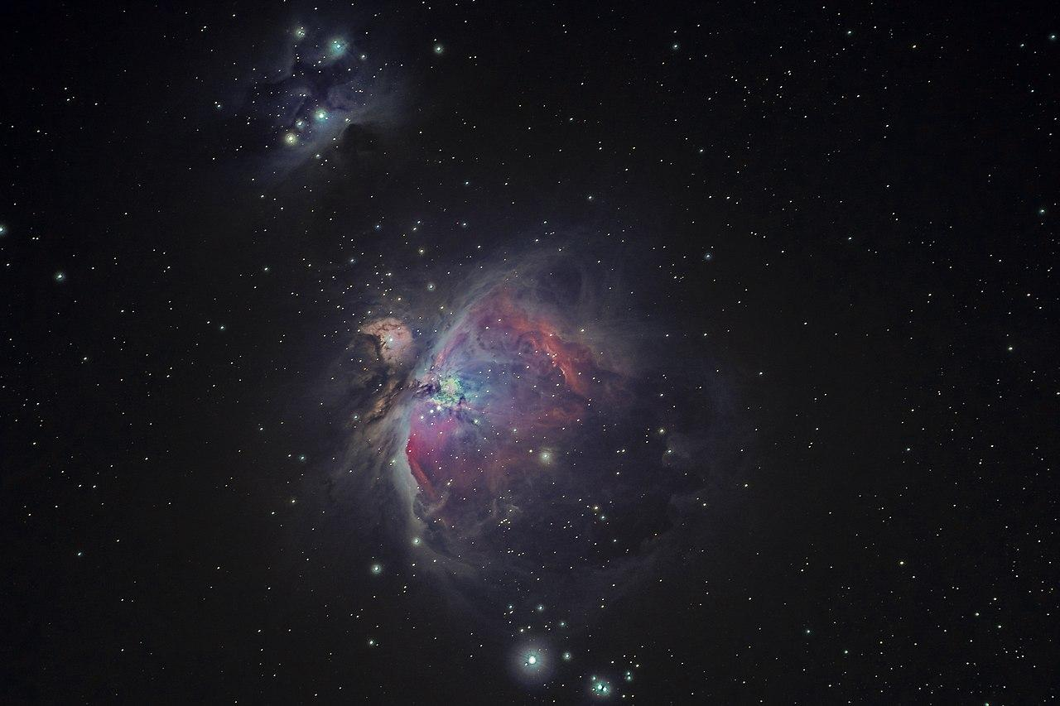
Today:
Mid-Semester Feedback
Review for Quiz!
Notes:
Put on music

Slide 5
Mid-Semester Feedback
https://tinyurl.com/pilawaMidSemForm
Raise your hand on Zoom when complete!

Slide 6
Quiz Information
Quiz next week!
1 submission of a .pdf of your work
Logistics next week
10 Minute Q&A
30 Minutes for Quiz
Rest of time to upload

Slide 7
Let’s Review!
🧐
Notes:
https://create.kahoot.it/details/quiz-2-review/66ed883e-97fe-4fd3-aedf-3d9b29279623

Slide 8
General Topics for the Quiz:
orbits + kepler’s laws + newton’s version of kepler’s law
Properties of light,
parallax, brightness as an inverse square law
stars, stellar
evolution,Main Sequence, Red giant and novae
Exoplanets, detection methods (transit method, doppler wobble method)

Slide 9
Any questions before we end for the week?
Notes:
https://create.kahoot.it/details/quiz-2-review/66ed883e-97fe-4fd3-aedf-3d9b29279623

Slide 10
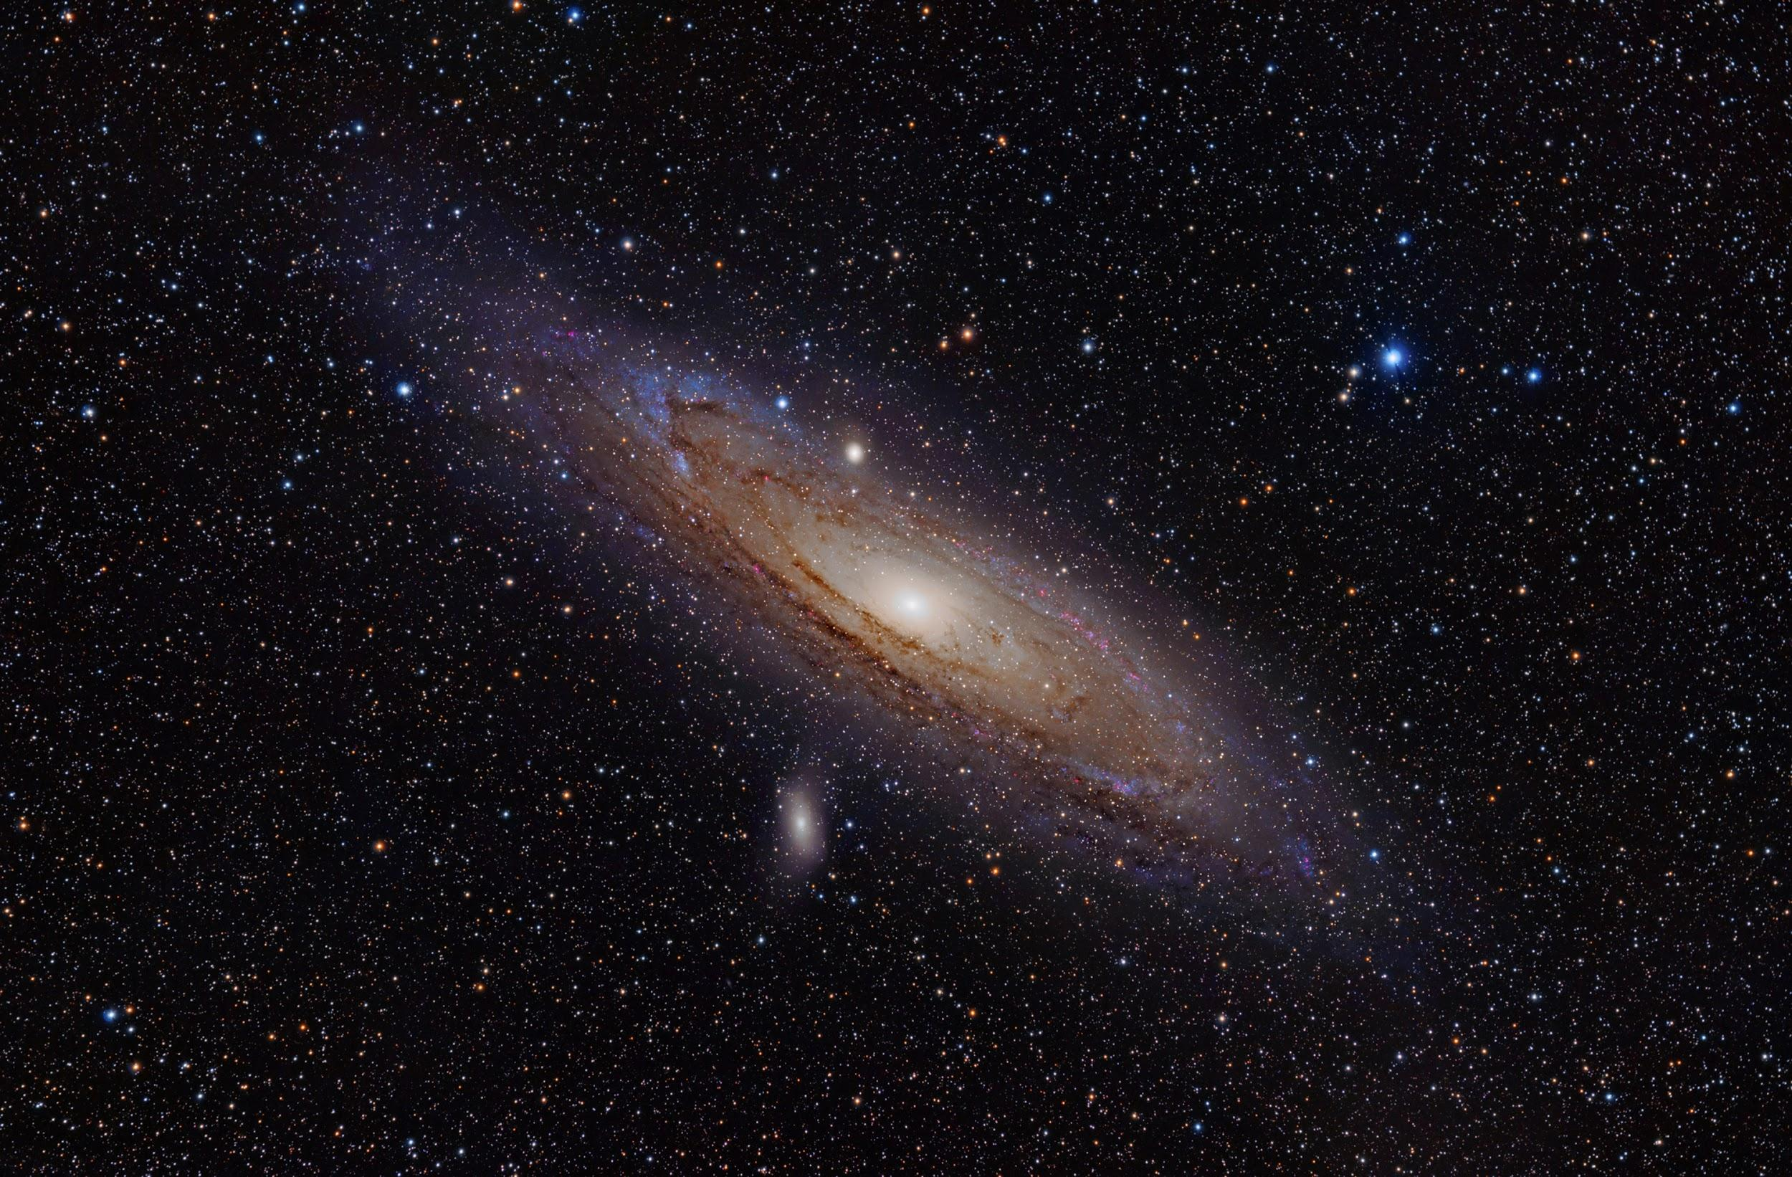
Thanks everyone!

