Slide 1
1mm observations of Orion-KL
Plambeck, PACS team, Friedel, Eisner, Carpenter, ...

Slide 2
fact 1: 2 massive stars in Orion-KL
20 μm image
(Downes et al. 1981)
Becklin-Neugebauer Object – brightest source at 5 μm
source I – heavily obscured even at 20 um

Slide 3
fact 2: source I and BN are recoiling from each other at 40 km/sec
ejected from a multiple stellar system ~500 years ago?
+12 km/sec
BN
27 km/sec NW
molecular cloud
(VLSR ~ 9 km/sec)
12 km/sec SE
source I
(proper motions proportional to line of sight velocities)
-4 km/sec

Slide 4
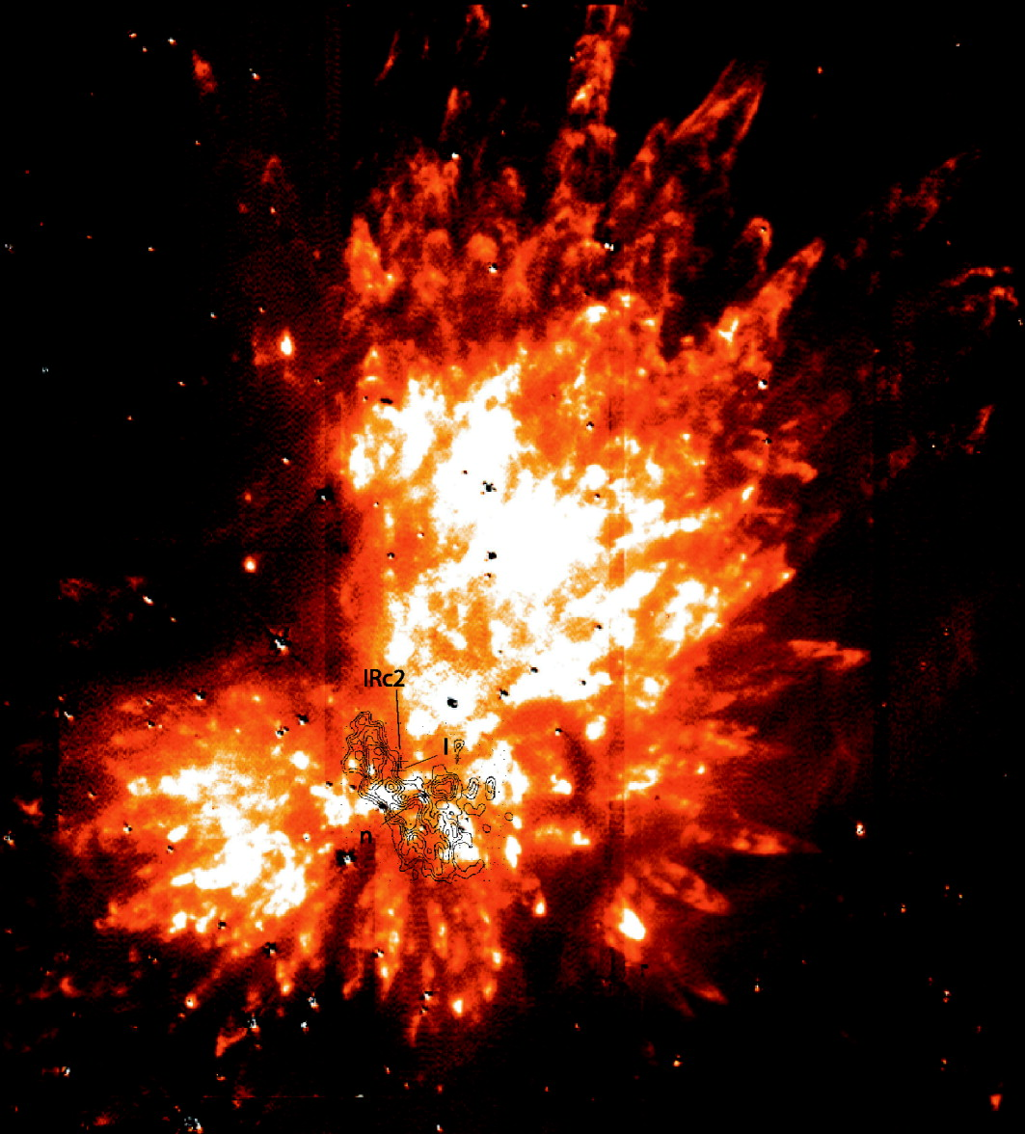
fact 3: fingers of shock-excited H₂
proper motions suggest age of 1000 yrs
related to the BN-I explosion?

Slide 5
fact 4: SiO v=1 masers surround source I
discovered by Snyder & Buhl
unusual around a young star
source I
43 GHz VLBA map

Slide 6
outflow from source I (Plambeck, Wright, Friedel et al 2009)

Slide 7
Orion-KL 225 GHz map with 0.9’’ resolution need higher resolution to measure fluxes of BN and source I
BN?
source I

Slide 8
we want to filter out large scale structure... the perfect job for an interferometer

Slide 9
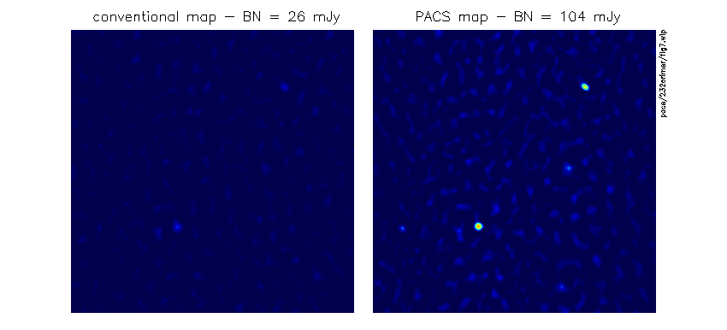
well-suited for PACS observations 30 GHz calibrator is ~1 Jy, 1.6 degrees away
CARMA B-array data, Dec 2008

Slide 10
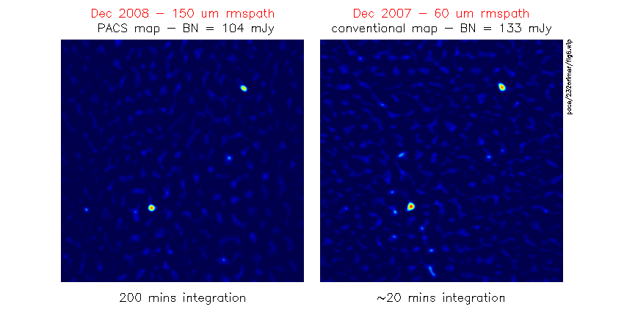
check fluxes against Dec 2007 B-array map obtained in superb weather

Slide 11
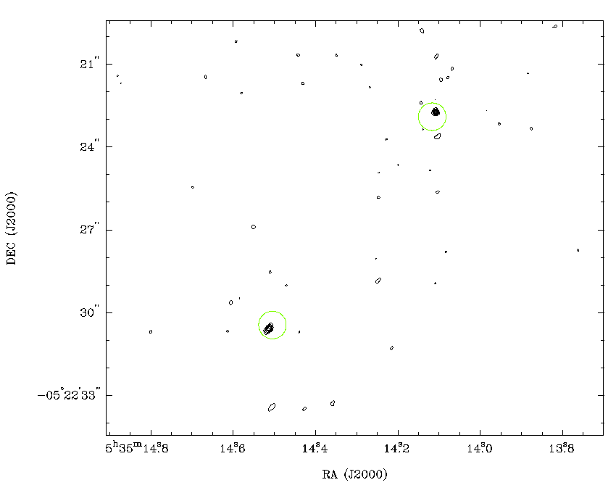
229 GHz continuum map
0.15’’ resolution
BN
circles are centered on 1995 positions
source I

Slide 12
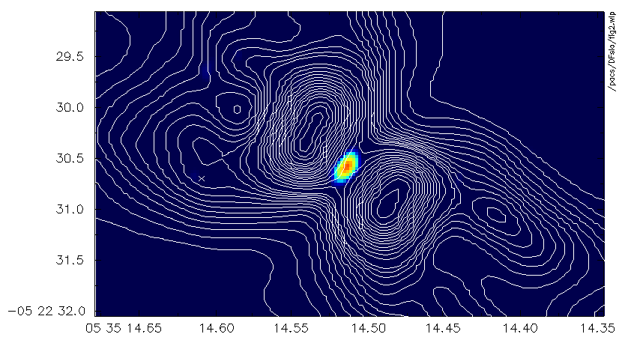
source I continuum elongated perpendicular to SiO outflow

Slide 13
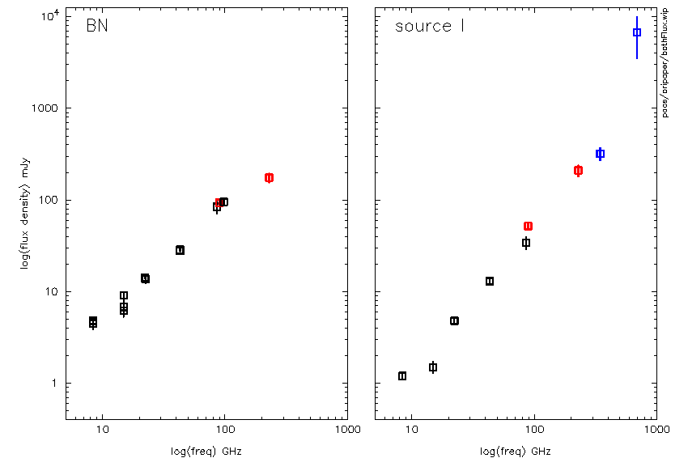
radio continuum spectra
Beuther et al
SMA
CARMA 86 GHz (Friedel & Widicus Weaver 2009)

Slide 14
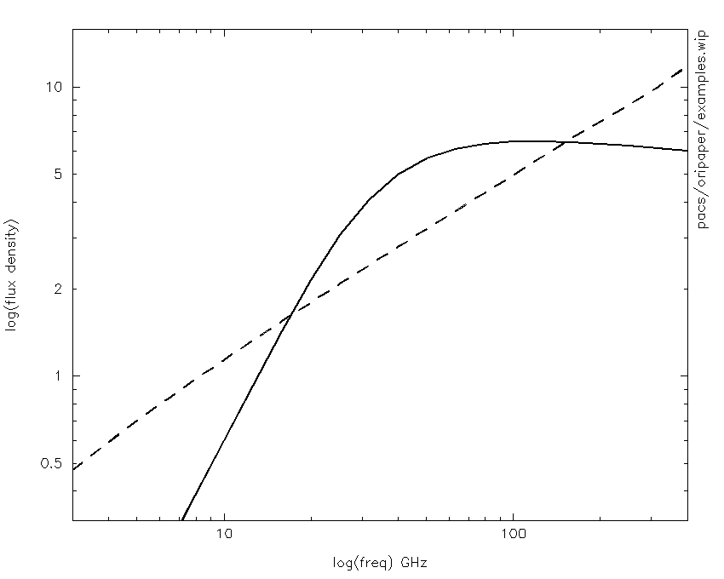
limiting cases of radio spectra
freely expanding fully ionized wind
S ~ ν^{0.6}
uniform density HII region
S ~υ² at low freq
S ~ υ^{-0.1} at high freq

Slide 15
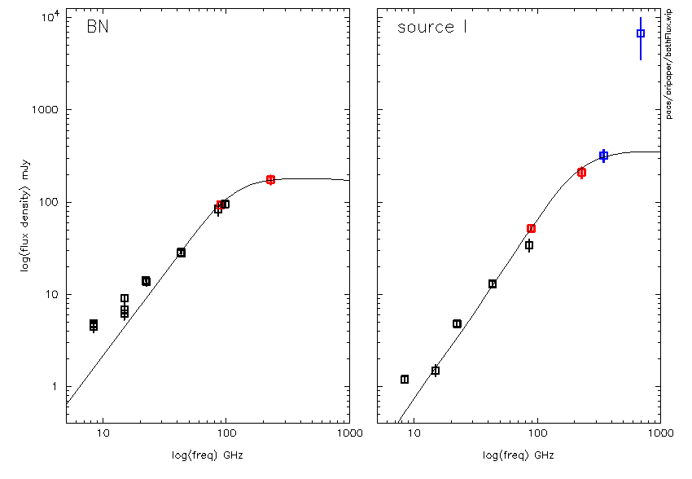
fits - uniform density HII regions
R = 7.6 AU,
n_{e} = 7.1e7
R = 10.5 AU
n_{e} = 2.8e7

Slide 16
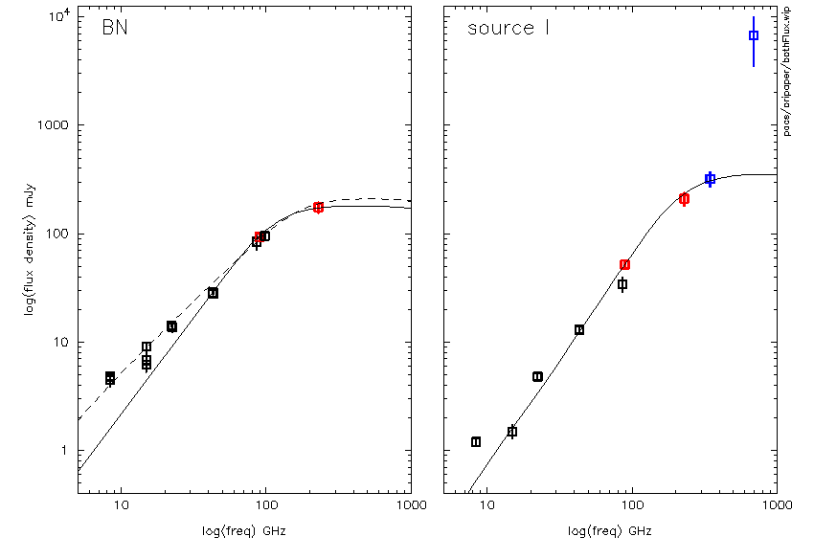
BN – can fit low freqs with power law ‘halo’

Slide 17
H recombination lines toward BN
Rodriguez et al 2009
CARMA
CARMA

Slide 19
line/continuum opacity ~ υ^{1.1}

Slide 20
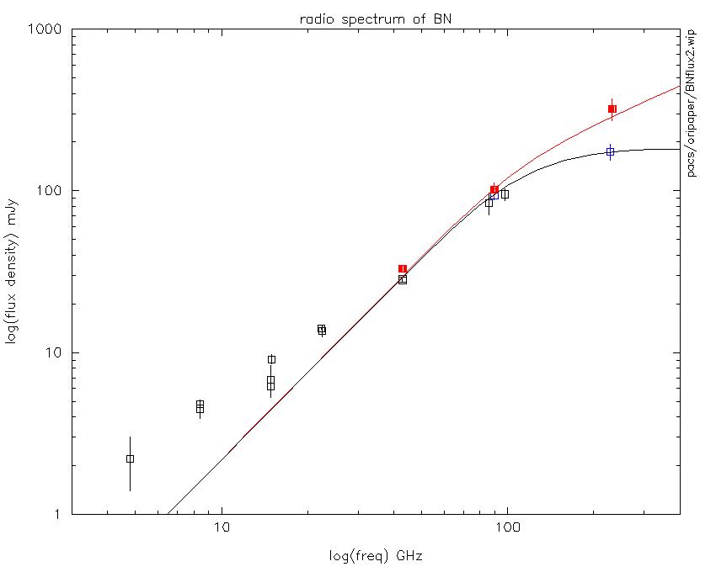
BN

Slide 21
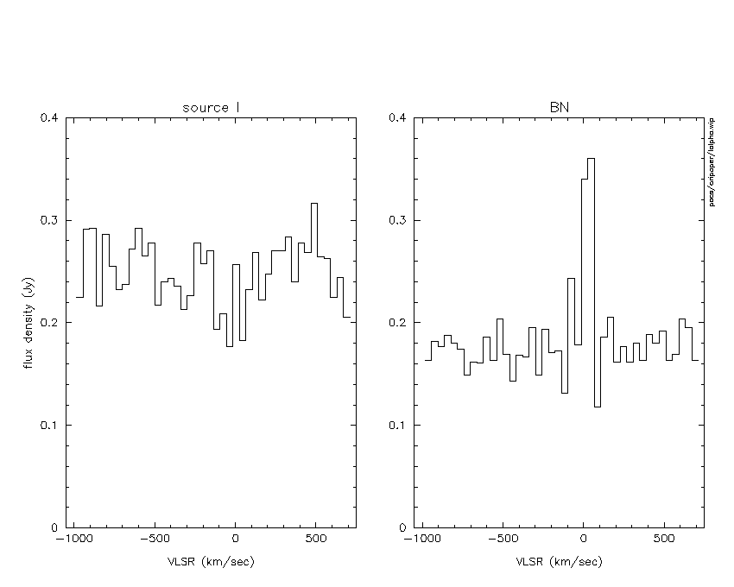
no detection of H30α toward source I

Slide 22
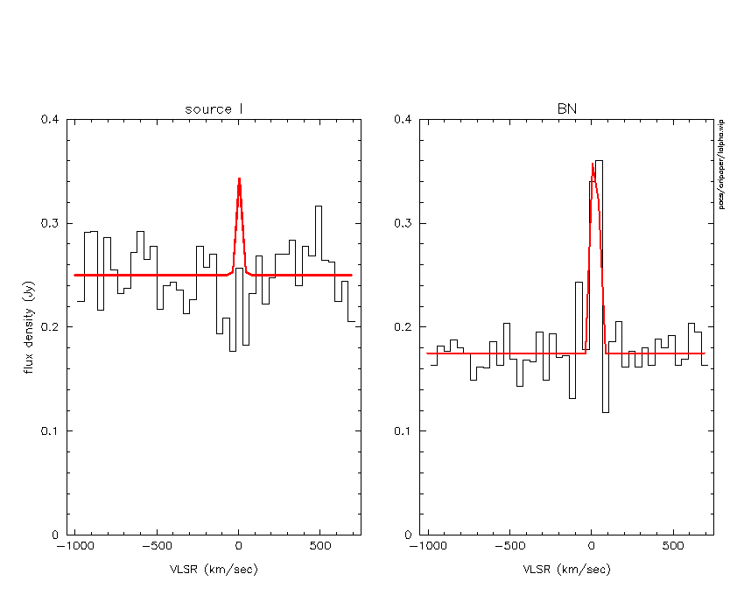
H30α line profiles predicted by HII region model
free-free continuum optically thin, but no recombination line?

Slide 23
implication: H is not ionized – opacity from H- free-free, as in stellar atmospheres
T ~ 1500 K
ionized Na, K contribute the electrons
opacity (per H) ~ 10⁻³ of p⁺-e⁻ opacity
responsible for the radio photospheres of Miras (Reid and Menten 1997)
p⁺ - e⁻
p⁺
e⁻
H – e⁻
H
e⁻

Slide 24
implications for source I (Reid et al. 2007)
need high densities (~ 10¹⁴ cm⁻³ at 4 AU) to get enough opacity – total disk mass ~ 3 M_{o}
central star unlikely to maintain T = 1500 K at r = 25 AU – heated by accretion?

Slide 25
3 observations that shook our belief: (2) the outflow is NE-SW, not NW-SE?
Greenhill et al. 2004

Slide 26
fragmentation in hot core? same clumps seen at 86 GHz with lower resolution

Slide 27
υ^{1.3}

