Slide 1
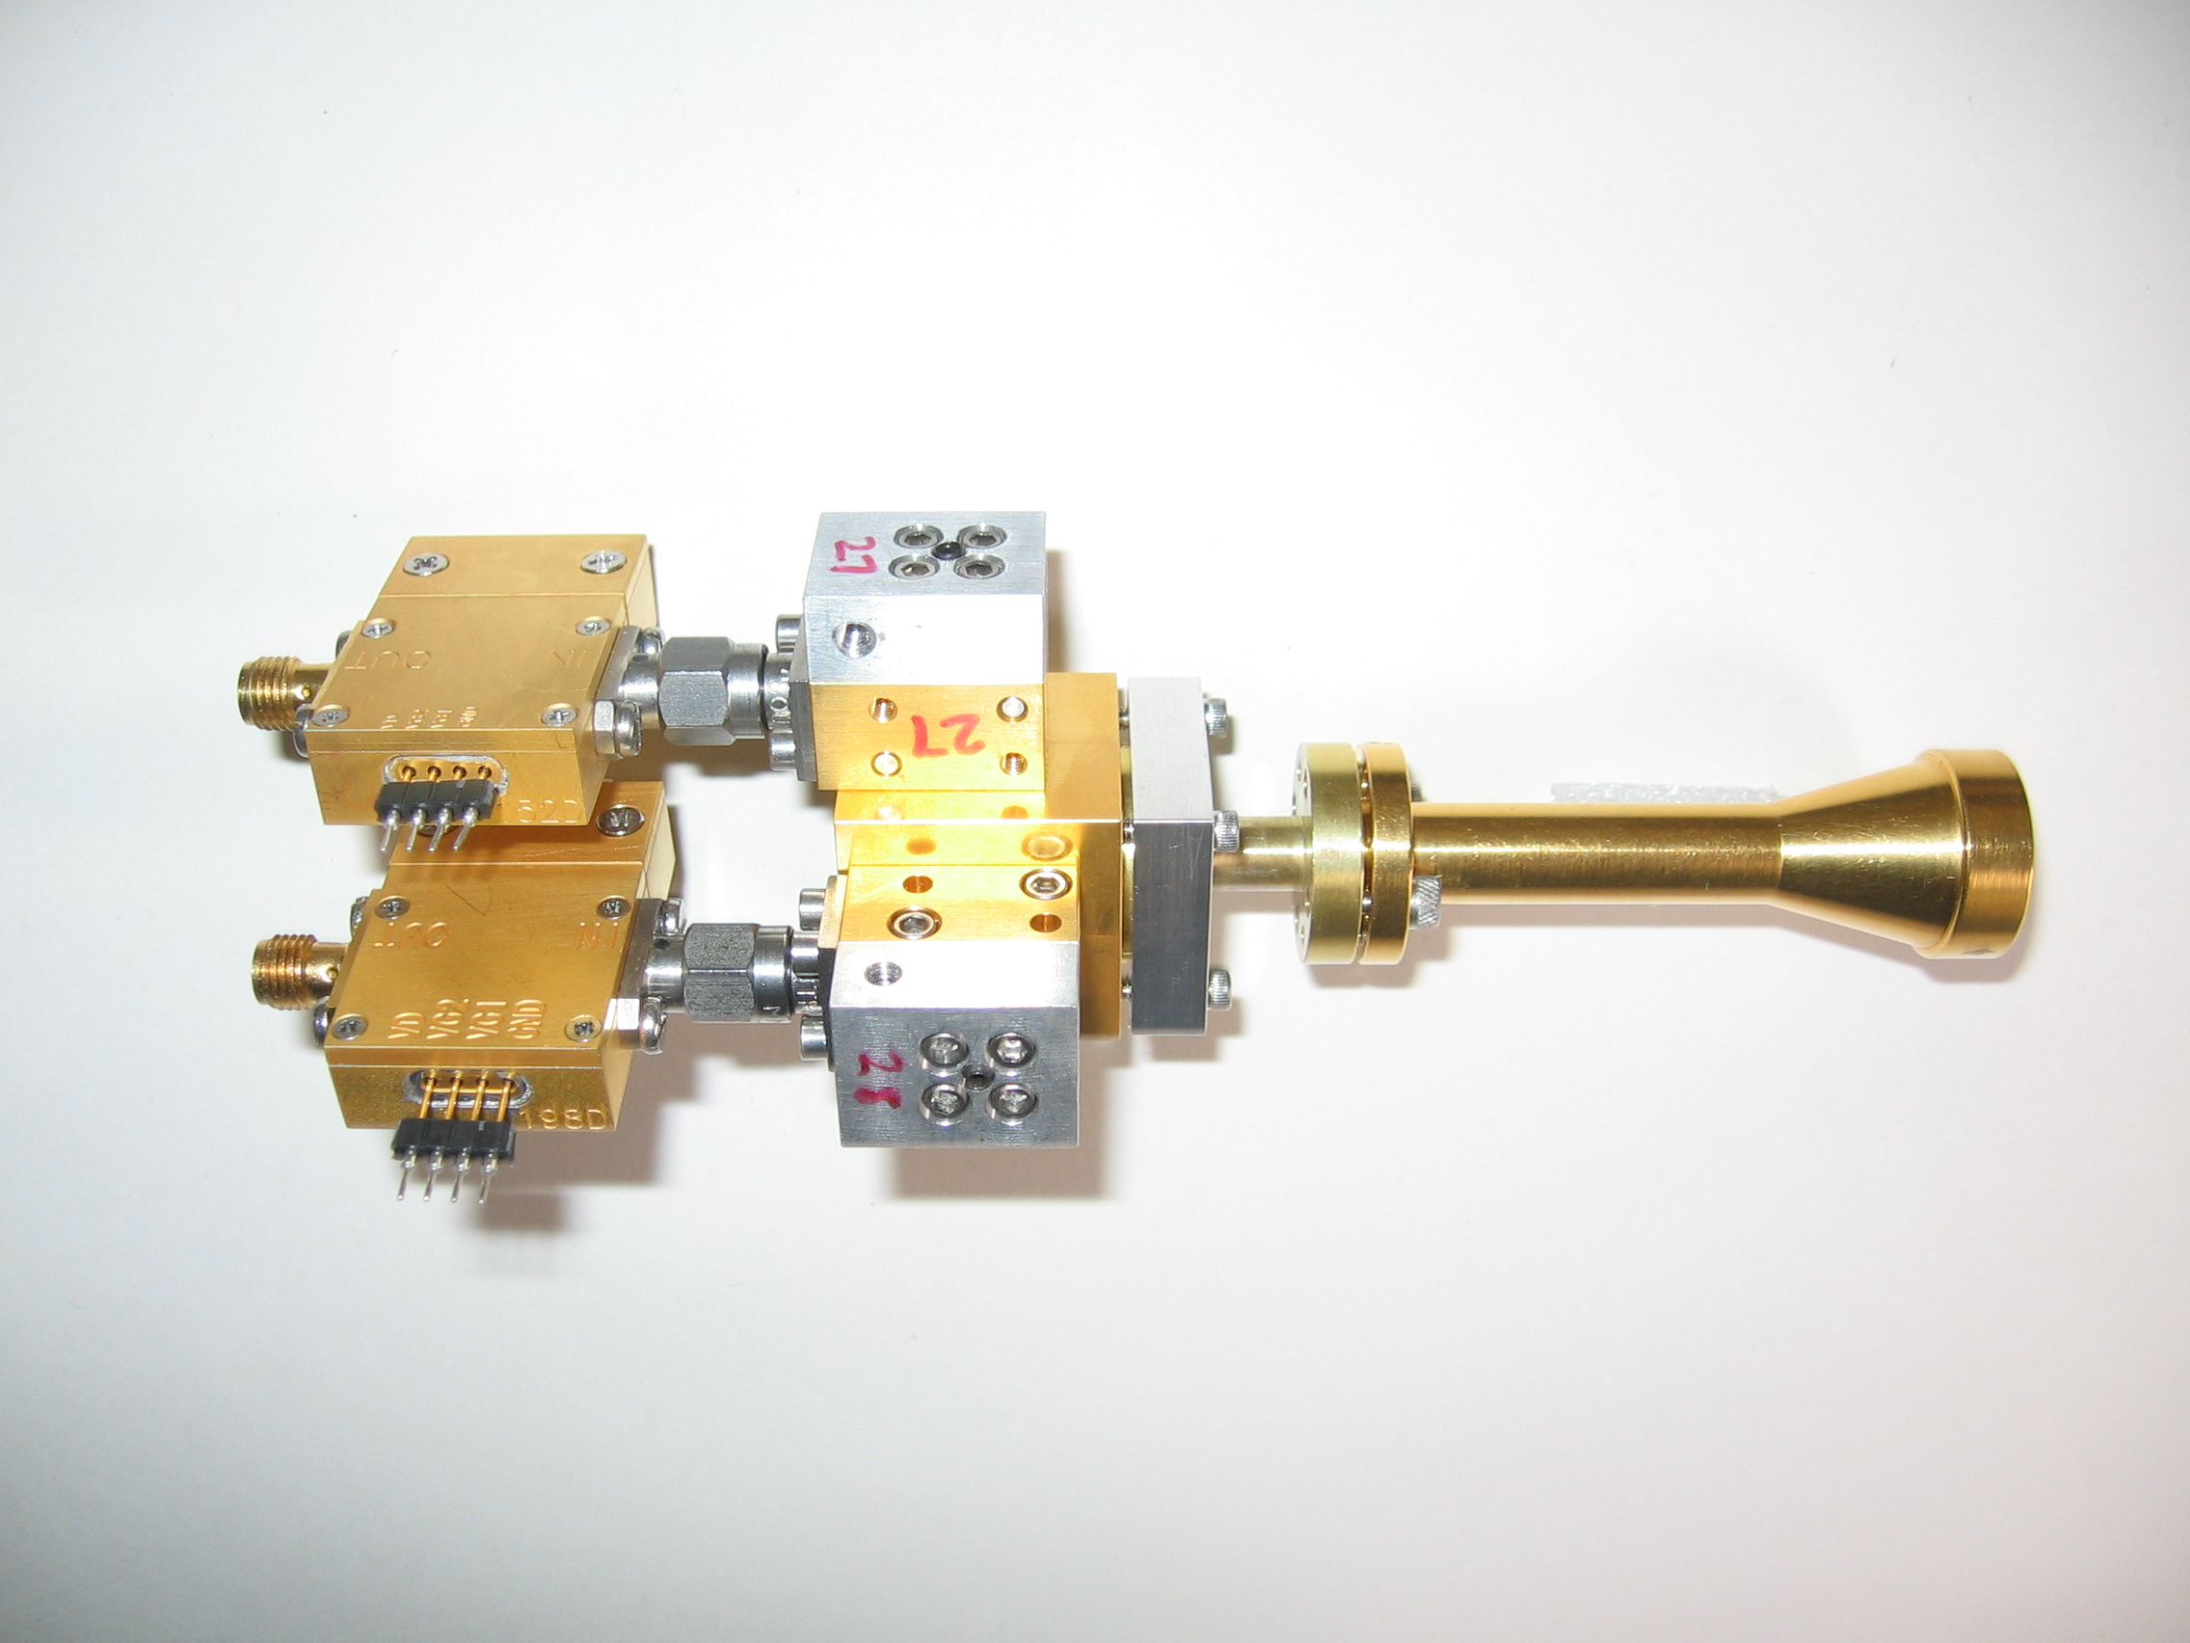
1mm dual pol receivers
SIS mixers – use ALMA band 6 devices purchased from UVa
orthomode transducer
circular polarizer
WBA13 I.F. amplifiers (1-9 GHz)
from Sandy Weinreb, Caltech

Slide 2
turnstile junction OMT
Navarrini & Plambeck 2006, IEEE-MTT, 54, 272-277
Notes:
The OMT is based on a turnstile junction and 2 power combiners - this design was worked out by Alessandro Navarrini when he was a postdoc in Berkeley.
It looks pretty intimidating to make, but it’s not as bad as it looks . The waveguides are all split down the middle, so what you have do do is to machine 4 blocks of metal and bolt them together.

Slide 3
waveguide circular polarizer
λ/2 retarder
at 15°
λ/4 retarder
at 74.5°

Slide 4
X, Y converted to R ,L

Slide 5
leakage for 1, 2, 3 section polarizers

Slide 6
leakages computed with random machining errors (±0.0003’’, ±0.2°)
2-sections
3-sections

Slide 7
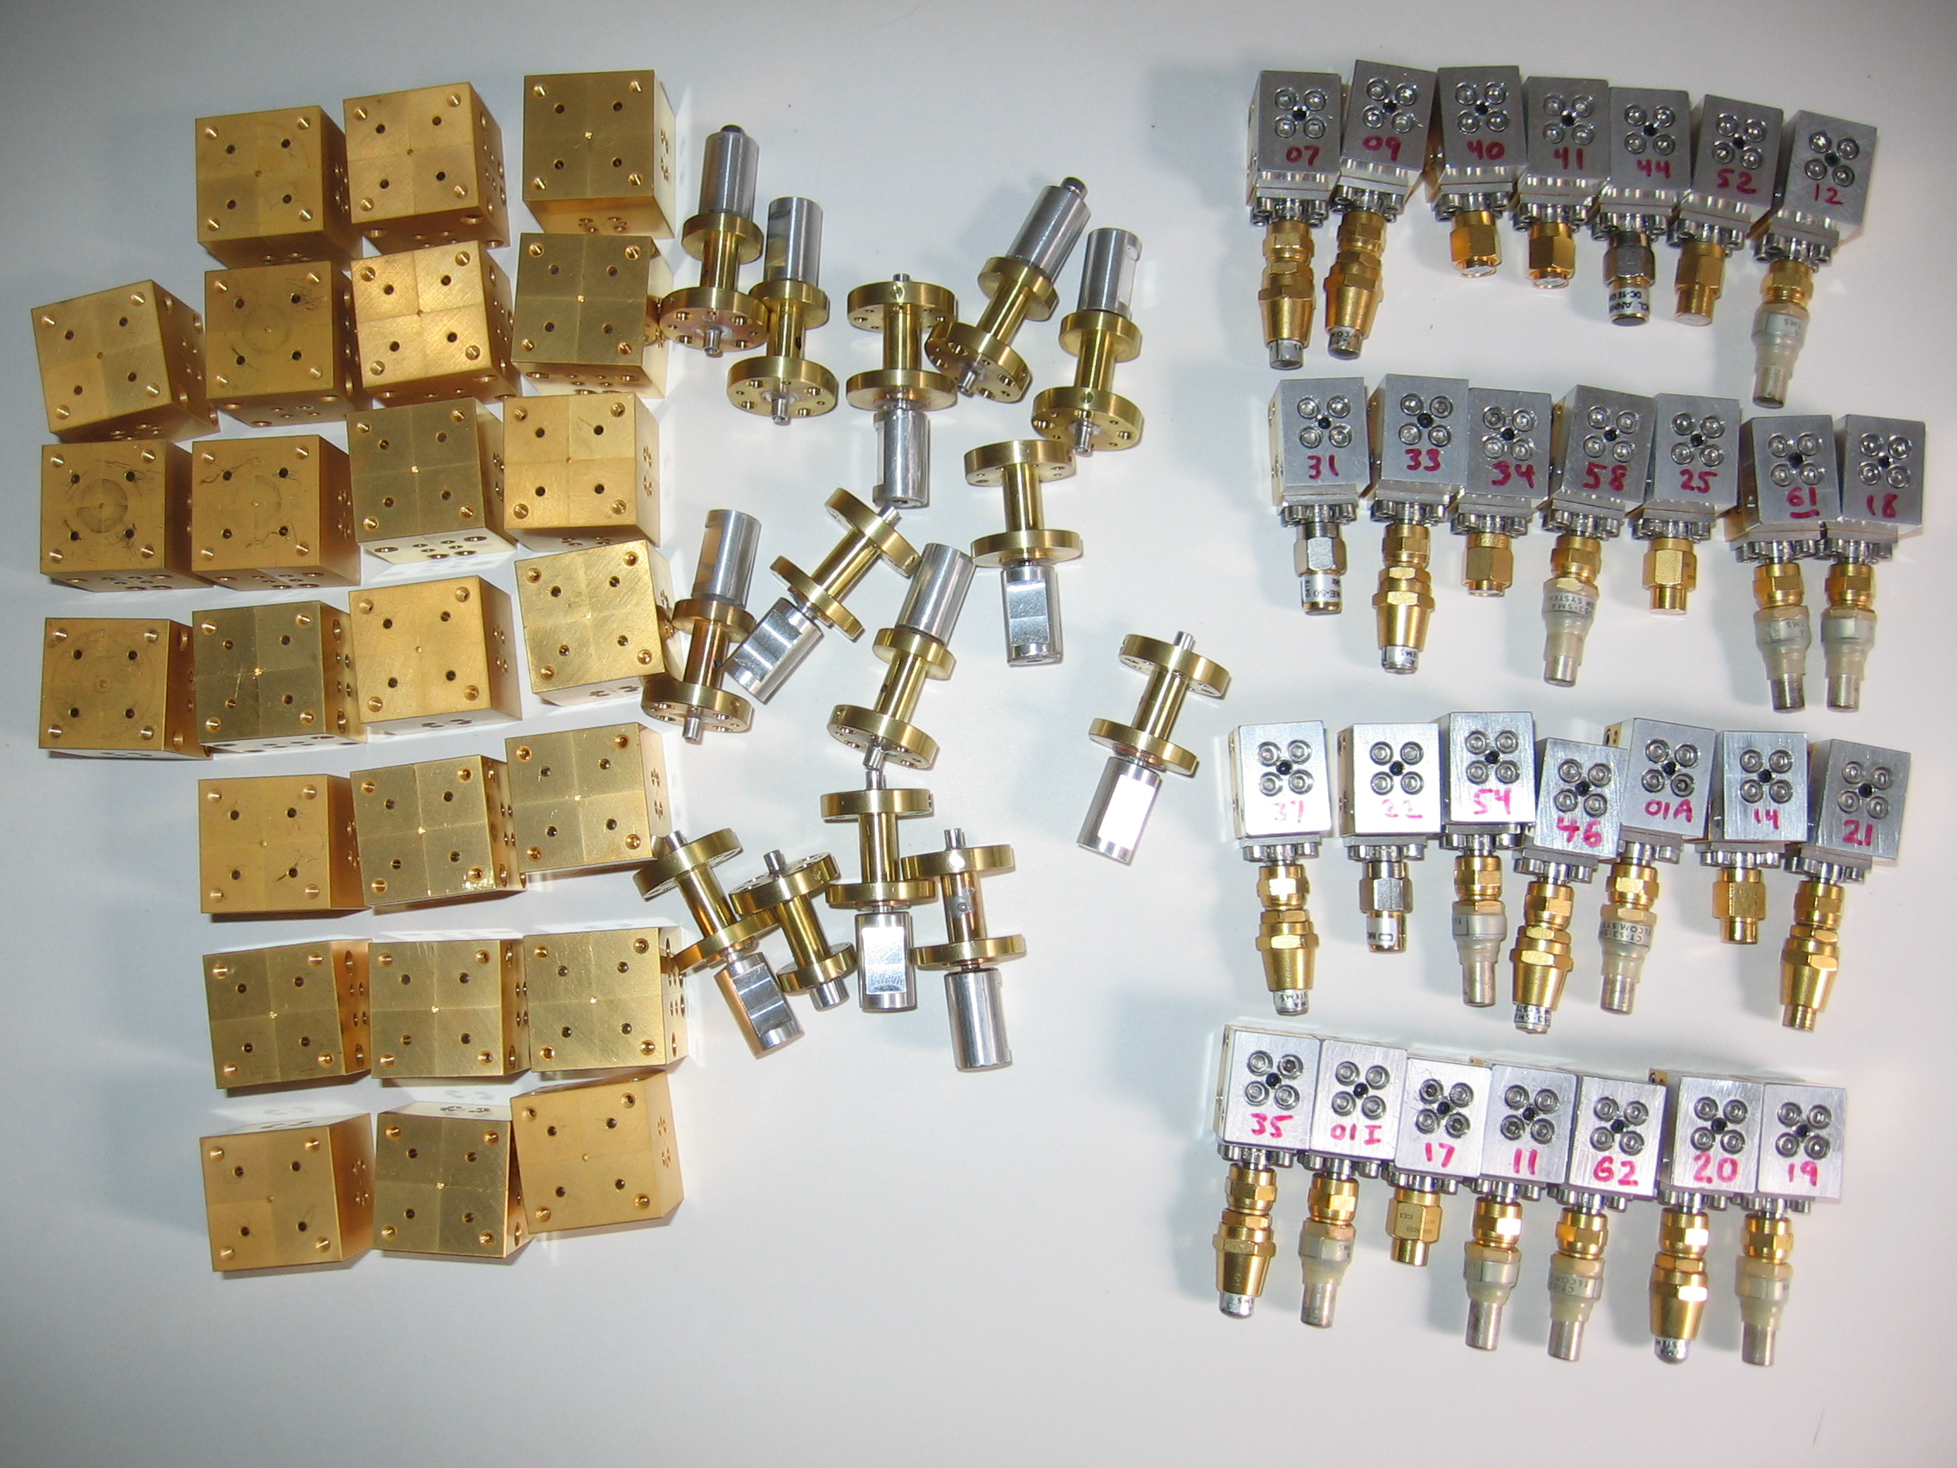

Slide 8
student involvement
Dustin Madison (Berkeley undergrad, B.S. Physics 2007, now a grad student at Cornell) – SIS mixer tests and much more
Chat Hull (current Astronomy grad student) – OMT tests; commissioning, dust polarization in star formation regions

Slide 9
single quarter wave plate retarder
Poincaré sphere
ellipticity at 3 frequencies
(adapted from John Kovac PhD thesis)

Slide 10
half wave + quarter wave retarder broadens bandwidth
ellipticity at 3 frequencies
(adapted fom John Kovac PhD thesis)

Slide 11
DSB receiver temperatures

Slide 12
OMT resonances

