Slide 1
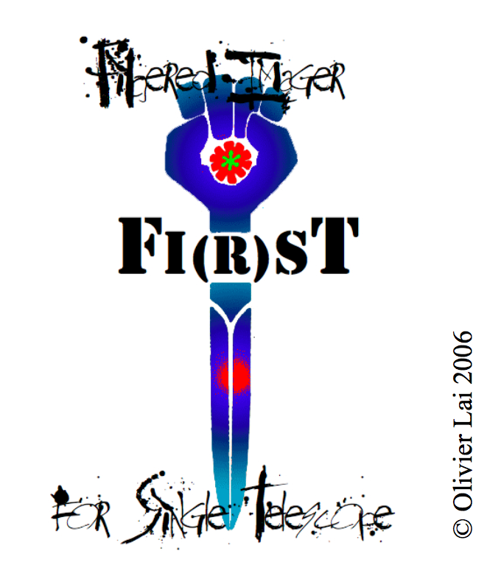
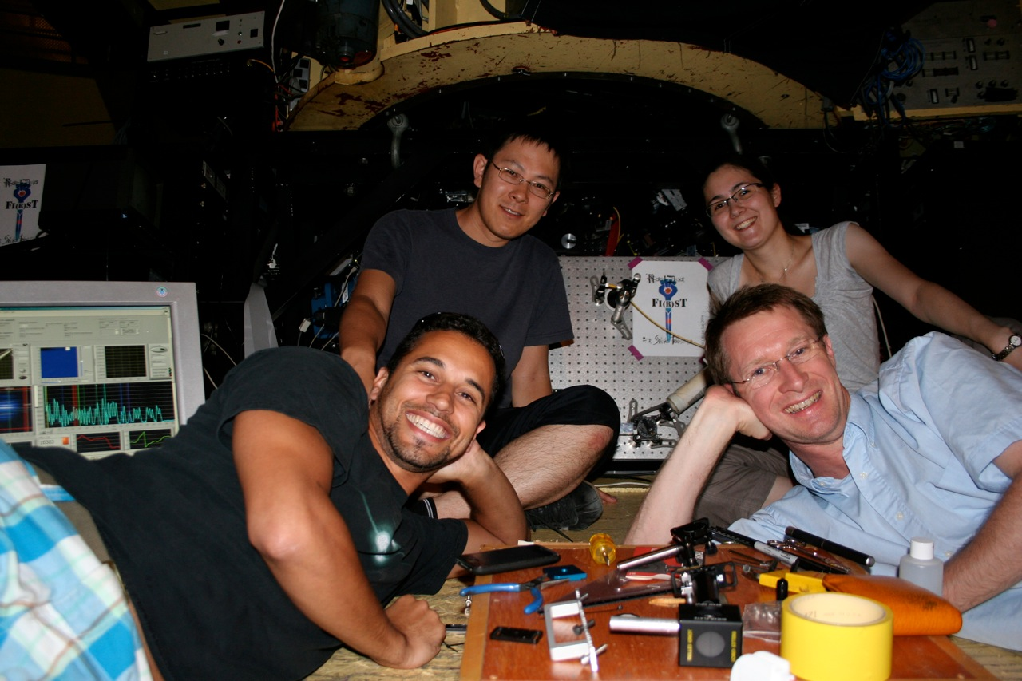
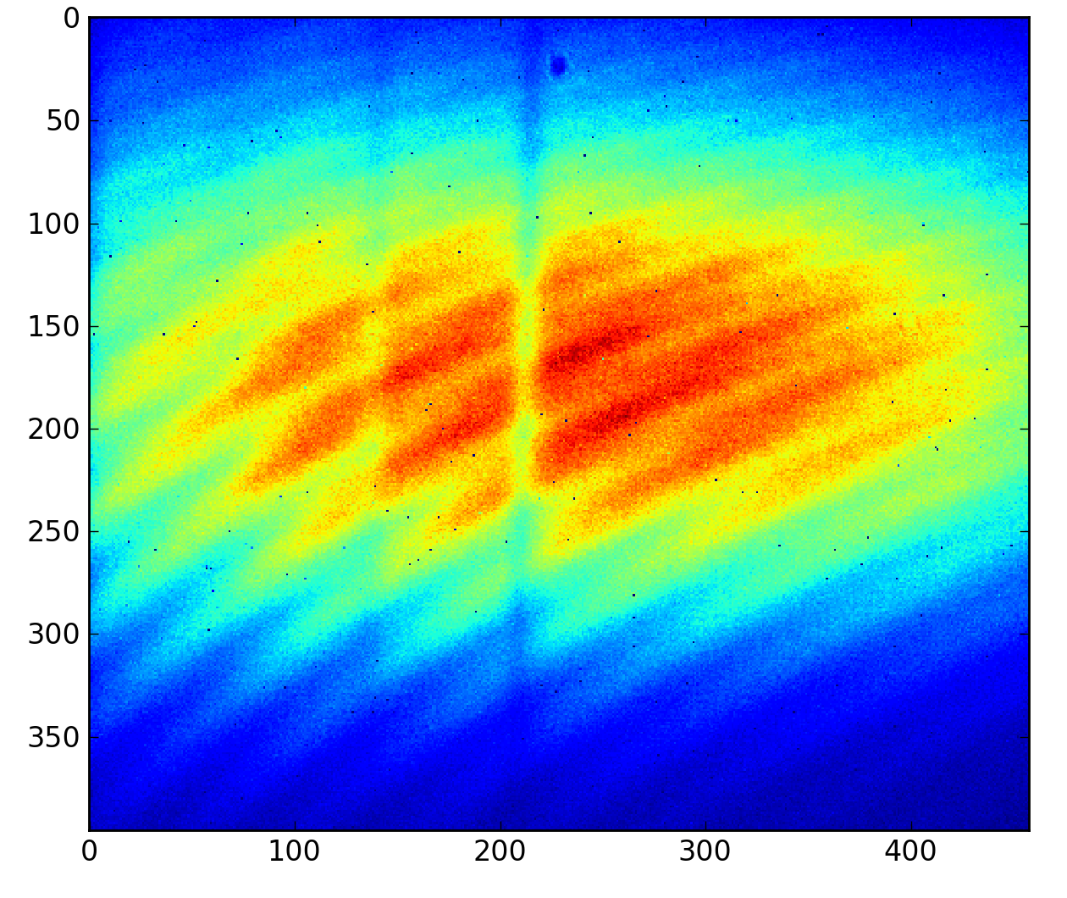
FIRST A Fibered Imager for Single Telescope Lick 3m first light & Perspectives
July 27, 2010
First fringes on the sky!
G. Duchêne, for the FIRST team
F. Marchis, G. Perrin, T. Kotani, S. Lacour, E. Huby,
E. Choquet, E. Gates, P. Fedou, J. Woillez, K. Burns, O. Lai

Slide 2
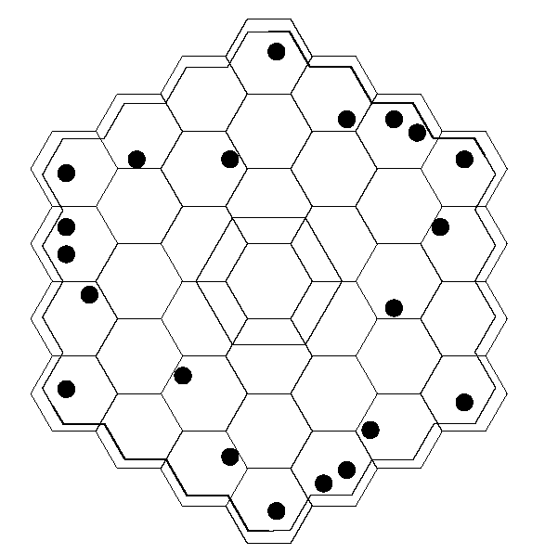
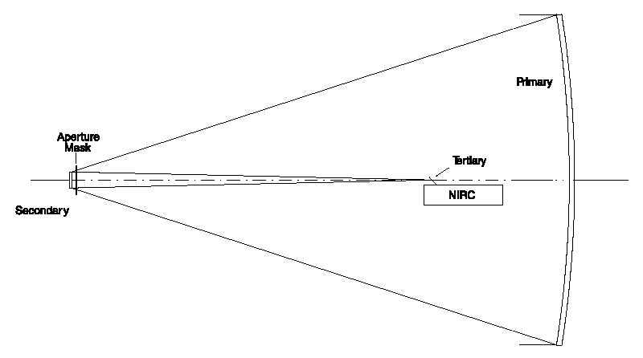
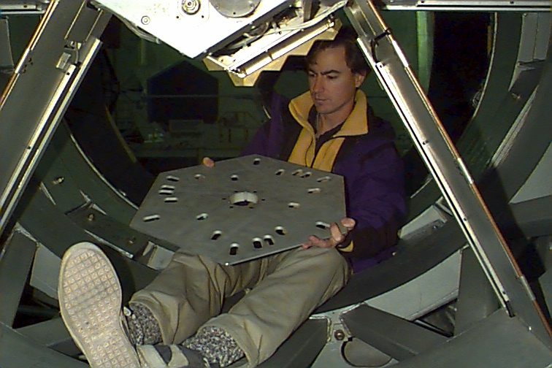
Aperture masking: Keck experiment
Keck-10m primary mirror is transformed into a separate‐element, multiple‐aperture interferometer

Slide 3
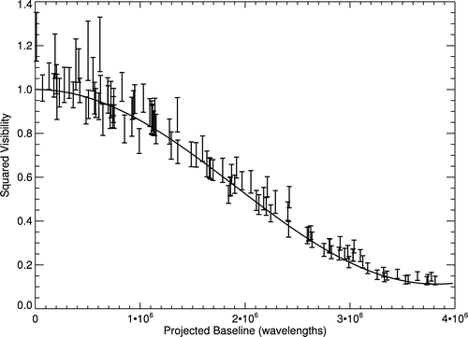
Scientific Results with Aperture Masking
First Keck result
Latest Keck result
Keck I @ 2.27 μm
Nakajima et al. 1989
Pravdo et al. 2006
Lloyd et al. 2006
Ireland et al. 2008
Woodruff et al. 2008
Woodruff et al. 2009
and others….
0.6 λ/D
FR 2:1
27mas, K band
160 u.a. = 100 mas
Search for low-mass companions
Kraus et al. (2008)
Pinwheel Nebula (WR 104)
Tuthill, Monnier & Danchi (1999)
Today ~15 refereed papers using Aperture Masking technique
Aperture masks are available on all 8-10m class telescopes equipped with AO
BUT
Uses a small fraction of the pupil (time consuming)
Observations in the NIR (because of AO) ➔ “limited” spatial resolution
“Limited” contrast (3:1 at 0.6 λ/D or 100:1 at λ/D)

Slide 4
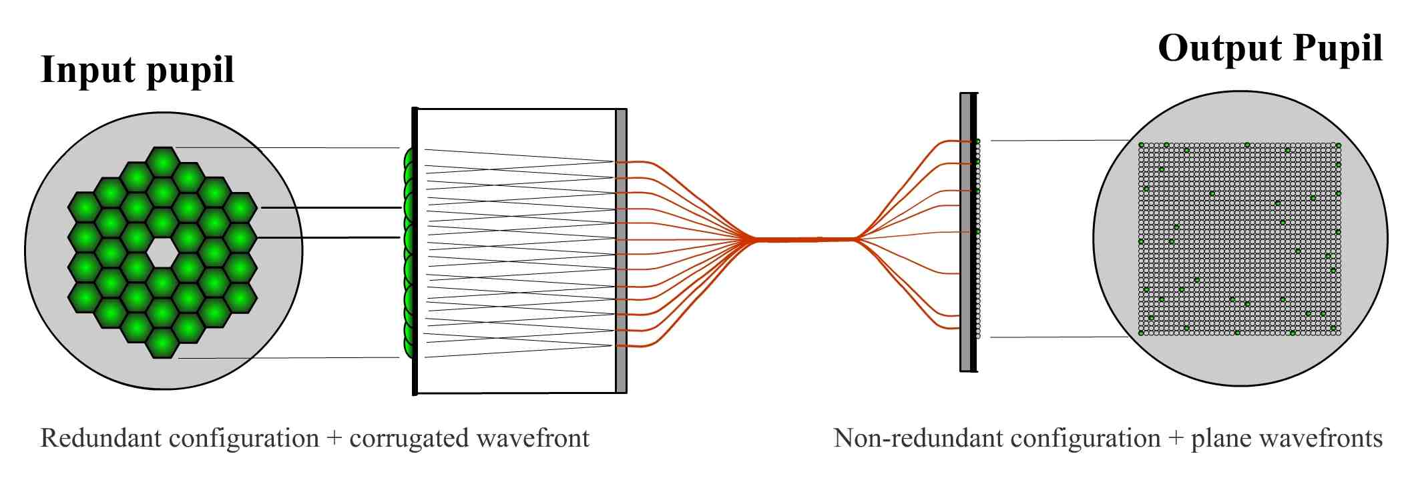
High Dynamic Range Imaging by Pupil Single-Mode Filtering
Fundamental idea: apply techniques developed for long baseline interferometry to a single telescope (Perrin et al. 2006)
Principles:
The telescope pupil is divided into sub-apertures, each feeding a single-mode fiber
Output sub-apertures are rearranged non-redundantly
A diffraction-limited image is reconstructed from the fringe pattern analysis with aperture synthesis techniques, free of speckle noise.
Advantages:
Single-mode fibers filter out atmospheric turbulence effects.
The non-redundant pupil configuration eliminates redundant noise affecting wavefront measurement accuracy.
The removal of atmospheric turbulence and redundant noise allows the calibration of the OTF/PSF to within photon noise, providing very high stability.

Slide 5
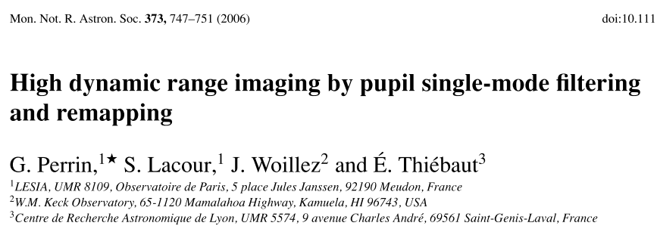
Article Reference - I

Slide 6
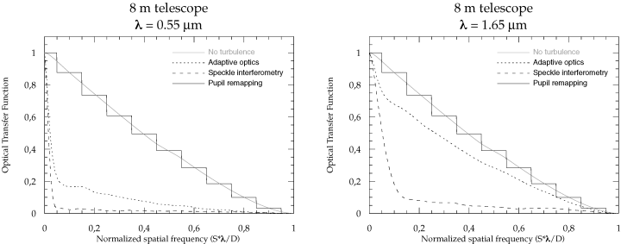
High Dynamic Range Imaging with a Single-Mode Pupil Remapping System
Single mode fibers act as a perfect, albeit discrete, phase filter, resulting in an
almost perfect OTF even in the presence of atmospheric turbulence.
➔ Number of unknowns to solve for = 2N (N phases and N fluxes)
which can all be measured thanks to redundancy of input pupil array

Slide 7
Article Reference- II

Slide 8
High Dynamic Range Imaging with a Single-Mode Pupil Remapping System
Star Magnitude: V=10 V=5 V=0
comp B
comp A
disc
Dynamic = 1:10⁴
Dynamic = 1:10⁵
Dynamic = 1:10⁶
Lacour et al. (2007)
Simulation parameters
λ= 0.63 µm
• r₀ = 20 cm
• 8m telescope
• t_{int} = 4 ms, 10,000 exposures
• 128-fiber system
Face-on disk
2 companions 1,000 and 10,000 fainter at 16 and 20 mas from the star
Total FOV 50 mas

Slide 9
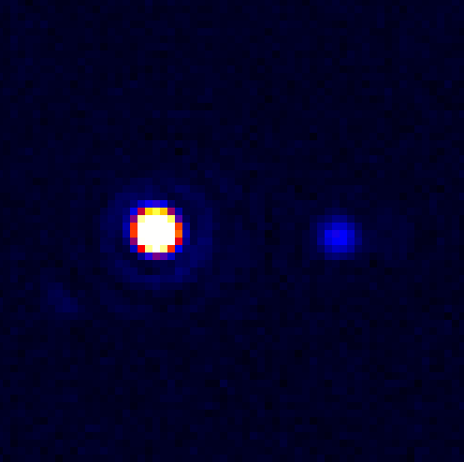
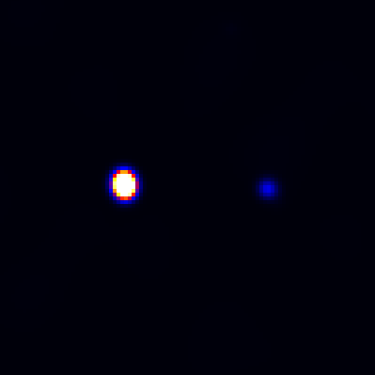
Article Reference - III
Artificial Binary Star Image
(CCD Image)
Reconstructed Image
through fringe analysis

Slide 10
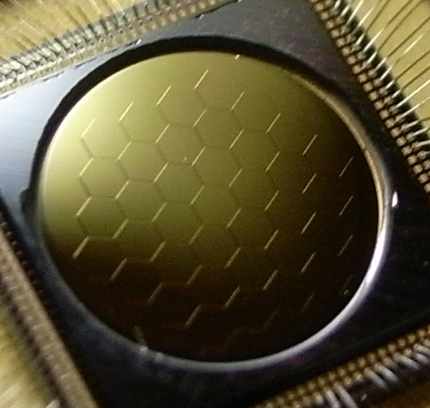
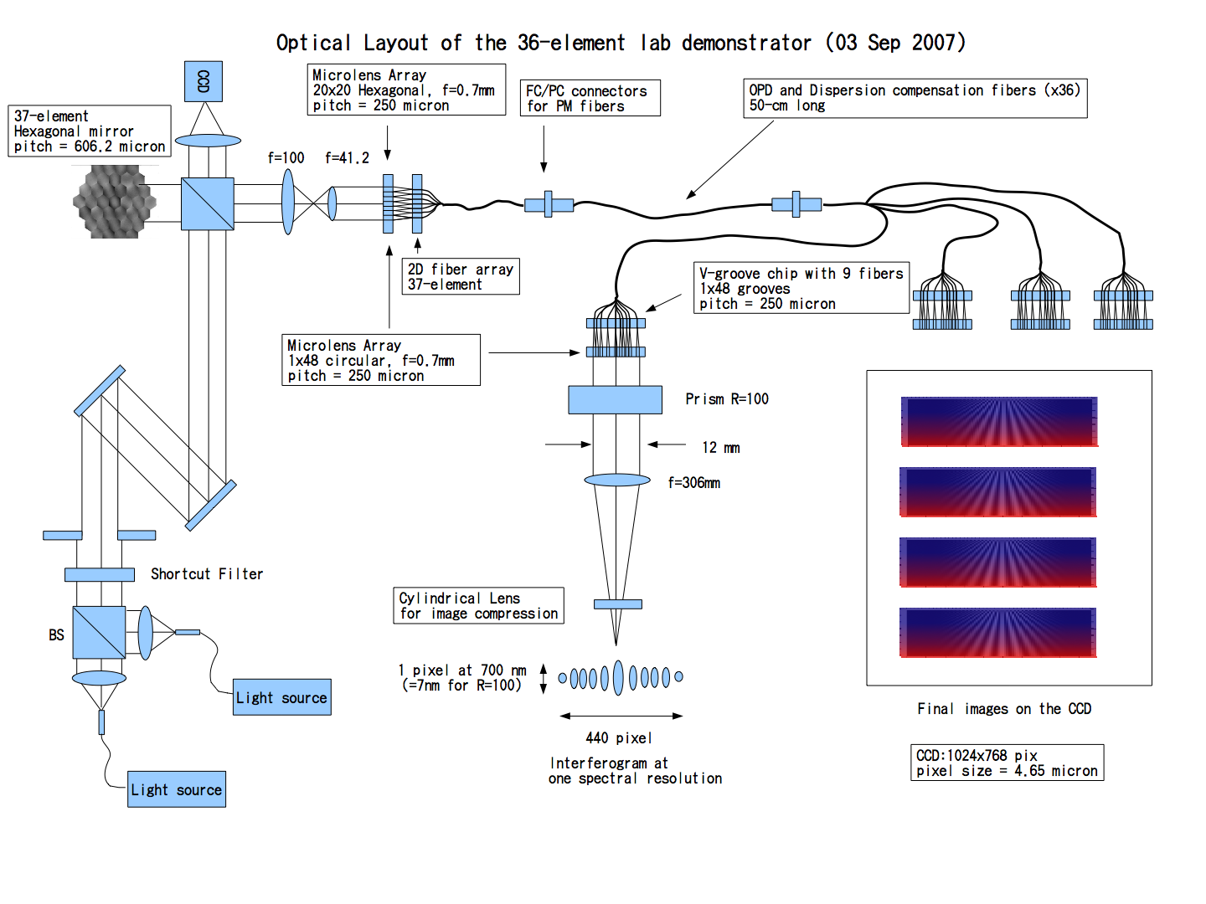
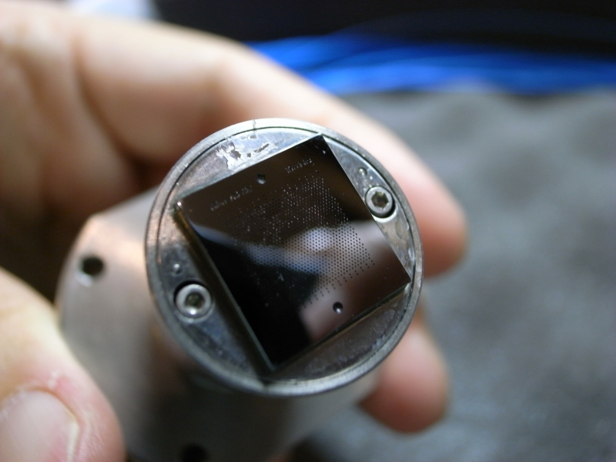
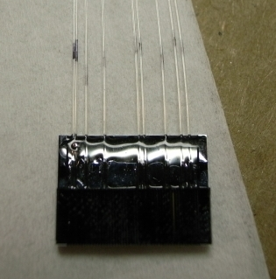
From a Laboratory Testbench…
37-elts DM from IRIS AO Inc.
Kotani et al. (2009) demonstrated the FIRST concept
(1) Deformable
Mirror for fiber alignment
(2) Redundant
Fiber Array
(Input Pupil)
(3) Non-redundant Fiber Array
(Output Pupil)
The input telescope pupil is divided into 9 sub-pupils by a microlens array. Thanks to the segmented deformable mirror, the beam from each sub-aperture can be precisely injected into a single-mode fiber (1). The two-dimensional fiber array is used to arrange the fibers in a hexagonal configuration (2). The output pupils from the fibers are remapped one-dimensionally and non-redundantly by using a silicon V-groove chip (3). The visible light (from 600 nm to 800 nm) is combined on the image plane to measure the interferometric fringes using an Andor EMCCD.

Slide 11
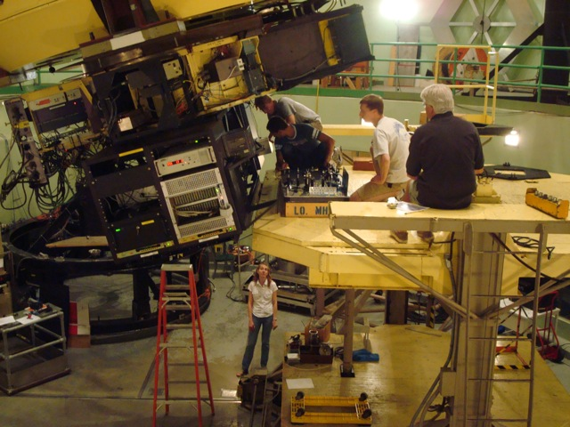
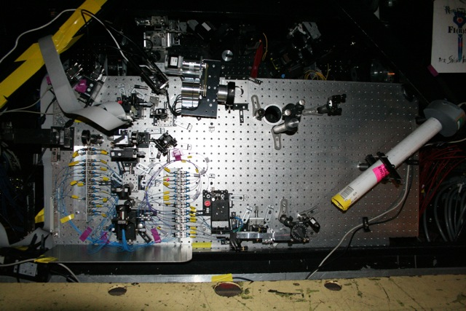
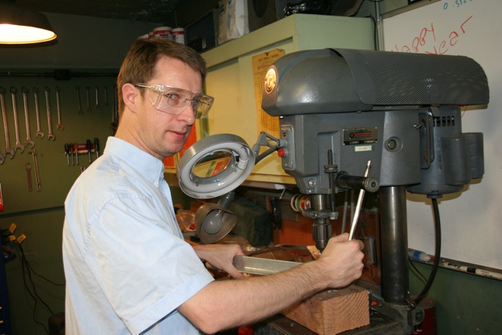
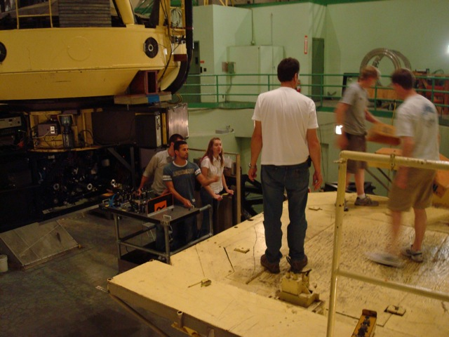
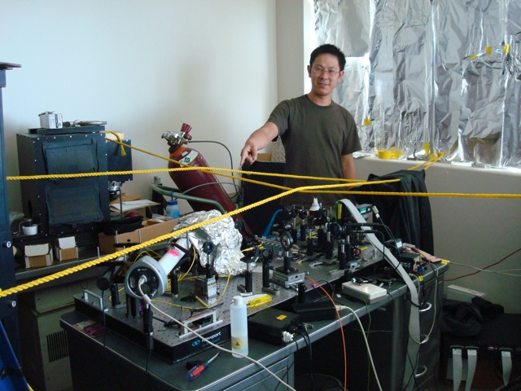
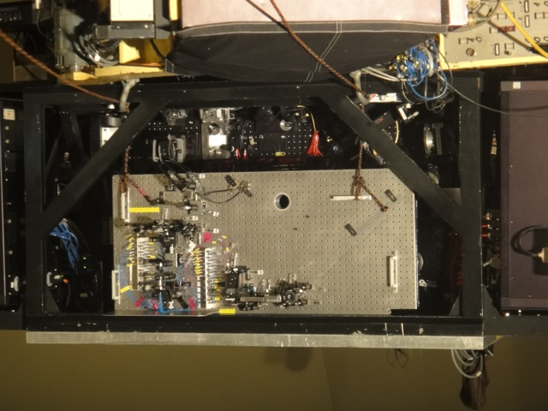
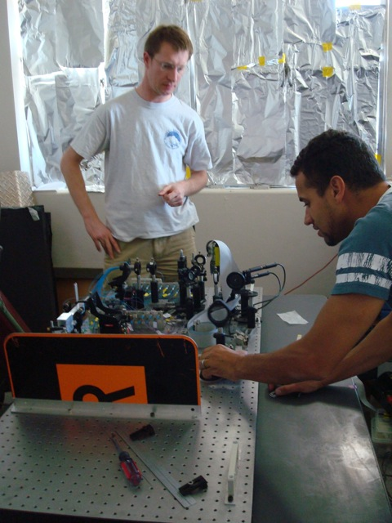
… to an On-Sky Prototype

Slide 12
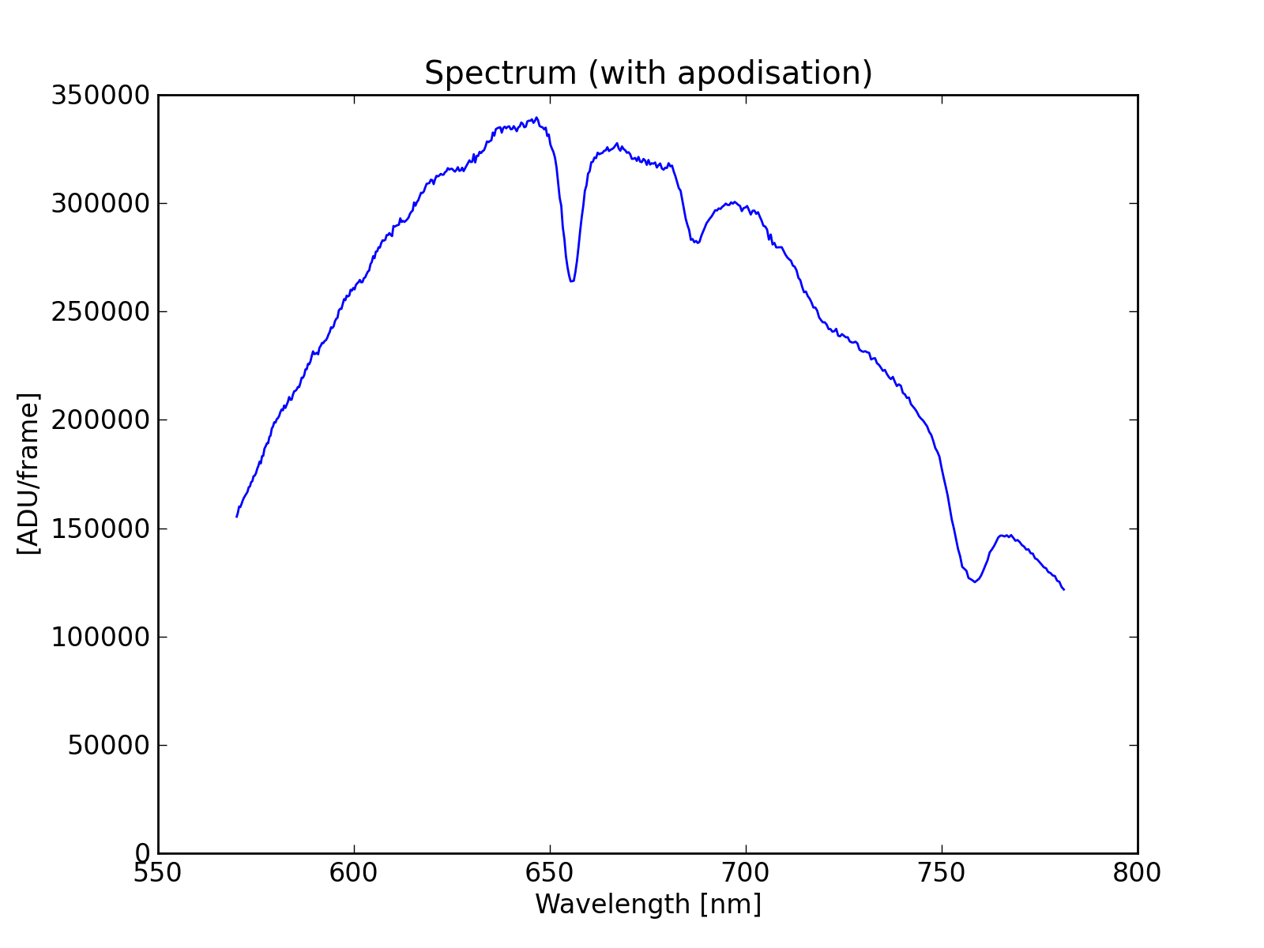
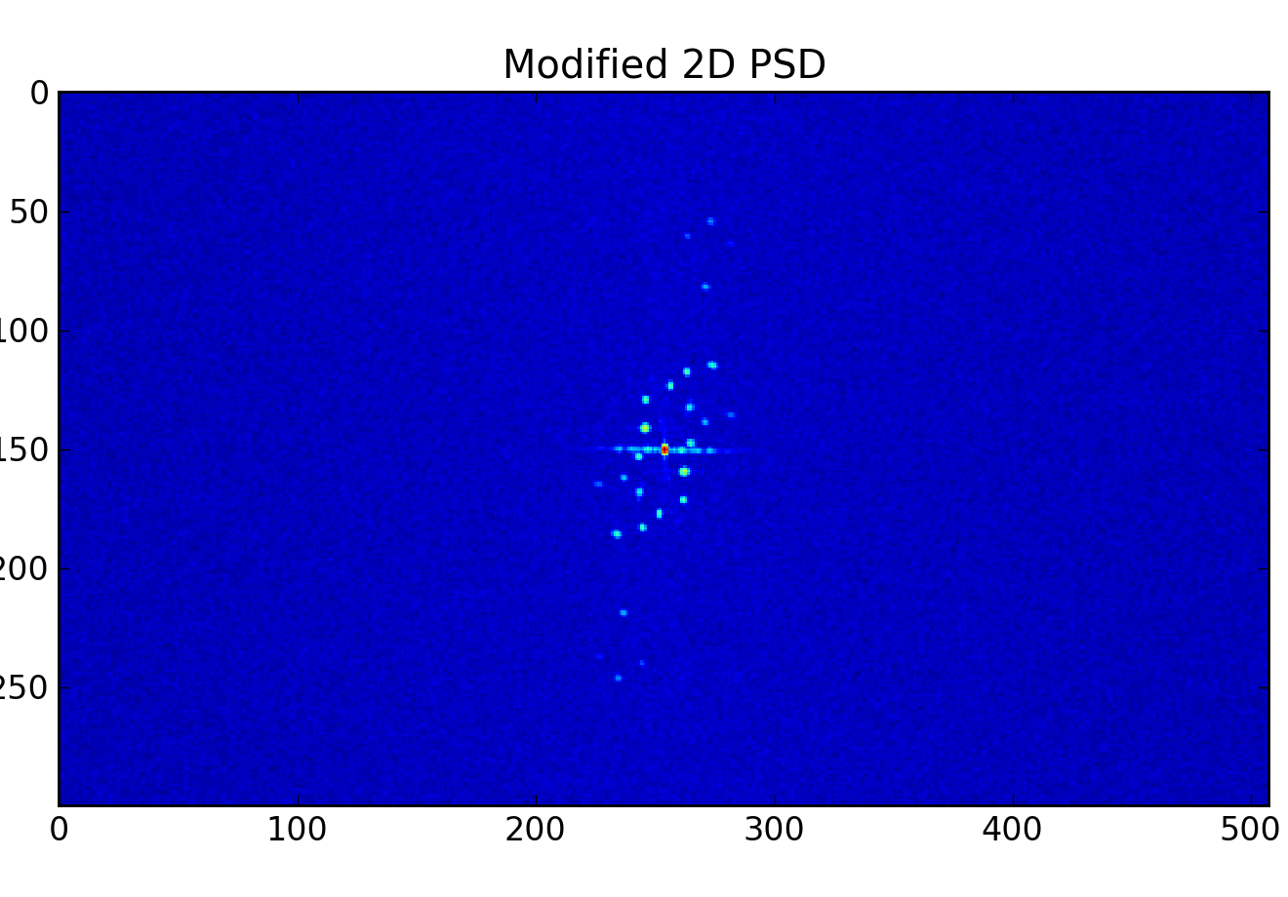
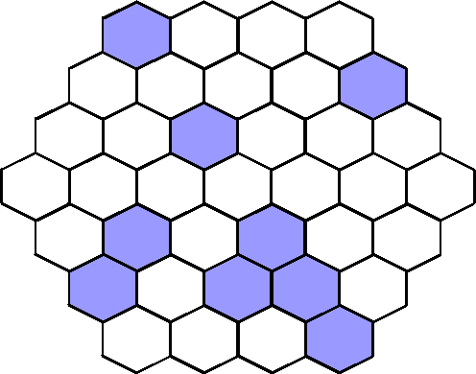
Successful First Light!
Interferogram
First Run: July 25-29 2010
Shane AO provides partial correction in visible wavelength (0.25”)
First fringes on Vega and other bright stars up to V~2
R=100 spectra from 600-800 nm
Preliminary analysis of one data cube (50 frames of ~150 ms) revealed 15 peaks in the power spectrum density implying that 6 fibers successfully interfered. Two fibers were masked out by the secondary mirror (easy to improve), one fiber had poor injection (improvement of injection procedure).
July 27 22:45pm
Low Res Spectrum

Slide 13
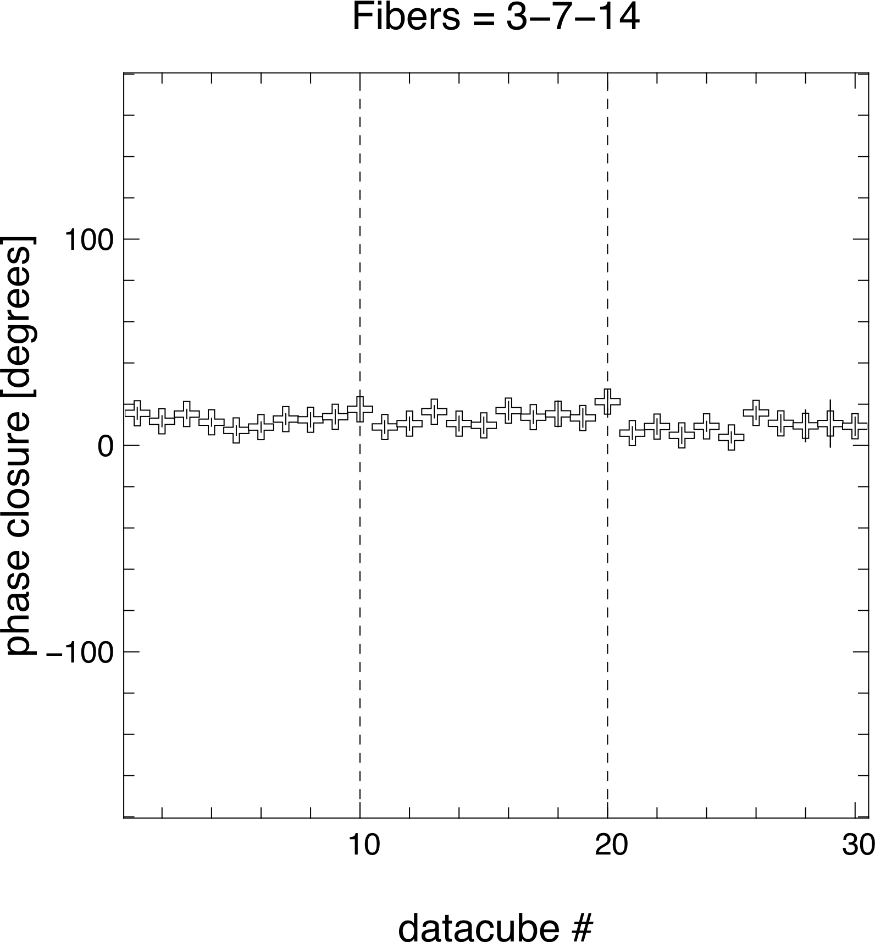
Preliminary Data Analysis
For just 3 fibers, 2 hours of observations – 30 data cubes of 50 (150ms) frames
Phase Closure over 2h
Stable ~11 deg with rms of ~2.8 deg
Group delay over 2 h
Differential phase between two wavelengths
OPD ~ 50 um but stable (rms~5 um)
With 9 fibers of the same injection efficiency and equally balanced dispersion
➔ Dynamic range of 130:1 (5.3 mag) uniformly from 22 mas (0.5 x λ/D) to ~200 mas

Slide 14
Future Developments (I)
2nd run at Lick: Oct 14-18
Identification and partial alleviation of main flexures
Faster acquisition via better optimization of injection
3rd run requested in July 2011
New design with 36 fibers, optimization of the injection with close loop control
Goals: better sensitivity (V~5) and Dynamic range (1000:1) at 22+ mas. (funded by Obs de Paris)
Test of Integrated Optics recombiner
Goals: Validate this promising technique in the NIR (partially funded by Obs de Paris/JAXA)

Slide 15
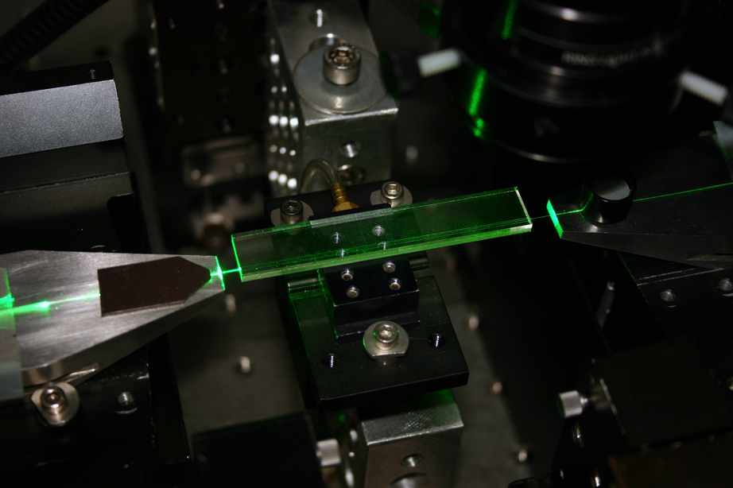
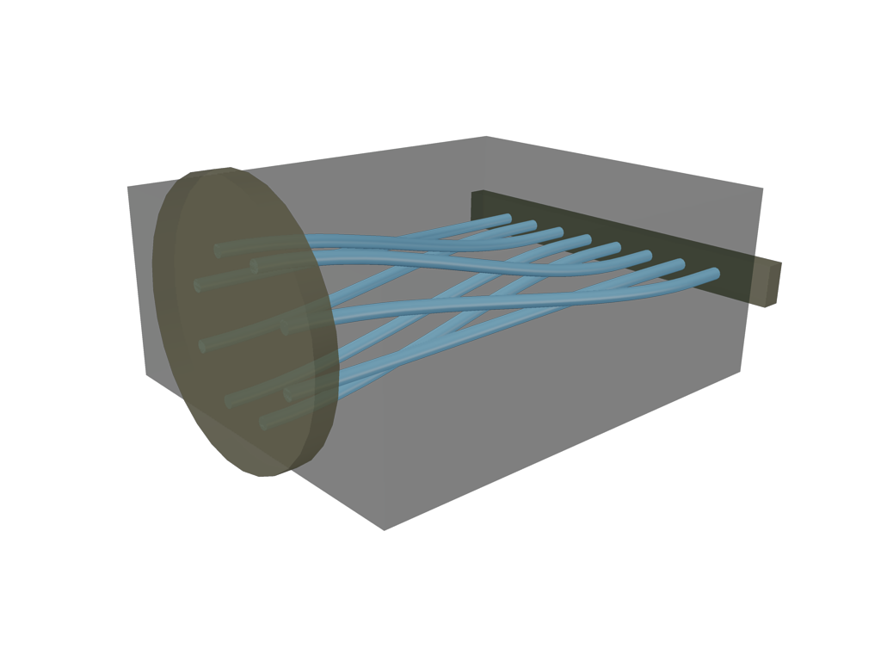
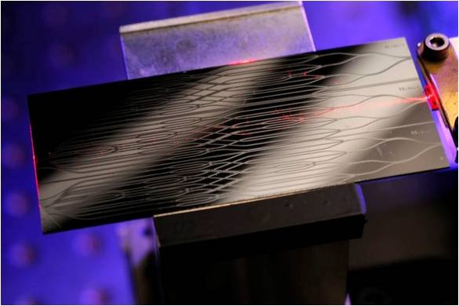
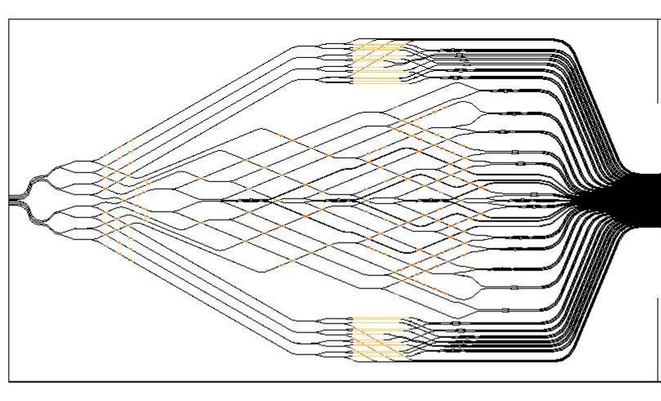
Integrated Optics
More compact and stable instrument
Optimized in the NIR (H band)
To be tested at Lick-Shane in July 2011
116 mm
3D combiner from Macquarie University (8 channels)
Being tested in lab at Meudon
65.7 mm
First IO received from a Japanese Company NTT (Oct 2010)
8 inputs, 112 outputs (being tested in lab at Meudon)

Slide 16
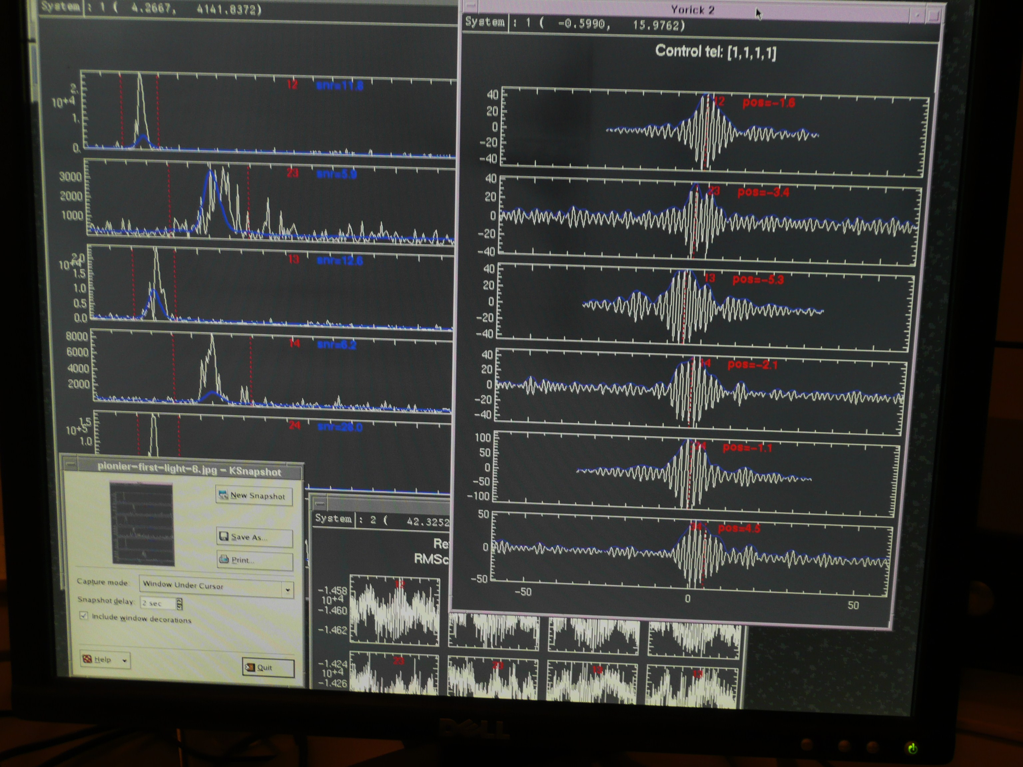
Integrated Optics
Technology already used in long-baseline interferometry experiments
VLTI/VINCI
IOTA/IONIC
VLTI/PIONEER
PIONEER : first fringes for
a 4-telescope integrated
optics recombiner
(10/24/2010)
Courtesy JP Berger (IPAG, ESO)

Slide 17
Future Developments (II)
Design of FIRST@LICK for the new Visible AO system
Increased throughput ➔ improved sensitivity
collaboration with D. Gavel & R. Kupke (Fall 2011) (partially funded by Obs. de Paris)
FIRST@KECK?
36-fiber FIRST in 2012?
1XX-fiber FIRST or Integrated Optics FIRST in 2013?

Slide 18
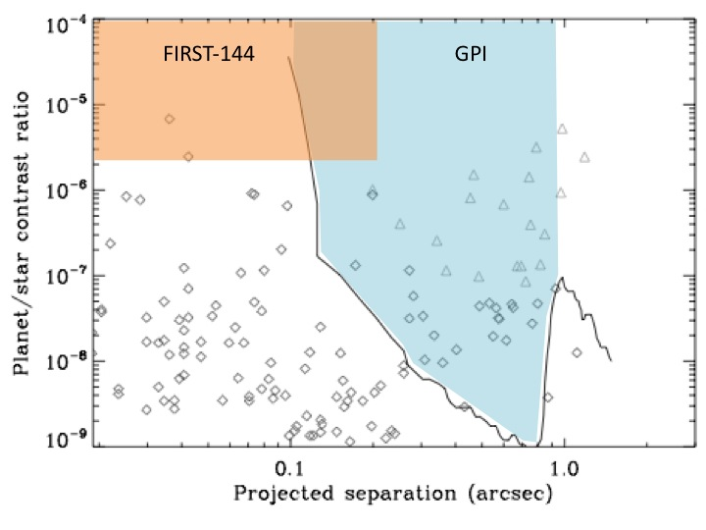
FIRST@Keck?
Simulation parameters
λ= 0.63 µm
• r₀ = 20 cm
• Keck-10m with its AO system
• t_{int} = 4 ms; 10,000 exposures
• 144-fiber system
V=6
➔ Contrast 10⁻⁵ uniform from 6 mas to 300 mas (spectral R~100)
10⁻²
Highly complementary to GPI and similar
instruments on large telescopes:
much smaller working angle
optical wavelength regime
Contrast
10⁻⁵
5
V (mag)
10

Slide 19
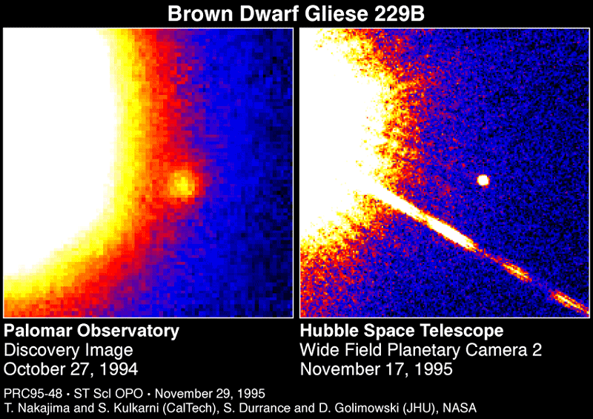
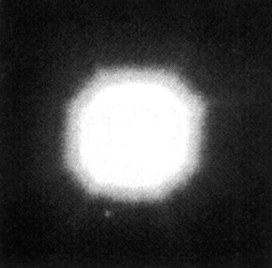
FIRST@Keck : potential science cases
Any subject that requires high contrast and high spatial resolution:
Close environment of nearby stars
Low mass star/BD companions
FIRST FOV
enlarged 10x
Nakajima et al. (1995)

Slide 20
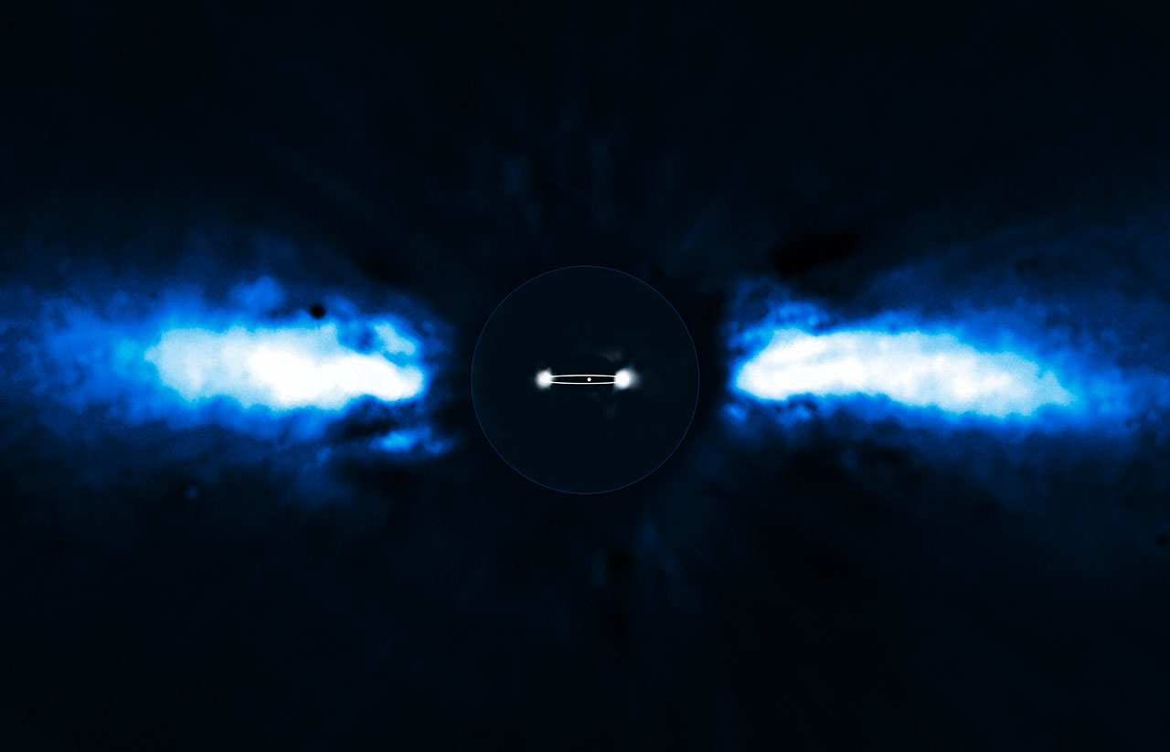
FIRST@Keck : potential science cases
Any subject that requires high contrast and high spatial resolution:
Close environment of nearby stars
Low mass star/BD companions
Exoplanets
Inner regions of debris disks
Golimowski et al. (2006)
FIRST FOV
Lagrange et al. (2010)

Slide 21
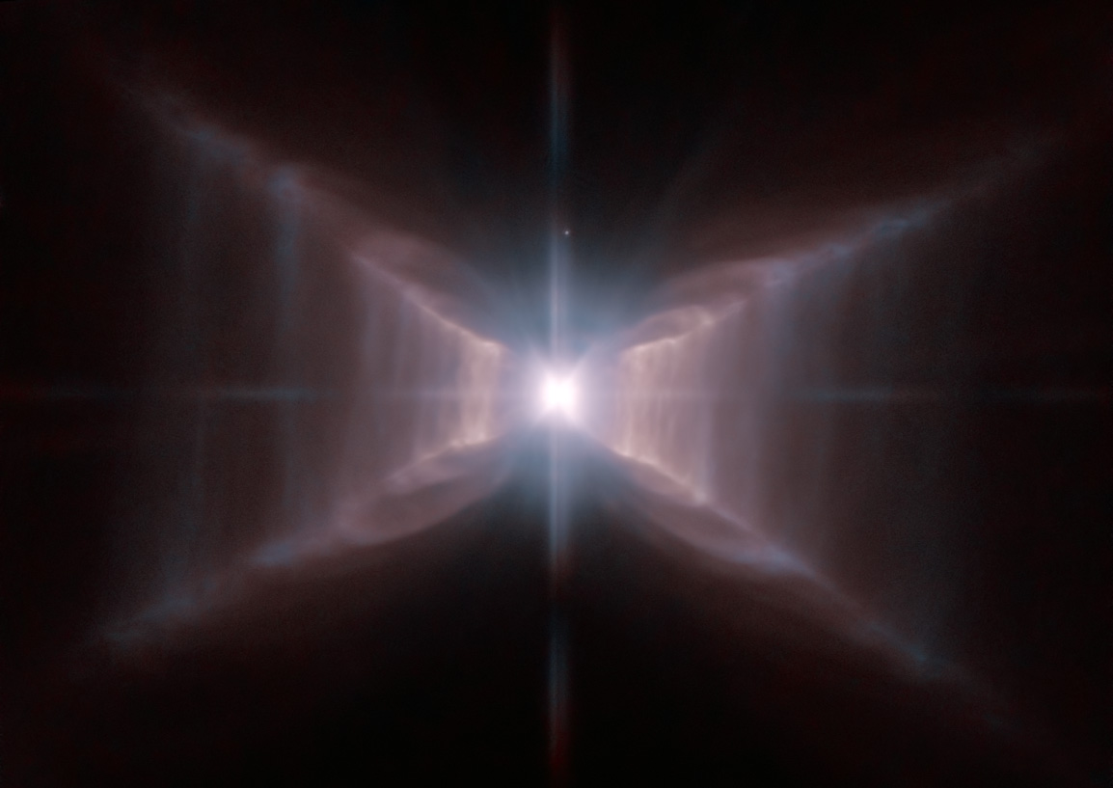
FIRST@Keck : potential science cases
Any subject that requires high contrast and high spatial resolution:
Close environment of nearby stars
Low mass star/BD companions
Exoplanets
Inner regions of debris disks
Mass loss in evolved objects
WR stars
Protoplanetary nebulae
160 u.a. = 100 mas
Tuthill et
al. (1999)
FIRST FOV
enlarged 10x
© ESA/NASA

Slide 22
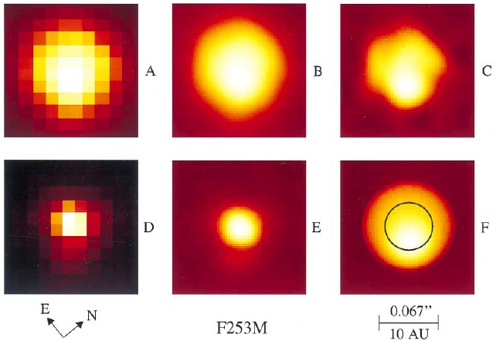
FIRST@Keck : potential science cases
Any subject that requires high contrast and high spatial resolution:
Close environment of nearby stars
Low mass star/BD companions
Exoplanets
Inner regions of debris disks
Mass loss in evolved objects
WR stars
Protoplanetary nebulae
Surface of supergiant stars
Gilligand & Dupree (1996)

Slide 23
FIRST@Keck : potential science cases
Any subject that requires high contrast and high spatial resolution:
Close environment of nearby stars
Low mass star/BD companions
Exoplanets
Inner regions of debris disks
Mass loss in evolved objects
WR stars
Protoplanetary nebulae
Surface of supergiant stars
Because FIRST opens a new window in terms of resolution/contrast,
it is bound to unearth unexpected details for a wide range of objects

Slide 24
Thanks!!
Special Thanks to the Lick Observatory and its amazing staff from the FIRST team
Future Funding ($700K for a 1XX elements FIRST)
: NSF-ATI 2010, NSF-MRI in 2011, NASA-ORIGIN in 2011, NASA-ARA in 2011
EU/FP-7, CNRS, JAXA-EU…

